Slide 1
Ashley High School How do we promote Positive Mental Health, Emotional Wellbeing and Reduce Anxiety?

Slide 2
What is working for the pupils at
Ashley
High School?
This is what we said:

Slide 3
When we are anxious or stressed, what helps us to calm down and manage our emotions?
Sensory or fidget toys
I like a pack of playing cards to fidget with – these distract me from random thoughts and help me to focus on my learning
I like to sit on the couch in class, it helps me to relax
I need to talk to someone
Sitting in a quiet place like the sensory room
Watching the fish
Going outside on the outdoor equipment
Talking to Mrs P, our Emotion Coach
Having a reiki session
Seeing the counsellor every week helps

Slide 4
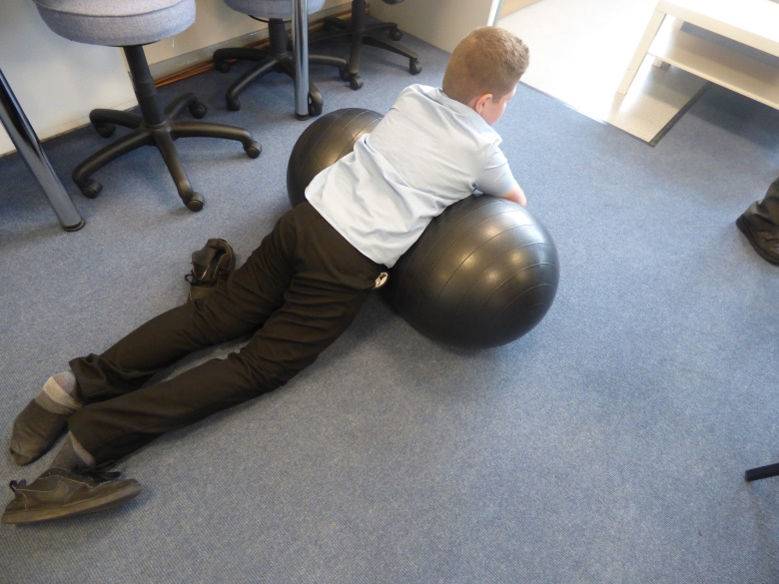
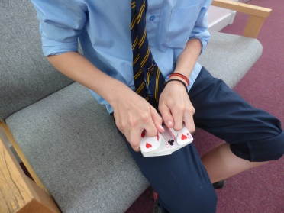
Inside classrooms
Couches
Fish tanks
Sensory toys
Stress balls
Booths to work in on my own if I need to

Slide 5
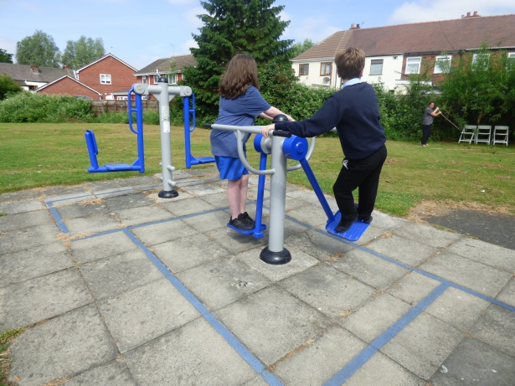
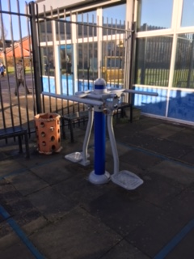
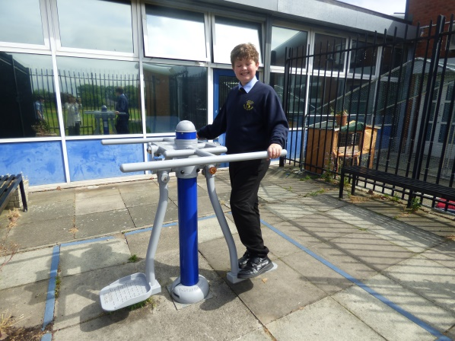
Outside
‘The outdoor exercise machines help me to get rid of my anger and help me to feel better.’
‘Walking round the field can help me feel less anxious. I can’t talk to anyone until I’m calm.’
Notes:
Different spaces suit different children, it is important that we plan for the needs of these different children by responding to their needs. Are there spaces available for the children to use as they wish – are there any changeable spaces?

Slide 6
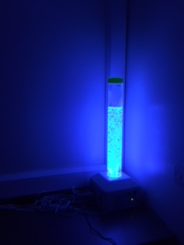
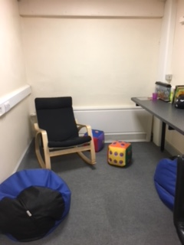
Other areas around school
Sensory
Room
‘All schools should have a Sensory Room or a place where you can have time and space to calm down.’

Slide 7
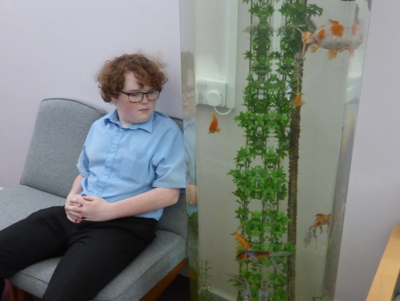
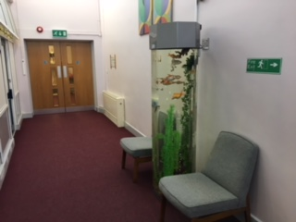
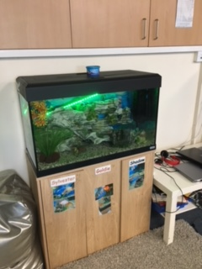
Fish Tanks
‘It’s good to have different places around school that are always available when you need some time out. Watching the fish helps take my mind off my problems.’

Slide 8
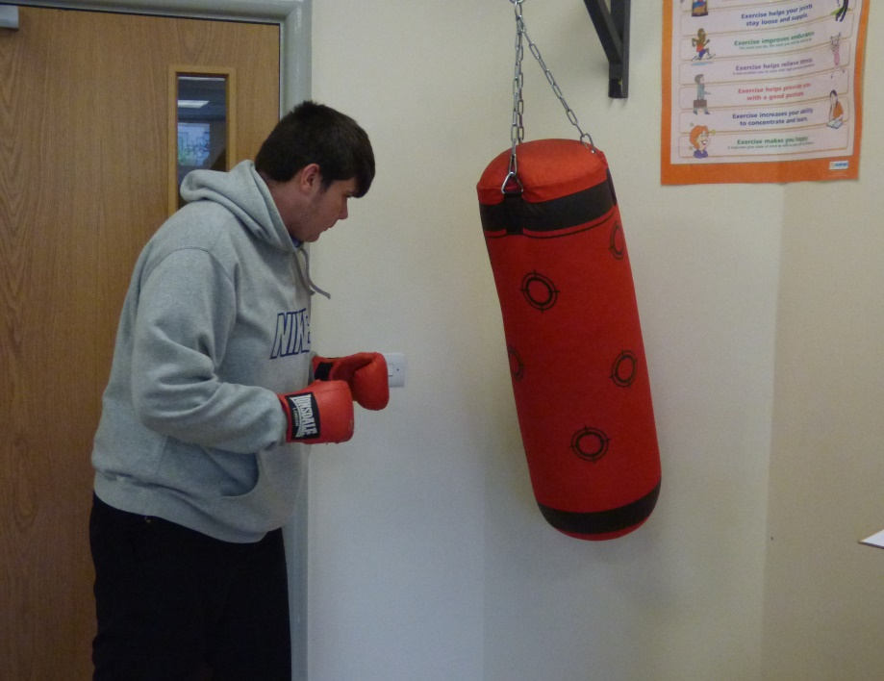
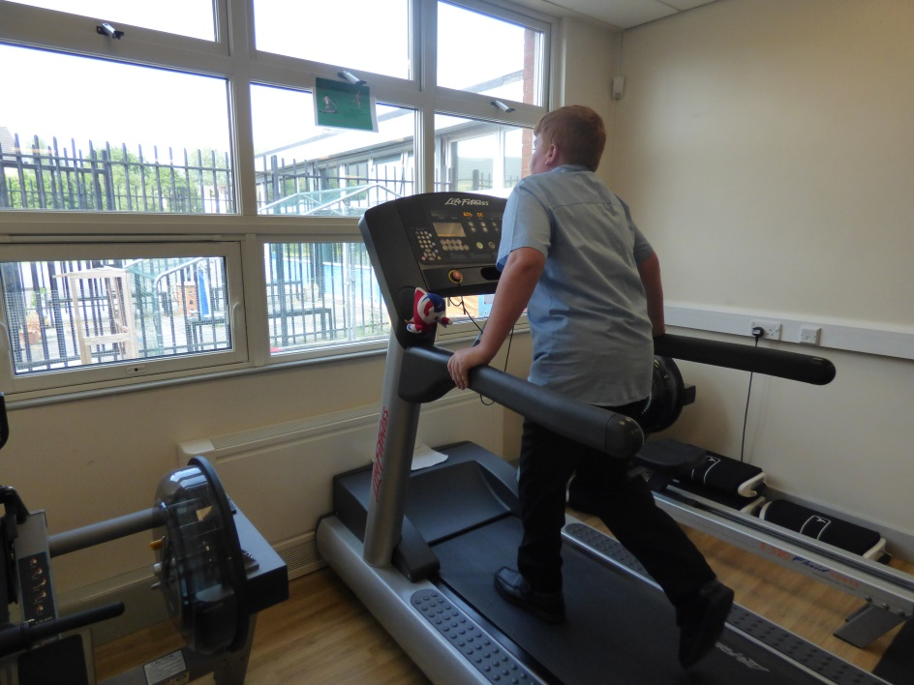
Gym
‘Going to the gym in the morning helps me if I have had a bad start to the day at home. It can help me get rid of my aggression.’

Slide 9
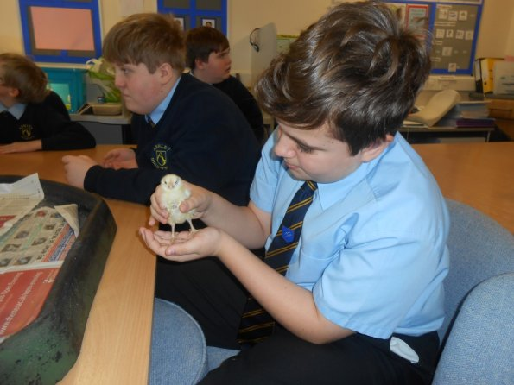
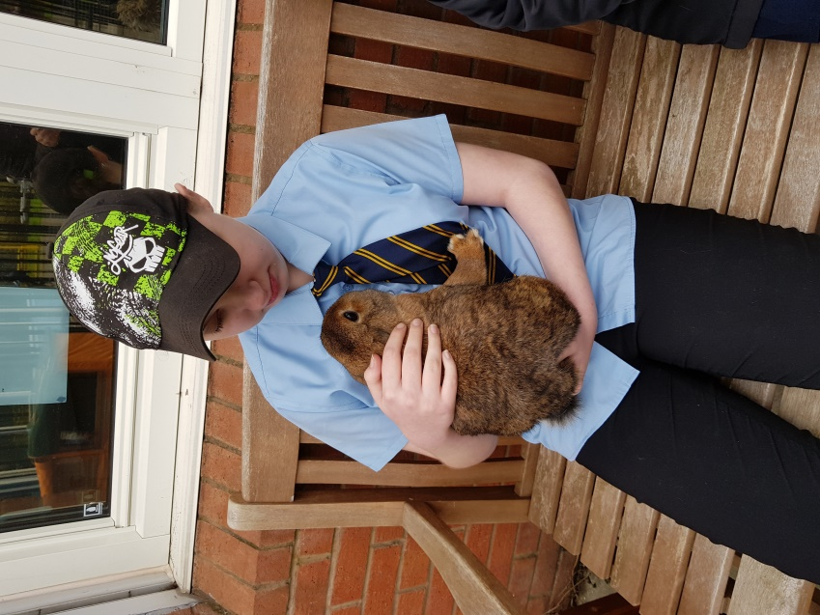
Having school pets/animals
‘It’s good to have different
animals in school. Handling them and looking after them can take your mind off things.’

Slide 10
Having a Peer Mentor
‘It’s good to be able to talk to another student who has experienced the same kind of problems as me. My Peer Mentor has helped me deal with things.’

Slide 11
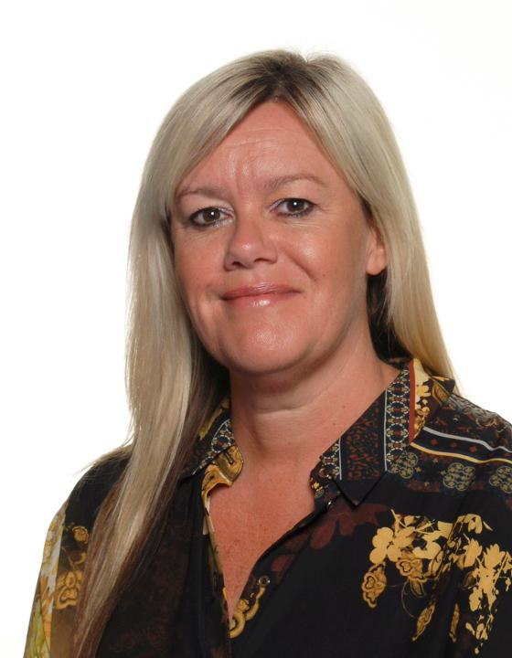
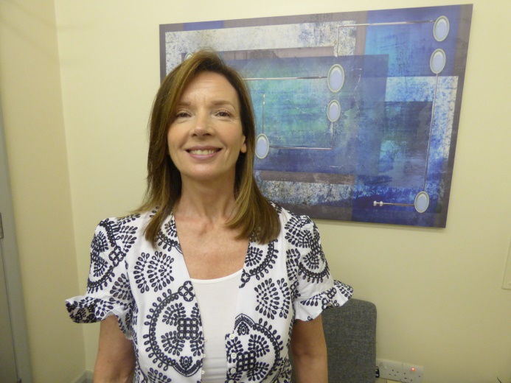
Having staff you can talk to
Counsellor
Emotion Coach
‘Having emotional support staff in school is really helpful. You can talk to them in private about your problems.’

Slide 12
The Counsellor
‘It’s good to be able to go to the
Therapy room and speak freely to her in privacy about all your worries.’
‘I think Alma has helped me the most because I don’t get as angry now. She’s taught me new strategies.’
‘My counselling sessions have helped me become more positive in my thinking.’
‘I get less wound up and angry because I’m not bottling everything up.’

Slide 13
The Emotion Coach
‘Having someone to talk to about anything is really good. I feel like I can let go of all my problems at once.’
‘I feel like I’ve got a voice when I talk to Mrs Pearsall.’
‘The sessions have changed the way I’m thinking. It helps me deal with situations.
‘It feels good to know there is someone there to help me with my feelings.’
Notes:
OWEN – Before I started at Ashley High I was in a mainstream school. I had a lot of difficult times there. Since working with the staff at Ashley, particularly Mrs Pearsall the Emotion Coach, I’ve learned to focus much more on positive things and now I deal with my emotions much better. Working with her has helped me settle into school. My learning has improved and now I’m a Prefect too. I’m hoping to be on School Council next year. I think every school should have someone like Mrs Pearsall.

Slide 14
Pastoral Staff
‘Miss does an emotional check-in with me every morning and at the end of the day. I like it because it gives me a voice.
‘Emotional check-ins help me reflect on how I’m feeling’.
‘They help staff pick up on any issues I’m having that might affect my day’.
‘I feel safe knowing a member of staff is there for me, 1-1.’

Slide 15
What would we advise other schools to put in place?
‘I’d advise them to introduce rooms similar to the sensory room. A quiet place where you can have time out when you’re feeling angry or anxious.’
‘ A school counsellor who is trained to help young people with their problems, emotions and anxieties’
‘Have staff who have the time to focus on students’ problems and not leave it or ignore it.’
‘Fidget toys/resources (eg. cards, blu-tac) to calm children down and help them focus more.’
‘Peer mentors - this has helped me because I have been able to talk to another pupil who has experienced similar problems to me. He gives me good advice.’
‘Every school should have a Mrs Pearsall (Emotion Coach).’

Slide 16
Thank you from the pupils of Ashley High School

