Slide 1
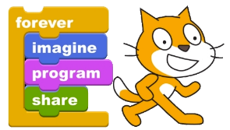
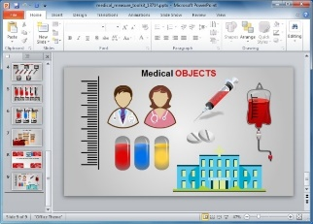
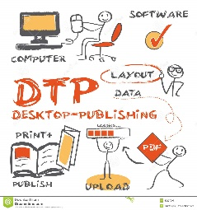
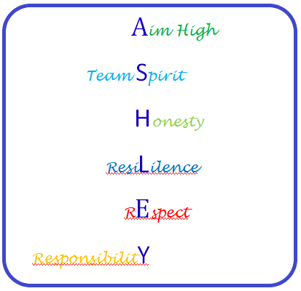
Endangered Animals -Powerpoint
Presentations
Scratch Programming
Spreadsheet Modelling
Half Term 1 Half Term 2 Half Term 3 Half Term 4 Half Term 5 Half Term 6
ICT Year 7
E-Safety / Cyberbullying
Desktop Publishing – Creating a leaflet
Using Datasets

Slide 2
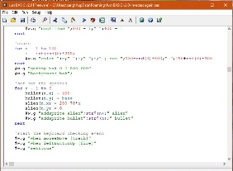
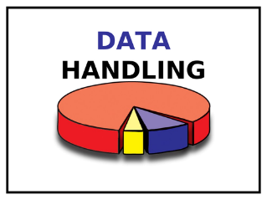
JustBasic Computer Programming
After School Club – Creating a survey / Gathering information
Spreadsheet Modelling
Half Term 1 Half Term 2 Half Term 3 Half Term 4 Half Term 5 Half Term 6
ICT Year 8
Powerpoint Presentations
Desktop Publishing – Creating a leaflet
Data Handling

Slide 3
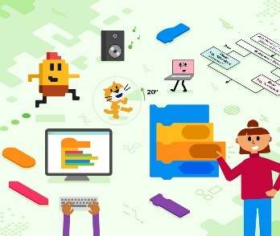
Hardware/ Software Multimedia ICT Presentations
Powerpoint Presentations
Spreadsheet Modelling
Half Term 1 Half Term 2 Half Term 3 Half Term 4 Half Term 5 Half Term 6
ICT Year 9
Databases – Murder Mountain Mystery
Scratch Programming Part 1
Scratch Programming Part 2

