Slide 1









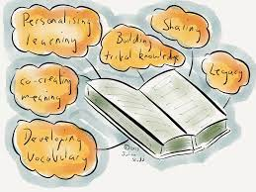


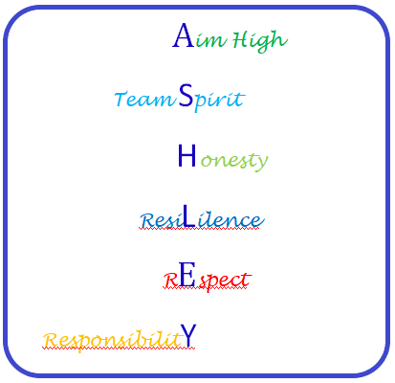











Speaking and Listening –
Group Discussion
Biographies –
Boy by Roald Dahl
Spelling, Punctuation and Grammar
Half Term 1 Half Term 2 Half Term 3 Half Term 4 Half Term 5 Half Term 6
English Year 7
Autobiographical Writing
Modern Novel –
TBC
Contemporary Drama –
TBC

Slide 2










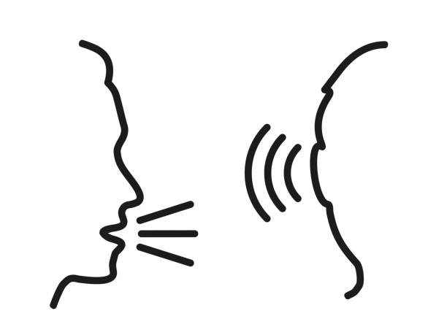


Travel Writing – Non-Fiction Texts
(Emails & Letters, Brochures & Adverts, Reviews)
Other Cultures - Stories
Half Term 1 Half Term 2 Half Term 3 Half Term 4 Half Term 5 Half Term 6
English Year 8
Other Cultures - Poetry
Modern Play/Drama –
Our Day Out/Blood Brothers
Speaking & Listening

