Slide 1
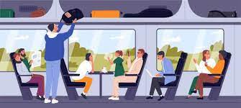
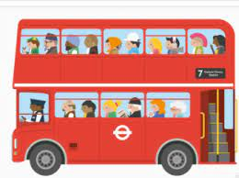
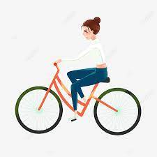
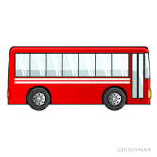
Crossing roads safely and independently
(Group 1)
Preparing yourself for a journey using public transport
(Group 1)
Travel independently on a chosen journey
(Group 1)
Half Term 1 Half Term 2 Half Term 3 Half Term 4 Half Term 5 Half Term 6
Travelling Independently Year 11
Preparing yourself for a journey using public transport
(Group 2)
Travel independently on a chosen journey
(Group 2)
Crossing roads safely and independently
(Group 2)

