Slide 1
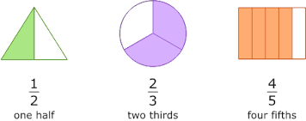
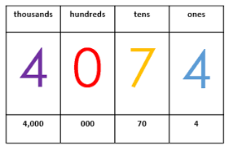
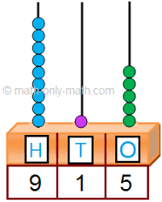
Place Value
Addition & subtraction
Geometry (shape)
Fractions
Geometry (position &direction)
Time
Statistics
Autumn Spring Summer
Maths Year 9 (L) WRM 2
Length & height
Mass, capacity and temperature
Money
Multiplication & division

Slide 2
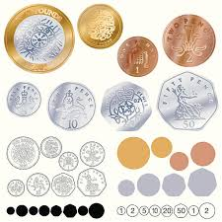
Decimals
Money
Time
Shape
Statistics
Position and direction
Place value
Addition & subtraction
Area
Multiplication and division
Autumn Spring Summer
Maths Year 9 (JO) WRM 5
Multiplication & division
Length & perimeter
Fractions
Decimals

