Slide 1
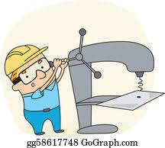
DT
Health & Safety
Plastics
(7A)
DT
Wood
(7A)
DT
Metals
(7B)
Half Term 1 Half Term 2 Half Term 3 Half Term 4 Half Term 5 Half Term 6
Design Technology Year 7
DT
Health & Safety
Plastics
(7B)
DT
Wood
(7B)
DT
Metals
(7A)

Slide 2
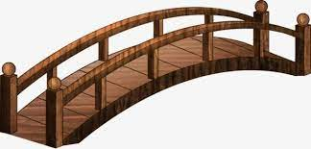
Health & Safety
Structures
(8A)
Mechanisms
(Levers)
(8A)
Desk Tidy
(8B)
Half Term 1 Half Term 2 Half Term 3 Half Term 4 Half Term 5 Half Term 6
Design Technology Year 8
Desk tidy
(8A)
Health & Safety
Structures
(8B)
Mechanisms
(Levers)
(8B)

Slide 3
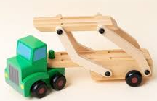
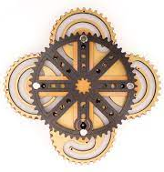
Mechanisms (Cams)
(9JO)
Electronics
(SHG)
(9JO)
Jigsaw (CAD/CAM)
(9L)
Half Term 1 Half Term 2 Half Term 3 Half Term 4 Half Term 5 Half Term 6
Design Technology Year 9
Jigsaw (CAD/CAM)
(9JO)
Mechanisms (Cams)
(9L)
Electronics
(SHG)
(9L)

