Slide 1
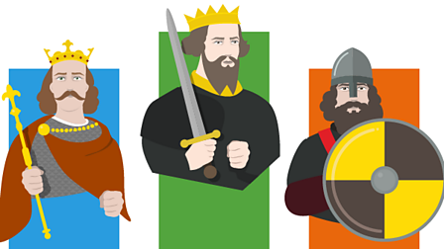


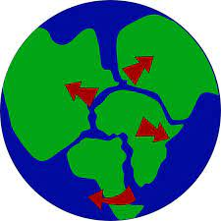
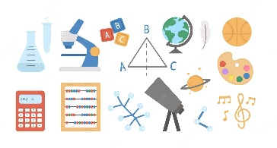
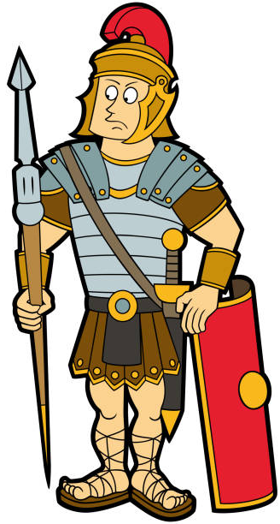
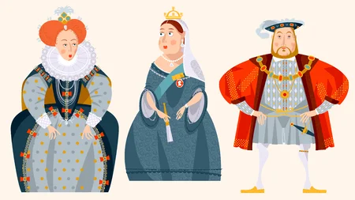
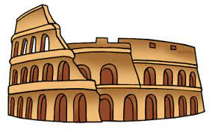
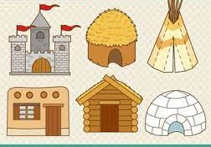
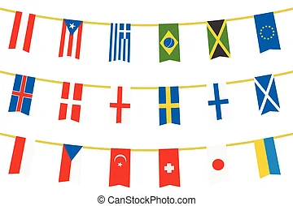
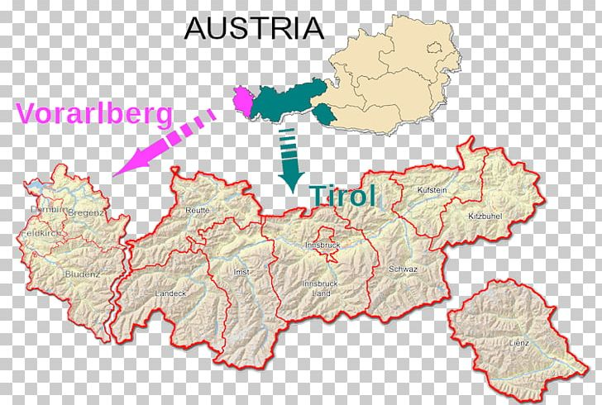
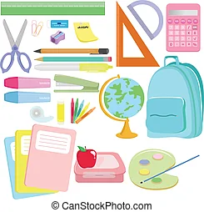
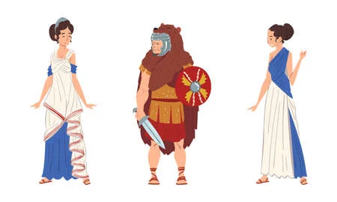

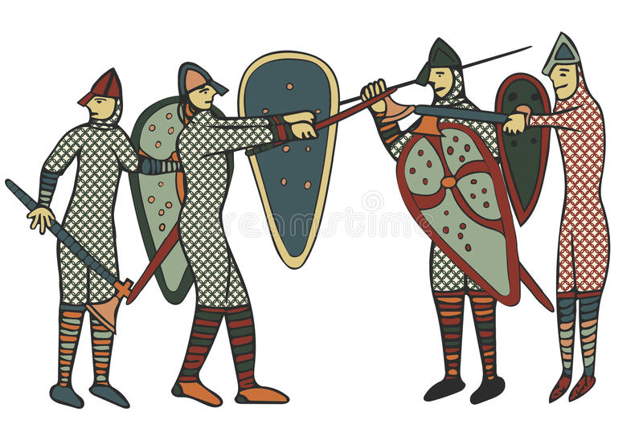
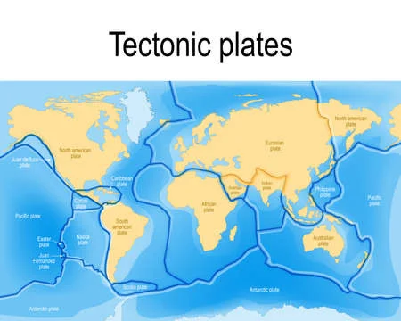
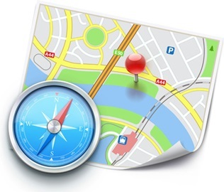
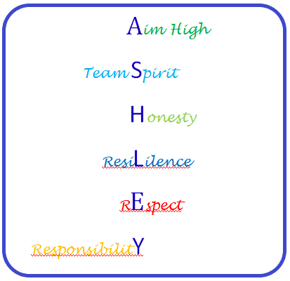









Italy
The Romans
Tectonics
A new start
(Greetings, feelings, numbers, colours)
Settlements
The Normans
Settlements
Animal nouns, singular and plural
Castles
Tudors
Map Skills
Fruit and veg nouns, board game
Half Term 1 Half Term 2 Half Term 3 Half Term 4 Half Term 5 Half Term 6
Wider World Year 7
Italy
The Romans
Tectonics
Days and months, Christmas
Settlements
The Normans
Settlements
Numbers to 15, age, dates, Easter
Castles
Tudors
Map Skills
Flags, Explore Germany

Slide 2
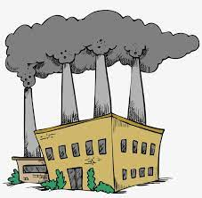

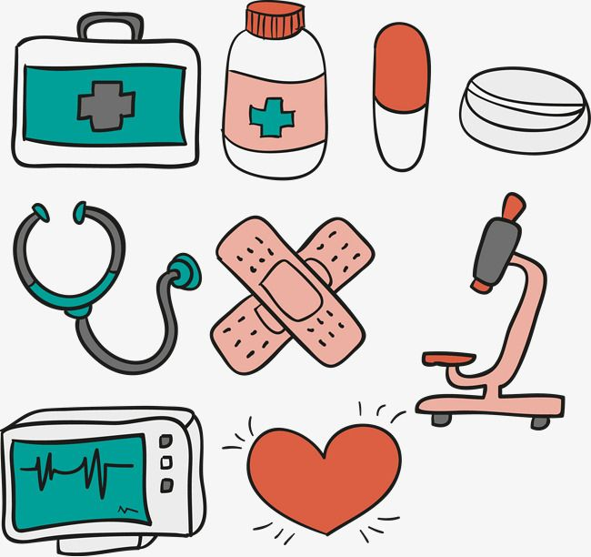





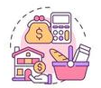
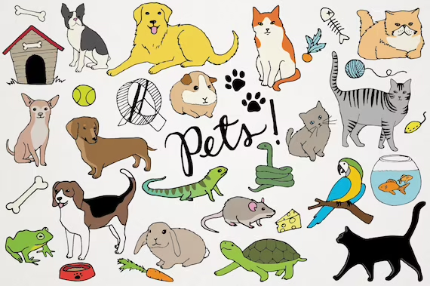

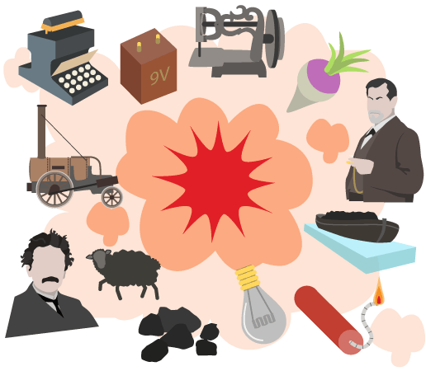
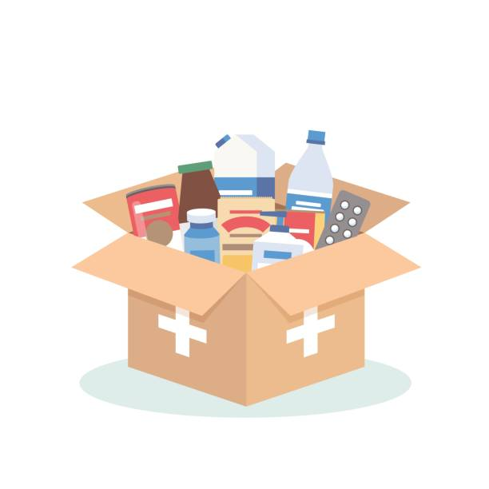
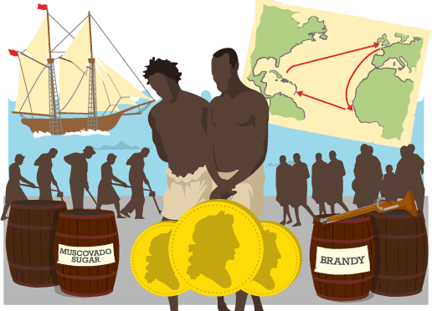



Industry
Industrial Revolution
Economics
Recap core language, rooms in a school, classroom objects
Development
Health and Medicine
World Development
Face parts, describing with colours
Developing Continents
Trans Atlantic Slave Trade
Kenya
Role play, animal nouns, adjectives
Half Term 1 Half Term 2 Half Term 3 Half Term 4 Half Term 5 Half Term 6
Wider World Year 8
Industry
Industrial Revolution
Economics
Family members, personal info
Development
Health and Medicine
World Development
Face and body parts nouns and commands
Developing Continents
Trans Atlantic Slave Trade
Kenya
Weather phrases, seasons

Slide 3



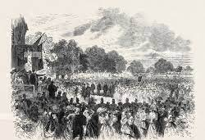

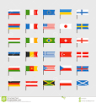



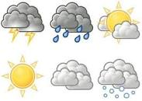

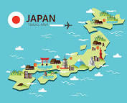


World at War
WWII
Japan
Introduce a friend, school subjects and opinions
Changes
Civil Rights
Climate Change
Prices, market dialogue, recipe
Halton
Halton through time
Local Study
Commands, shops, asking and giving directions)
Half Term 1 Half Term 2 Half Term 3 Half Term 4 Half Term 5 Half Term 6
Wider World Year 9
World at War
WWII
Japan
German city, buying a ticket, directions, festive jumper
Changes
Civil Rights
Climate Change
Clothes nouns, verb to wear, describe using adjectives
Halton
Halton through time
Local Study
Rooms in a house, furniture, describe rooms

