Slide 1
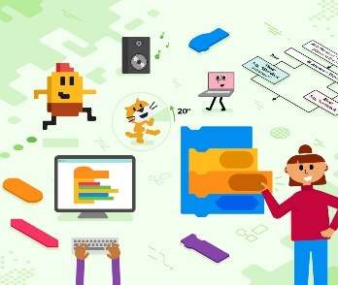
Hardware/ Software Multimedia ICT Presentations
Powerpoint Presentations
Spreadsheet Modelling
Half Term 1 Half Term 2 Half Term 3 Half Term 4 Half Term 5 Half Term 6
ICT Year 9
Scratch Programming Part 1
Scratch Programming Part 2
Databases

