Slide 1
Responding to a Tectonic Event
Changing Population
?
Half Term 1 Half Term 2 Half Term 3 Half Term 4 Half Term 5 Half Term 6
Humanities Year 10
?
Responding to a Tectonic Event
?
Changing
Population

Slide 2
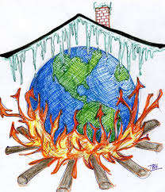
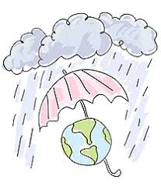
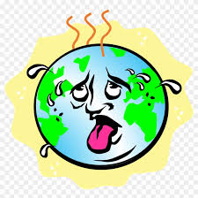
?
Climate
Change
Half Term 1 Half Term 2 Half Term 3 Half Term 4 Half Term 5 Half Term 6
Humanities Subject Year 11
?

