Slide 1
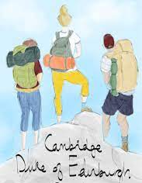
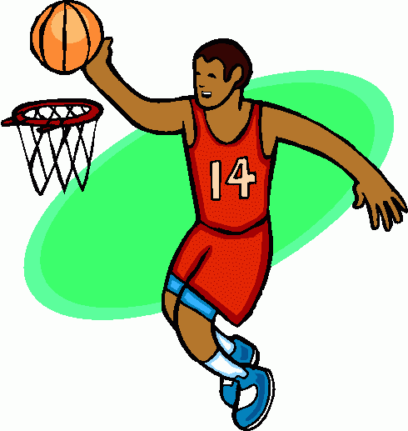
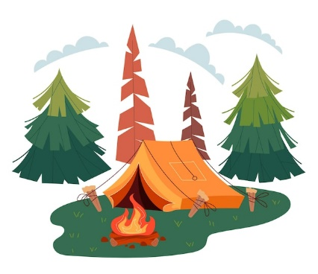
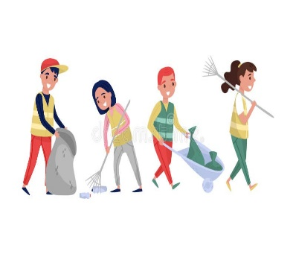
Learning a new skill
(Camp craft + Navigation skills)
Taking part in team sports
Volunteering/Preparing for the expedition
Half Term 1 Half Term 2 Half Term 3 Half Term 4 Half Term 5 Half Term 6
DofE: Year 10 (Bronze Award)
Learning a new skill
(Camp craft Navigation skills)
Taking part in team sports
Volunteering/Preparing for the expedition

Slide 2
Taking part in individual sports
Learning a new Skill
Volunteering/Preparing for the expedition
Half Term 1 Half Term 2 Half Term 3 Half Term 4 Half Term 5 Half Term 6
DofE: Year 11 (Silver Award)
Taking part in individual sports
Learning a new skill
Volunteering/Preparing for the expedition

