Slide 1
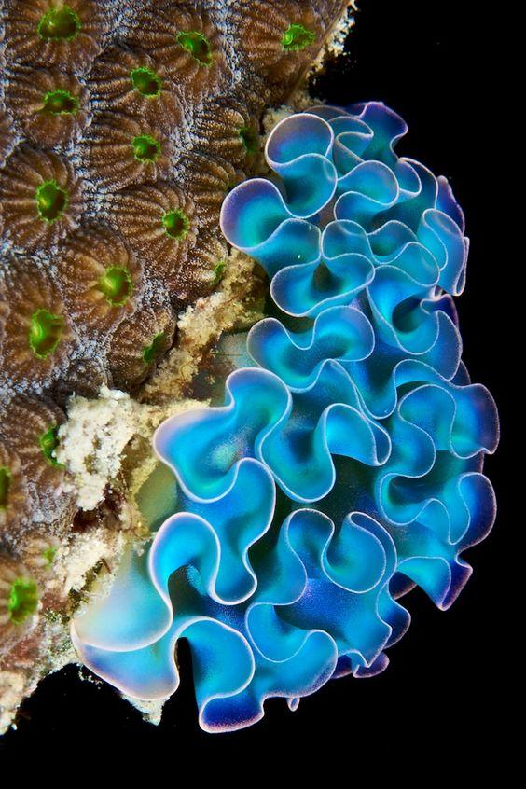
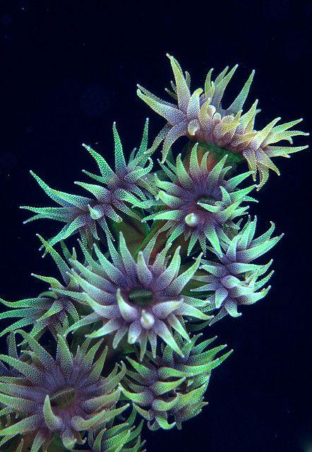
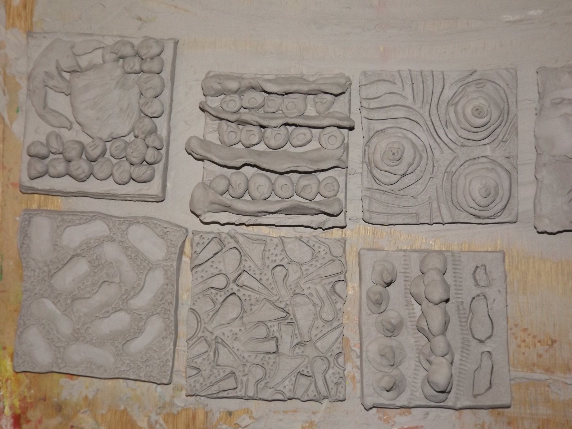
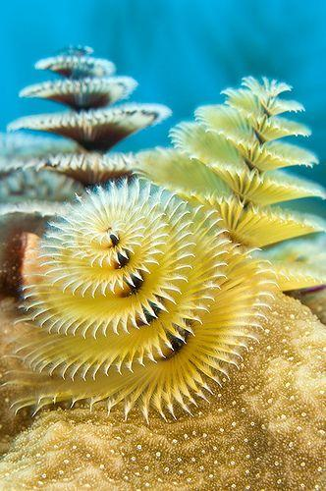
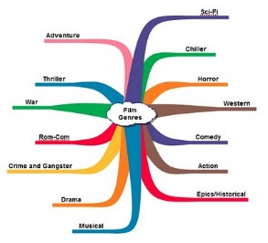
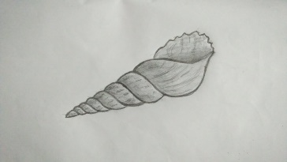
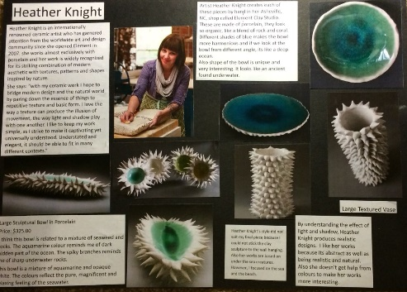
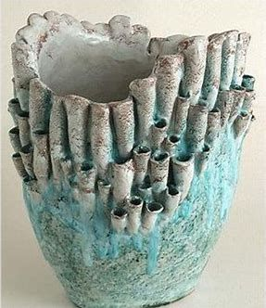
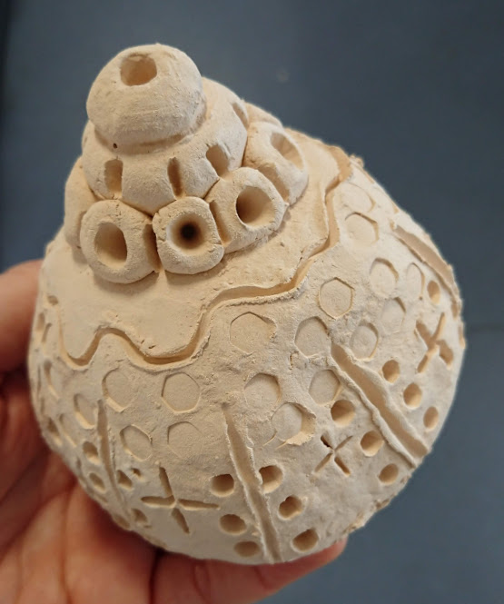
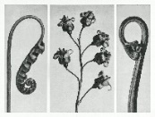
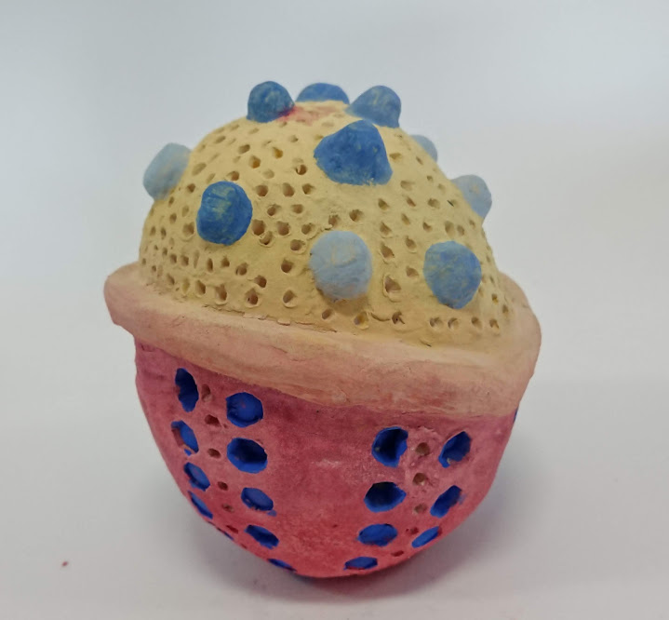
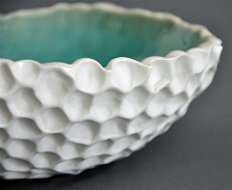
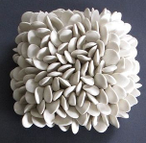
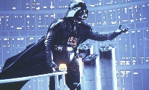
Ceramics
LO3 Evidence of an
Appropriate Ceramic
Outcome
Ceramics
LO1 Record Experiences
Film Genres
L01 How films
are grouped in Genres
LO2 Key Conventions
Half Term 1 Half Term 2 Half Term 3 Half Term 4 Half Term 5 Half Term 6
Creative Media Year 10
Ceramics
LO2 Evidence of Ideas
Ceramics
LO3 Evidence of an
Appropriate Ceramic
Outcome
Film Genres
LO3 Produce an
Idea for a New Film

