Slide 1
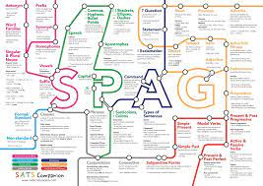
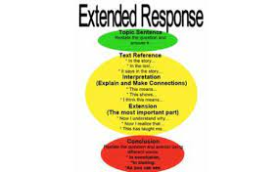
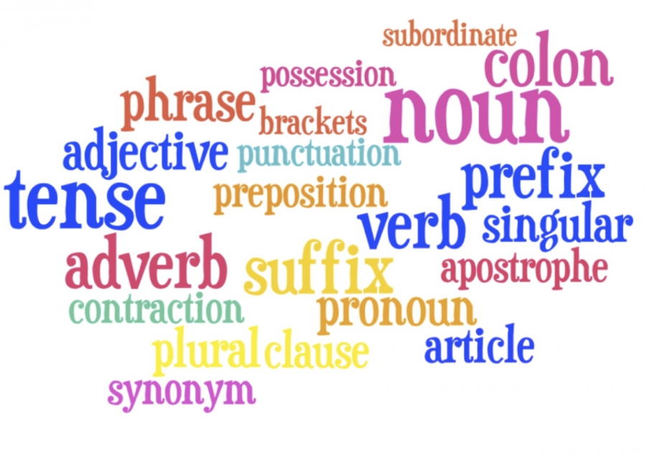
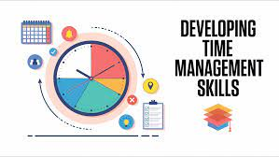
Reading –
Reading and understanding non-fiction texts.
Multiple source questions.
Non-Fiction Writing –
Shorter Writing task
Composition & SPaG
Speaking and Listening –
Individual presentation
Group discussion
Half Term 1 Half Term 2 Half Term 3 Half Term 4 Half Term 5 Half Term 6
Functional Skills English Year 12
Reading –
Reading and understanding non-fiction texts.
Single source questions.
Non-Fiction Writing –
Longer Writing task
Composition & SPaG
Exam Skills –
Understanding Instructions, Time management, managing exam stress etc.

Slide 2
Reading –
Reading and understanding non-fiction texts.
Multiple source questions.
Non-Fiction Writing –
Shorter Writing task
Composition & SPaG
Speaking and Listening –
Individual presentation
Group discussion
Half Term 1 Half Term 2 Half Term 3 Half Term 4 Half Term 5 Half Term 6
Functional Skills English Year 13
Reading –
Reading and understanding non-fiction texts.
Single source questions.
Non-Fiction Writing –
Longer Writing task
Composition & SPaG
Exam Skills –
Understanding Instructions, Time management, managing exam stress etc.

