Slide 1
Christianity: God and Humanism
Caused or Chance?
Ideas about the origins of the universe.
Christianity: Jesus
Faith and Justice –
How should we treat our ‘neighbours’?
Christianity: Church
What is the Church?
Half Term 1 Half Term 2 Half Term 3 Half Term 4 Half Term 5 Half Term 6
Beliefs and Values Year 7
Islam
What does belonging
mean to a young
Muslim in the UK?
Judaism
How do Jewish
holy days remind
adherents of
their faith?
Hindu Dharma
What might Hindus learn through celebrating festivals?

Slide 2
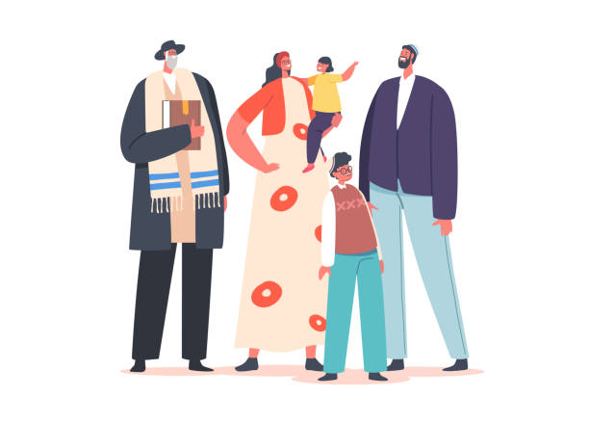
Christianity, Jesus and
non-religious
responses
Who was Jesus?
Hindu Dharma
What is the purpose of life?
Buddhism
Is suffering a necessary part of the human experience?
Half Term 1 Half Term 2 Half Term 3 Half Term 4 Half Term 5 Half Term 6
Beliefs and Values Year 8
Christianity: Church
What beliefs are central to Christianity?
Judaism
What does it
mean to be
the ‘Chosen
people’?
Islam
How do the Qur’an and Hadith guide Muslim life?

Slide 3
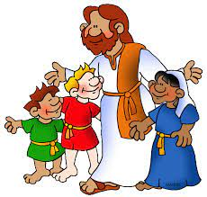
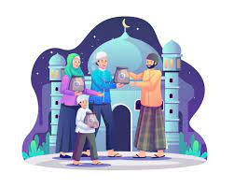
Christianity (God)
What is faith?
Islam
What matters most in Islam?
Sikh Dharma
Does religion encourage equality?
Half Term 1 Half Term 2 Half Term 3 Half Term 4 Half Term 5 Half Term 6
RE Year 9
Hindu dharma
What matters in the journey of life?
Christianity (Jesus, Church, humanism)
How should we make moral decisions?
Does religion matter in the 21st century?

