Slide 1
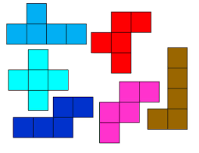
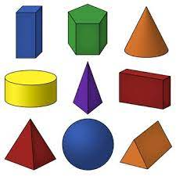
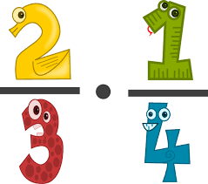
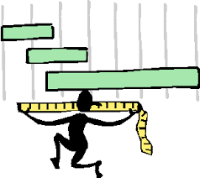
Data Handling – recording information
Data handling – extracting information
Applying Fraction skills
Coursework completion
Autumn Spring Summer
Maths Skills ENTRY 3 Year 12
Data – continued
Number Skills

