Slide 1
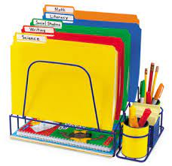
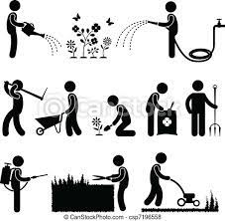
Year 12 Core Developing a Personal Progression Plan Year 13 Core Working as a Team Sector Caring for and Feeding Animals (Group 2) UK Travel and Tourism (Group 1) Preparing and Cooking Food (Group 3)
Year 12 Core Being Organised Year 13 Core Researching a Topic Sector Caring for and Feeding Animals (Group 3) UK Travel and Tourism (Group 2) Preparing and Cooking Food (Group 1)
Year 12 Core Working as a Team Year 13 Core Preparing Portfolio for Assessment Sector Moving and Accommodating Animals (Group 1) UK Travel and Tourism (Group 3) Preparing and Cooking Food (Group 2)
Half Term 1 Half Term 2 Half Term 3 Half Term 4 Half Term 5 Half Term 6
Vocational Studies Year 12/13
Year 12 Core Developing a Personal Progression Plan Year 13 Core Working as a Team Sector Caring for and Feeding Animals (Group 2) UK Travel and Tourism (Group 1) Preparing and Cooking Food (Group 3)
Year 12 Core Being Organised Year 13 Core Researching a Topic Sector Caring for and Feeding Animals (Group 3) UK Travel and Tourism (Group 2) Preparing and Cooking Food (Group 1)
Year 12 Core Working as a Team Year 13 Core Preparing Portfolio for Assessment Sector Moving and Accommodating Animals (Group 1) UK Travel and Tourism (Group 3) Preparing and Cooking Food (Group 2)

