Slide 1
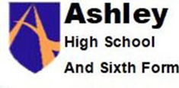
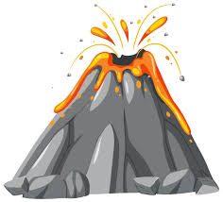
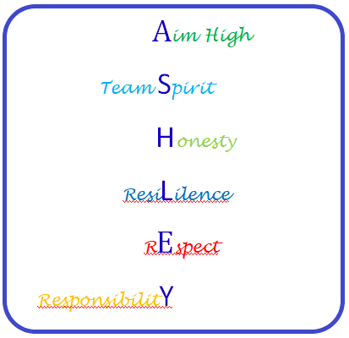
Responding to a Tectonic Event (1 lesson)
Changing population (2 lessons)
Responding to a Tectonic Event (1 lesson)
People and Protest (2 lessons)
Responding to a Tectonic Event (1 lesson)
Changing population (2 lessons)
Half Term 1 Half Term 2 Half Term 3 Half Term 4 Half Term 5 Half Term 6
Humanities Year 10 RF
Responding to a Tectonic Event (1 lesson)
Changing population (2 lessons)
Responding to a Tectonic Event (1 lesson)
People and Protest (2 lessons)
Responding to a Tectonic Event (1 lesson)
People and Protest (2 lessons)

Slide 2
Responding to a Tectonic Event
Changing population
People and Protest
Half Term 1 Half Term 2 Half Term 3 Half Term 4 Half Term 5 Half Term 6
Humanities Year 10RH
Responding to a Tectonic Event
People and Protest
Changing population

Slide 3
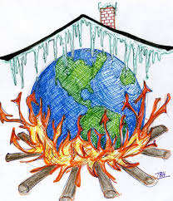
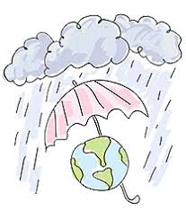
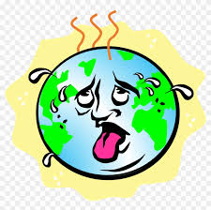
Preparing portfolios for assessment
Climate Change
Prejudice and
Discrimination against People
Half Term 1 Half Term 2 Half Term 3 Half Term 4 Half Term 5 Half Term 6
Humanities Subject Year 11
Working as Part of a Group
Climate Change
Prejudice and
Discrimination against People

