Slide 1
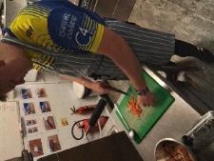
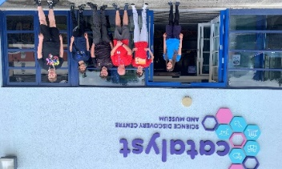
Ashley 6th Form
Ashley 6th Form provides specialist education for students aged 16 – 18 years with Autism and Social Communication Difficulties. We recognise that our students have ambitions to live and work as self-reliant adults and we help them reach their goals with continued support, structure and guidance. It is our aim to prepare our young people for a rich and fulfilling life by – Providing a variety of new experiences to build confidence and self efficacy Building on essential life skills Developing key employability skills Delivering qualifications required for further learning and employment. Students will attend college 3 days per week and follow one of our two pathways Pathway 1 – Ashley 6th Form Post 16 Bridging Course (1 Year) or Pathway 2 – Ashley 6th Form Preparation for Learning, Life and Employment (2 Years) Once an application has been made to 6th Form it will be reviewed carefully and we will advise on the most appropriate pathway. All students will have the support of a career guidance coach who will work closely with our young people and their families to help them make important decisions about their next steps.
Pathway 1 - Post 16 Bridging Course (1 Year)
Success at Post 16 looks different for every learner. This one year programme aims to support students to bridge the gap between Year 11 and Post 16 Education. It is ideal for learners who may have achieved academic qualifications but need further support to explore career aspirations and develop their confidence and independence needed to take the next steps.
Pathway 2 - Preparation for Learning, Life and Employment (2 Years)
The Preparation for Learning, Life and Employment course aims to provide students with the opportunity to build confidence and independence as well as improving English, Maths, ICT, Employability and Vocational skills. The course is delivered over two years.
Support
We provide ourselves on creating a supportive and friendly atmosphere. Strong relationships which exist between staff and students create a community where each person is values and can flourish.
Transferable Skills
Transferable skills are skills that are needed for success in a range of activities in education and training, work and life in general. Students will develop skills in teamwork, problem solving, communication, leadership, self management, personal development, ICT, organisation, time management and decision making.

Slide 2
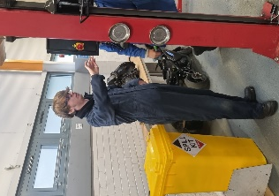
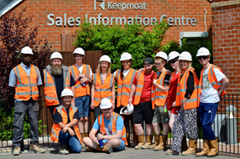
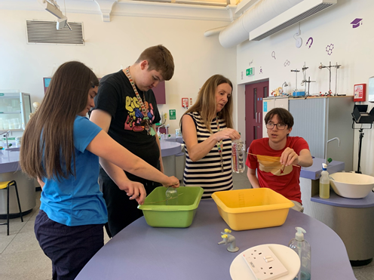
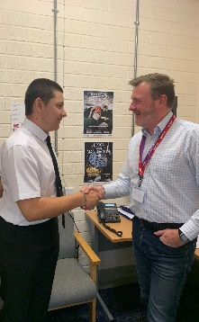
6th Form Curriculum
English, Maths & ICT
Students will study a core curriculum of English, Maths and ICT through Entry and Functional Skills qualifications. There is no requirement for students to continue with English or Maths qualifications once they have achieved a Functional Skills L2 or equivalent.
Vocational Studies | Employability
Our Entry 3/Level 1 Vocational Studies programme will give students the opportunity to explore various employment sectors including Hospitality & Catering Gardening Animal Care Hair & Beauty Motor Mechanics Construction Volunteering | Our Entry 3/Level 1 Employability programme will cover Exploring Interpersonal Skills Preparation for Work Customer Service Health, Safety and First Aid Working in an Office Environment Making and Receiving Phone Calls Career Progression Planning Being Organised Working as Part of a Team
Preparing for Adulthood
Employment Career Exploration Work Experience Customer Service CV Building Mock Interviews Work Place visits Vocational Tasters | Good Health Drug & Alcohol Education Sex and Relationship Education Personal Hygiene Physical Health Mental Health Health Care
Independent Living Travel Training Healthy Living Staying Safe Personal Finance Life Skills Cooking Cleaning Washing & Ironing Decision Making | Friendships, Relationships & Community Beliefs and Values Healthy Relationships Accessing community provision Responsibilities Safe use of Internet/Social Media Tolerance/Diversity Extremism/Radicalisation Criminal justice system

Slide 3
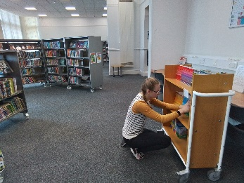
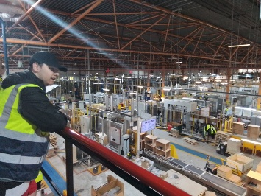
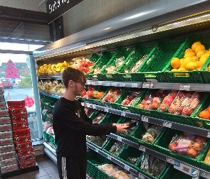
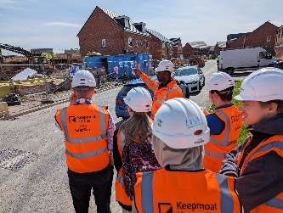
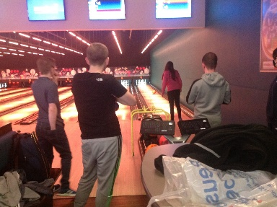
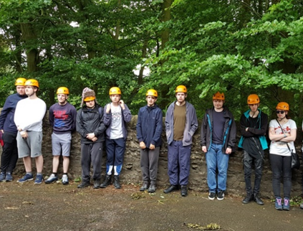
Extra-Curricular
Work Experience/ Voluntary Work
Work experience is seen as an integral part of the curriculum as a way of helping students to experience a new environment and develop essential work skills. We have good links with local employers who are familiar with the needs of our students and have created tasks that are suitable for them. For students who are not ready for an individual work placement, we have opportunities within our school environment and have developed a group work placement at the local library. We also provide opportunities for students to participate in voluntary work and have built up an excellent partnership with North West Air Ambulance and Halton Housing Trust.
Careers Support
Students have access to one to one careers guidance from a qualified careers adviser to help them develop their career aspirations and goals and explore the different options open to them. Students are also encouraged to carry out their own careers research so that they can develop the careers management skills needed for the future.
Transition
Moving on from Ashley 6th Form can cause anxiety for some of our students and therefore needs careful planning. We work closely with local colleges and providers to ensure that students feel confident about their next steps and arrange individual visits and taster sessions where needed. Our 6th Form curriculum is designed so that students are introduced to the idea on moving on and preparing for the future as soon as they arrive with us with lots of opportunities to try new environments.
Residential / Trips
6th Form students participate in a range of social activities including visit to The Trafford Centre, Bowling, Cinema and meals out. There is also an opportunity to take part in a 3 day residential to complete the Skills4Life programme at The Kingswood Colomendy centre.

