Slide 1
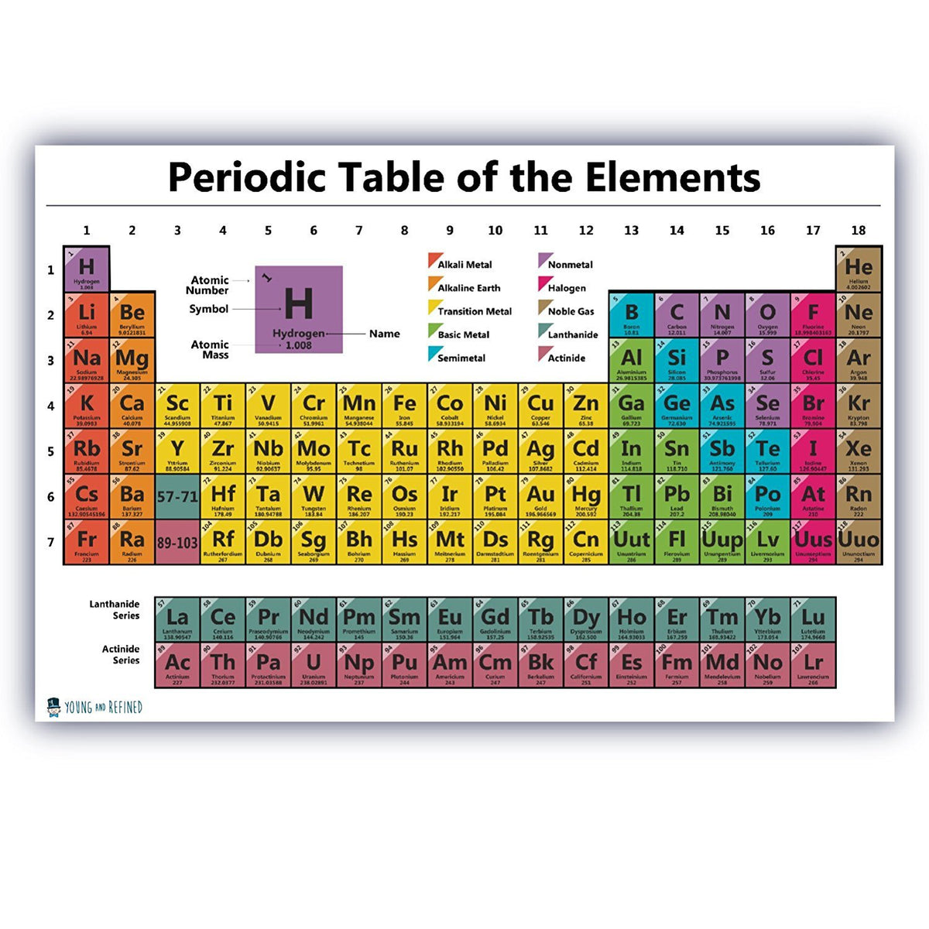
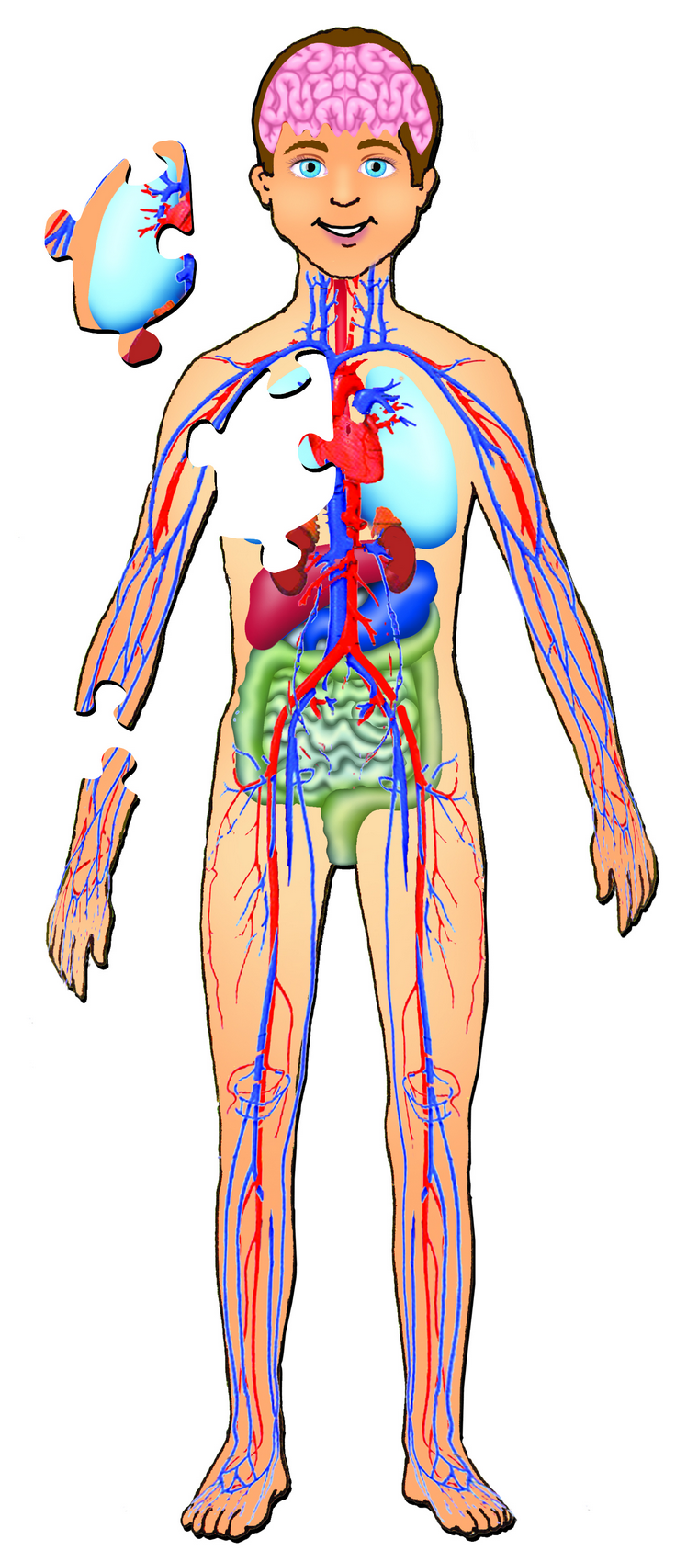
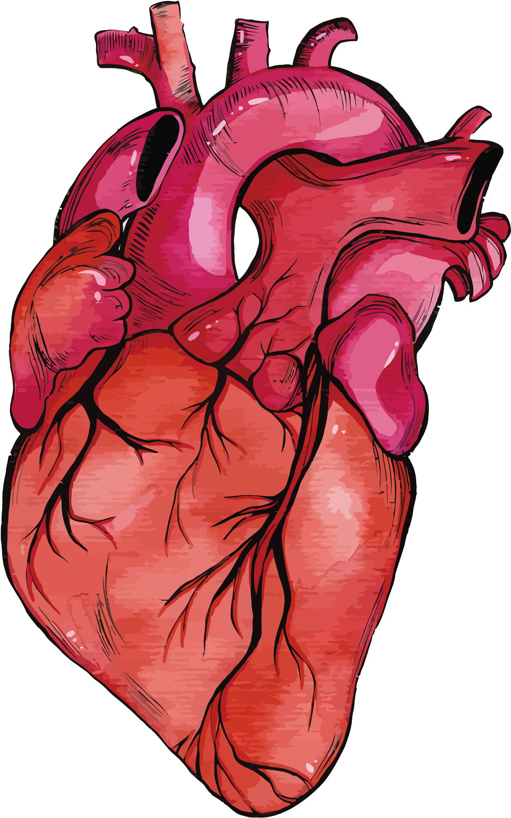
C1 The Human Body – Theory
C3 Elements, Mixtures and Compounds – Theory
C5 Energy, Forces and Structures of Matter – Theory
Half Term 1 Half Term 2 Half Term 3 Half Term 4 Half Term 5 Half Term 6
Subject Year 10
C1 The Human Body – ESA and TDA investigations
C3 Elements, Mixtures and Compounds – ESA and TDA investigations
C5 Energy, Forces and Structures of Matter – ESA and TDA investigations

Slide 2
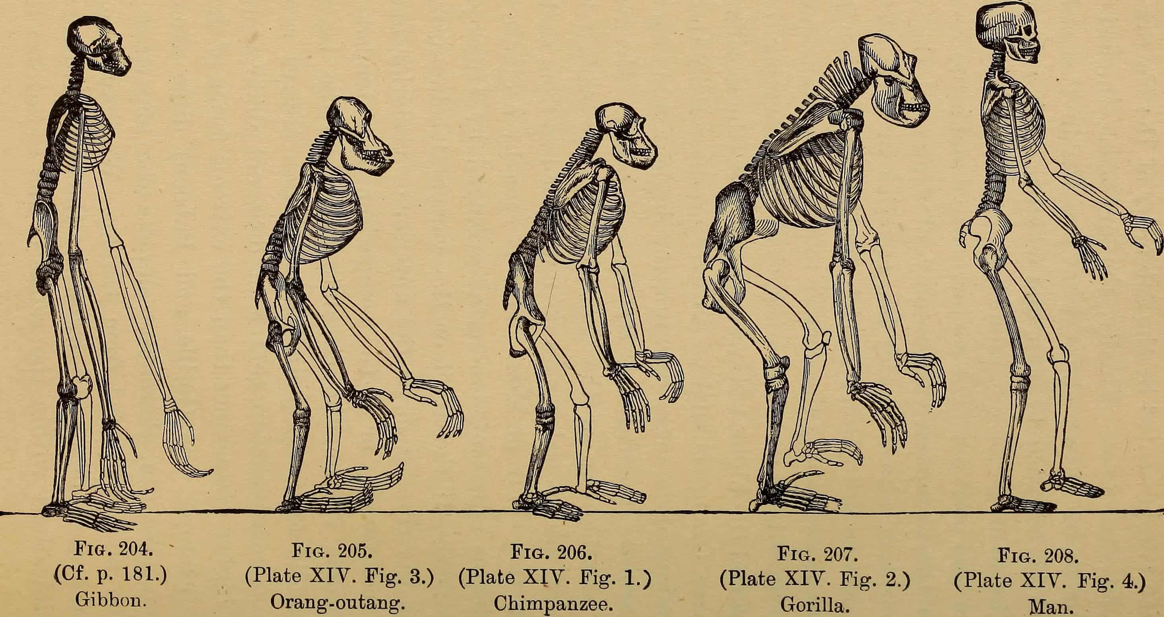
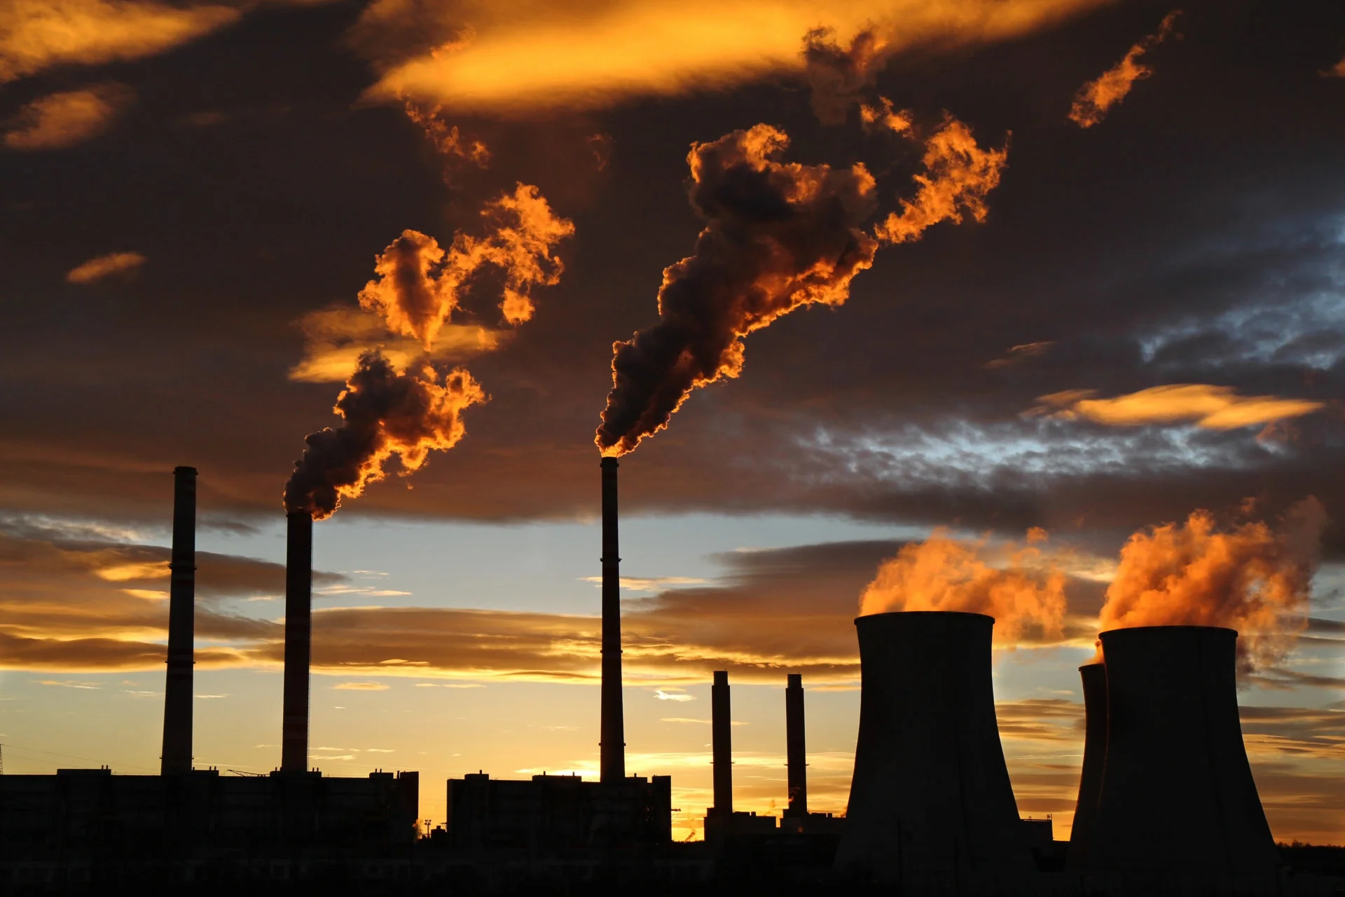
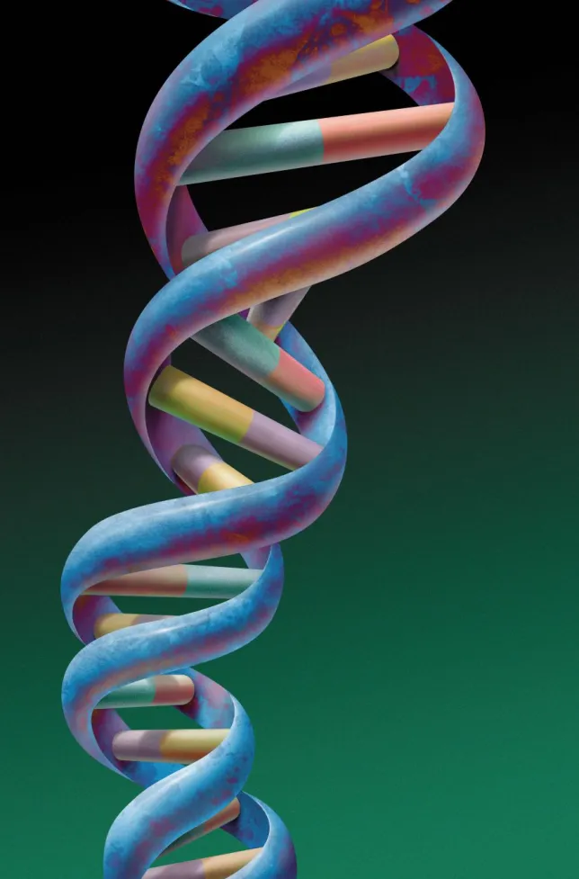
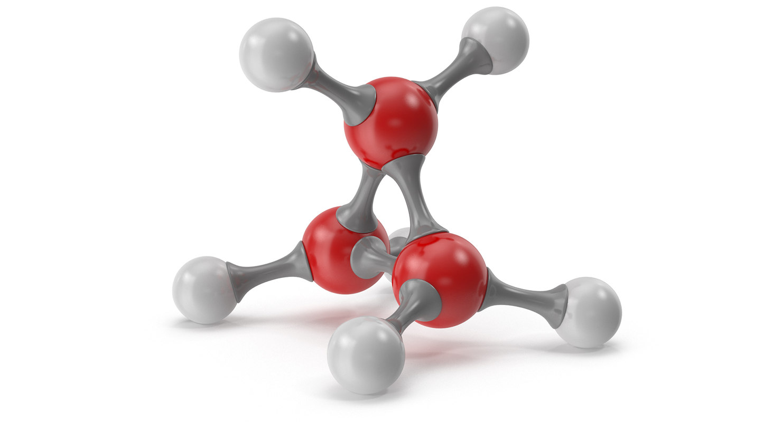
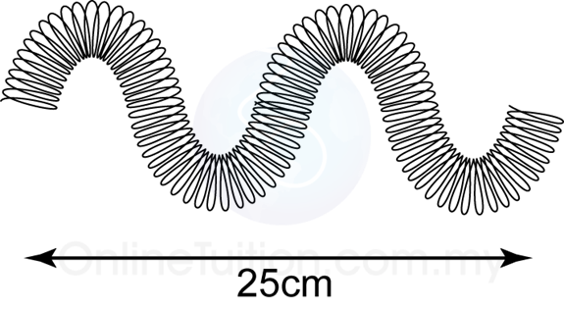
C2 Environment, Evolution and Inheritance
C4 Chemistry in our World – Theory and ESA and TDAs
TDA finishing, Portfolio completion and submission
Half Term 1 Half Term 2 Half Term 3 Half Term 4 Half Term 5 Half Term 6
Subject Year 11
C2 Environment, Evolution and Inheritance – ESA and TDA investigations
C6 Electricity, Magnetism and Waves- Theory and ESA, and TDA
Post Submission – Extended Work based Learning or Project work

