Slide 1
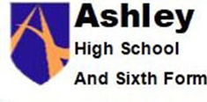
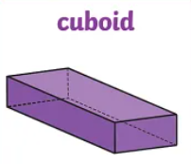
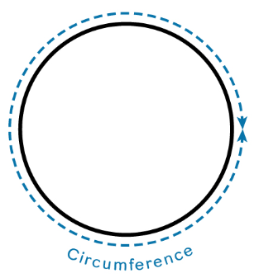
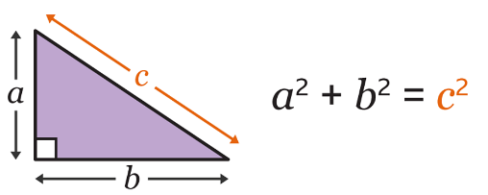
Rounding
Pythagoras
2D representation of 3D shapes
Standard form
Calculating with percentages
Algebra recap and extension
Congruence and similarity
Trigonometry
Simultaneous equations
Properties of polygons
∏r² sounds like area to me…..
Half Term 1 Half Term 2 Half Term 3 Half Term 4 Half Term 5 Half Term 6
Maths Year 10 AQA GCSE foundation
Measures
Statistical measures
Indices
Constructions and loci
Perimeter and area
Graphs recap and extension
Circumference and area
Real life graphs
Review of basic probability
Probability

Slide 2
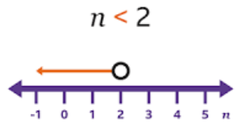
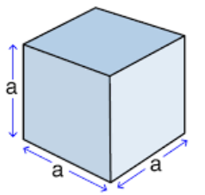
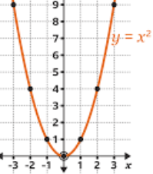
Properties of polygons
Real life graphs
Probability
Volume
Algebra and graphs
Sketching graphs
Mock examinations (2)
Direct and inverse proportion
Quadratic graphs
Growth and decay
Vectors
Half Term 1 Half Term 2 Half Term 3 Half Term 4 Half Term 5 Half Term 6
Maths Year 11 AQA GCSE foundation
Algebra quadratics
Mock examinations (1)
Inequalities
Recap of trigonometry
Solving quadratic equations
Revision
(x+1)(x-3) = 12

