Slide 1
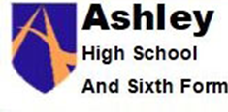
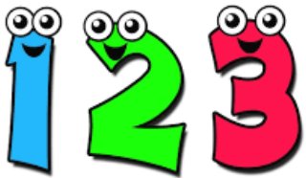
Understanding and Using 2D shapes
Understanding Volume
Understanding and Using Fractions
Half Term 1 Half Term 2 Half Term 3 Half Term 4 Half Term 5 Half Term 6
Maths Skills LEVEL 1 Year 12
Using Calculations: Addition and Subtraction of Whole Numbers
Understanding Numbers
Probability
Units subject to change

Slide 2
Understanding and using 2D shapes
Understanding Volume
Understanding and Using Fractions
Half Term 1 Half Term 2 Half Term 3 Half Term 4 Half Term 5 Half Term 6
Maths Skills LEVEL 1 Year 13
Using Calculations: Addition and Subtraction of Whole Numbers
Understanding Numbers
Probability
Units subject to change

