Slide 1
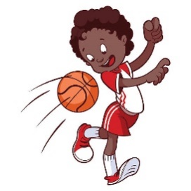
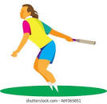
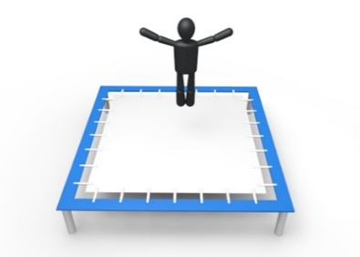
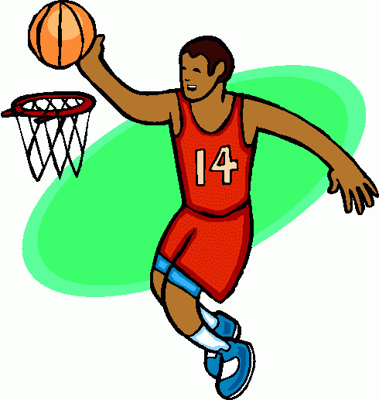
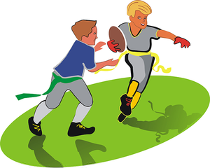
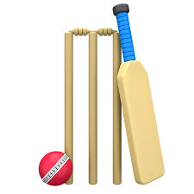
Dodgeball
Trampolining
Rounders/
Athletics
Half Term 1 Half Term 2 Half Term 3 Half Term 4 Half Term 5 Half Term 6
P.E. Year 10
Basketball
Fitness/Cricket
Tag Rugby

Slide 2
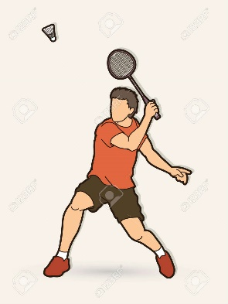
Dodgeball
Trampolining
Rounders/
Athletics
Half Term 1 Half Term 2 Half Term 3 Half Term 4 Half Term 5 Half Term 6
P.E. Year 11
Badminton
Fitness/Cricket
Tag Rugby

