Slide 1
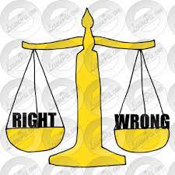
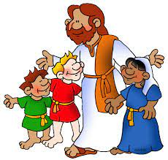
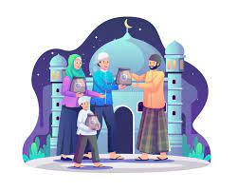
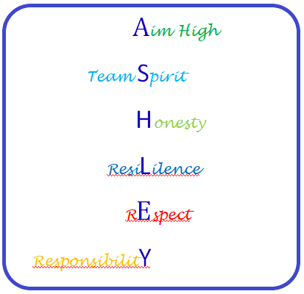
Christianity (God)
How do Christians mark the ‘turning
points’ on the journey of life?
Islam
What is Hajj and
why is it important to Muslims?
Buddhism
What do we mean by a ‘good life’?
Half Term 1 Half Term 2 Half Term 3 Half Term 4 Half Term 5 Half Term 6
Beliefs and Values Year 9
Hindu dharma
Is there one journey or many?
Christianity (Jesus)
Why do Christians
believe Good Friday is ‘good’?
Christianity (Church)
If life is like a journey, what’s
the destination?

Slide 2
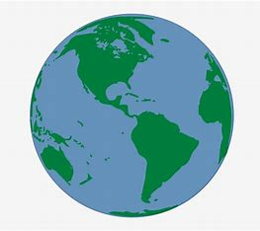
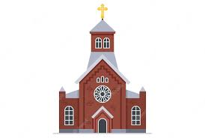
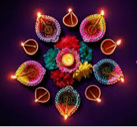
What do we mean by religion and worldviews?
(Contentious Issues)
Christianity: Jesus
Faith and Justice –
How should we treat our ‘neighbours’?
Christianity: Church
What is the Church?
Half Term 1 Half Term 2 Half Term 3 Half Term 4 Half Term 5 Half Term 6
RE Year 10
Islam
What does belonging
mean to a young
Muslim in the UK?
Judaism
How do Jewish
holy days remind
adherents of
their faith?
Hindu Dharma
What might Hindus learn through celebrating festivals?

Slide 3
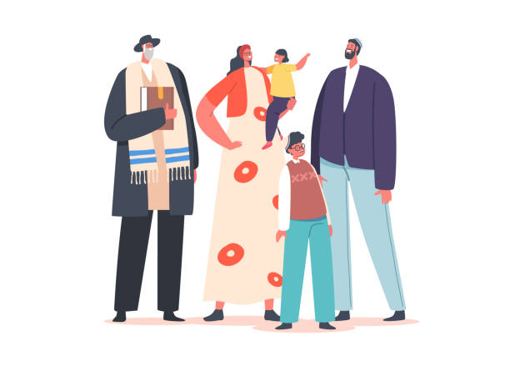
Christianity, Jesus and
non-religious
responses
Who was Jesus?
Hindu Dharma
What is the purpose of life?
Belonging to a Sikh family.
Buddhism
Is suffering a necessary part of the human experience?
Half Term 1 Half Term 2 Half Term 3 Half Term 4 Half Term 5 Half Term 6
RE Year 11
Life in a Muslin family.
Life in a Jewish family.
Christianity: Church
What beliefs are central to Christianity?
Judaism
What does it
mean to be
the ‘Chosen
people’?

