Slide 1
Health & Wellbeing Mental health and ill health, tackling stigma, building resilience RSE The benefits of regular self-examination and screening
Relationships Managing change, grief and bereavement Managing relationship challenges, including break ups Relationship myths and expectations Careers Lesson/s Raising aspirations and stereotyping (1 lesson)
Relationships Personal values and assertive communication in relationships Tackling domestic abuse and forced marriage RSE Characteristics and legal status of other types of long-term relationships
Half Term 1 Half Term 2 Half Term 3 Half Term 4 Half Term 5 Half Term 6
RSE & Health Ed Year 10
RSE The facts about reproductive health, including fertility, and the potential impact of lifestyle on fertility for men and women and the menopause Careers Lesson/s Employer Talk (1 lesson)
RSE
Healthy relationships and consent
Risks of STI’s, sexting and pornography
Careers Lesson/s
What makes you tick personality test and job values (1 lesson)
Health & Wellbeing Mental health and ill health, tackling stigma, building resilience RSE The benefits of regular self-examination and screening

Slide 2
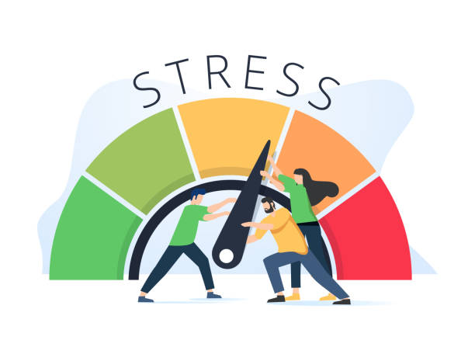
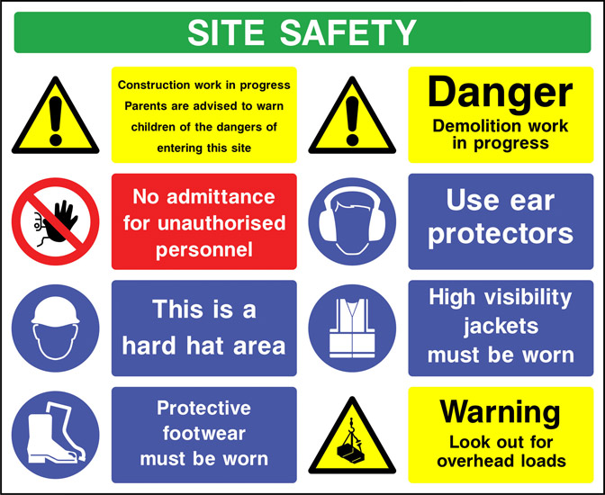
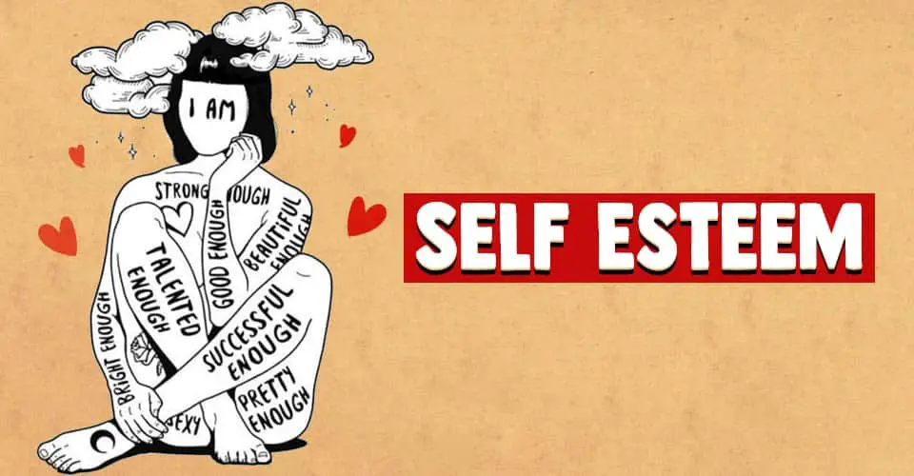
Health & Wellbeing Promoting self-esteem and coping with stress Careers Lesson/s Decision Making Self-awareness recap of skills and interests including how to prove my employability skills Opportunity Awareness – apprenticeships, traineeships, college
Living in the Wider Community Skills for employment and career progression Careers Lesson/s CV Writing/updating and covering letters Application forms
Health & Wellbeing
Health and Safety
Careers Lesson/s
Interview preparation
Financial support for students
Evaluation www.youthemployment.uk
Half Term 1 Half Term 2 Half Term 3 Half Term 4 Half Term 5 Half Term 6
RSE & Health Ed Year 11
Health & Wellbeing Promoting self-esteem and coping with stress Careers Lesson/s Decision Making Self-awareness recap of skills and interests including how to prove my employability skills Opportunity Awareness – apprenticeships, traineeships, college
Living in the Wider Community
Skills for employment and career progression
Careers Lesson/s
CV Writing/updating and covering letters
Application forms
Health & Wellbeing
Health and Safety
Careers Lesson/s
Interview preparation
Financial support for students
Evaluation www.youthemployment.uk

