Slide 1
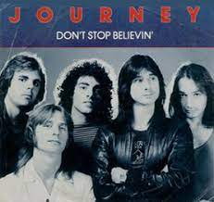
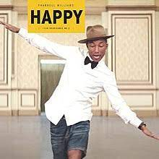
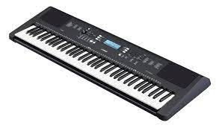
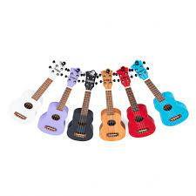
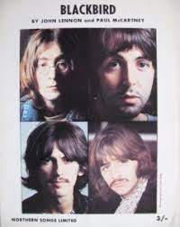
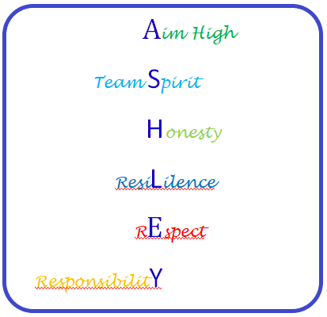
Pop/soul music (Happy)
Keyboard practical
Rock anthems (Don’t Stop Believing)
Half Term 1 Half Term 2 Half Term 3 Half Term 4 Half Term 5 Half Term 6
MUSIC YEAR 9
Ukulele practical
Songs about civil rights (Blackbird)
Pop ballads (Make you feel my love)

