Slide 1
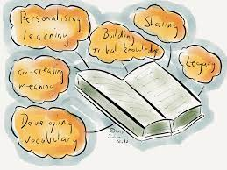
Speaking and Listening –
Group Discussion
Biographies –
Boy by Roald Dahl
Spelling, Punctuation and Grammar
Half Term 1 Half Term 2 Half Term 3 Half Term 4 Half Term 5 Half Term 6
English Year 7
Autobiographical Writing
Modern Novel –
TBC
Contemporary
Drama

Slide 2
Travel Writing – Non-Fiction Texts
(Emails & Letters, Brochures & Adverts, Reviews)
Other Cultures - Stories
Half Term 1 Half Term 2 Half Term 3 Half Term 4 Half Term 5 Half Term 6
English Year 8
Other Cultures - Poetry
Speaking & Listening
Modern Play/Drama –

Slide 3
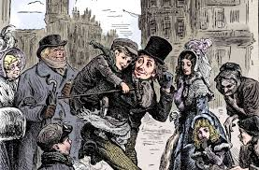
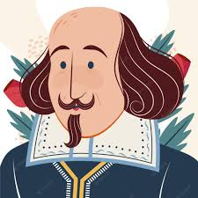
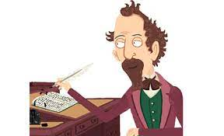
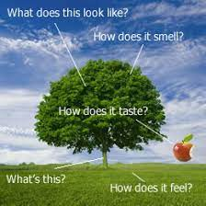
Classics – A Christmas Carol
Shakespeare –
Romeo and Juliet
Contemporary Fiction –
Refugee Boy/Terror Kid/Ghost boys etc.
Half Term 1 Half Term 2 Half Term 3 Half Term 4 Half Term 5 Half Term 6
English Year 9
Descriptive/
Narrative Writing
Speaking & Listening

