Slide 1
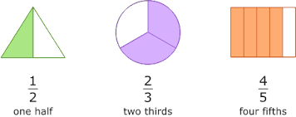
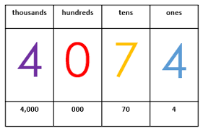
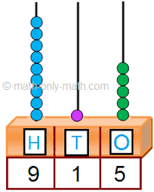
Place Value
Addition & subtraction
Geometry (shape)
Multiplication & division
Fractions
Geometry (position &direction)
Place value
Autumn Spring Summer
Maths Year 7
Addition & subtraction
Place value
Length & height
Weight & volume
Money
Time

Slide 2
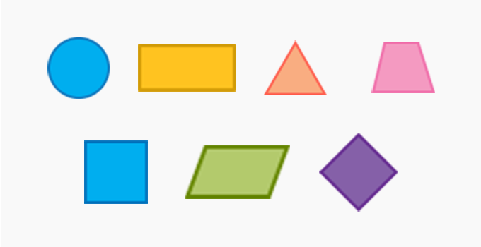
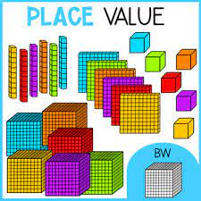
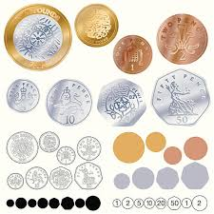
Fraction
Time
Statistics
Position & direction
Place value
Addition & subtraction
Shape
Autumn Spring Summer
Maths Year 8
Money
Multiplication & division
Length & height
Mass, capacity & temperature

Slide 3
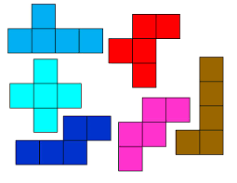
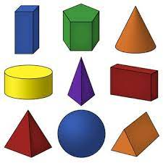
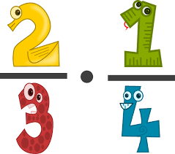
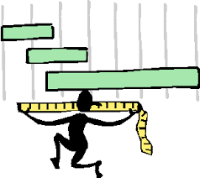
Place value
Addition & subtraction
Multiplication & division
Fractions
Money
Time
Shape
Statistics
Autumn Spring Summer
Maths Year 9
Multiplication & division
Length & perimeter
Fractions
Mass & capacity

