Slide 1
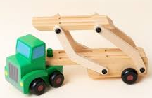
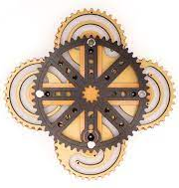
Mechanisms (Cams)
(9JO)
Electronics
(SHG)
(9JO)
Jigsaw (CAD/CAM)
(9JO)
Half Term 1 Half Term 2 Half Term 3 Half Term 4 Half Term 5 Half Term 6
Design Technology Year 9
Jigsaw (CAD/CAM)
(9JO)
Mechanisms (Cams)
(9JO)
Electronics
(SHG)
(9JO)

