Slide 1
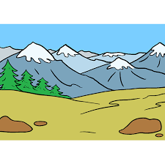
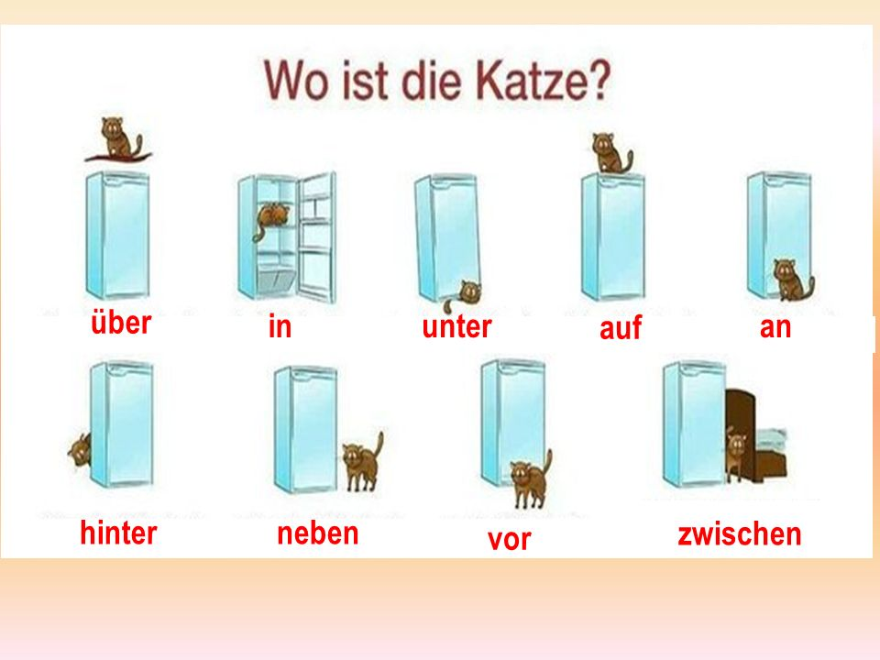
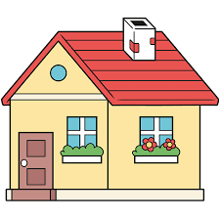
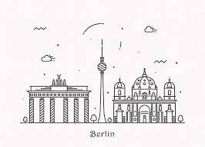
Wo wohnst du?
Where do you live?
Wo ist der Markt?
Types of transportation
Wo ist es?
German
prepositions
Half Term 1 Half Term 2 Half Term 3 Half Term 4 Half Term 5 Half Term 6
MFL YEAR 9
Mein Haus –
My house
Wo liegt das?
Study of German city
Boardgames in German

