Slide 1
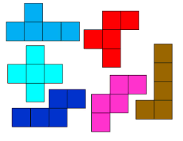
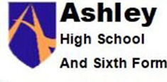
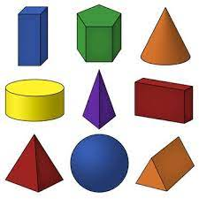
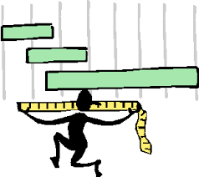
Place value
Addition & subtraction
Multiplication & division
Fractions
Money
Time
Shape
Statistics
Autumn Spring Summer
Students will also complete WJEC assessments – Number, Data, Shape, Measures, Fractions, Angles and Money
Maths Year 10 (RF / RH)
Multiplication & division
Length & perimeter
Fractions, decimals and percentages
Mass & capacity

Slide 2
Complete coursework - with Shape & Money
Data Handling
Coursework completion
Preparing for post 16 Maths
Autumn Spring Summer
Students will complete the WJEC Entry Pathways Maths qualification
Maths Year 11 WJEC Entry 2 / 3
Data Handling – cont.
Measures

