Slide 1
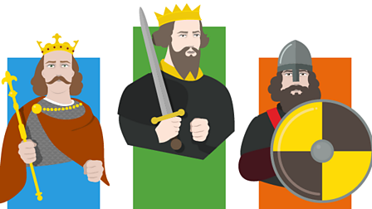
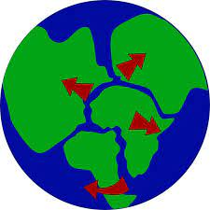
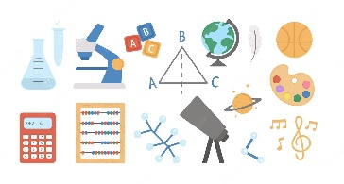
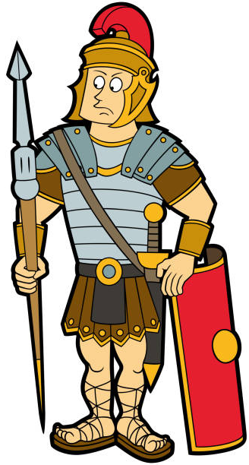
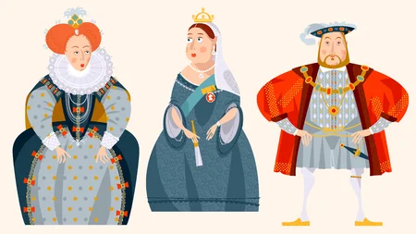
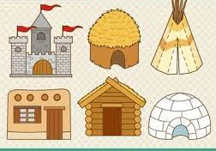
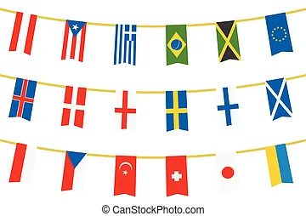
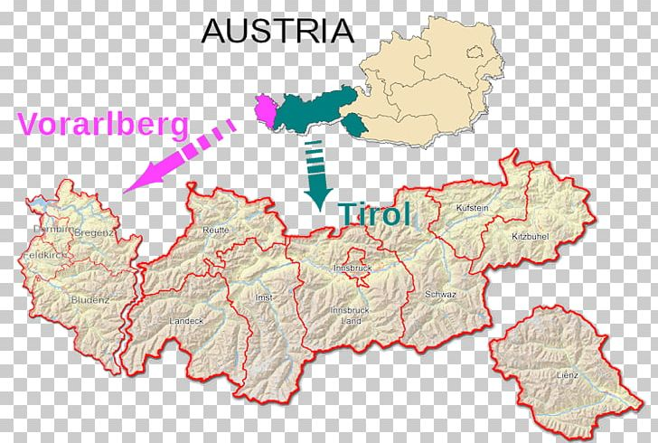
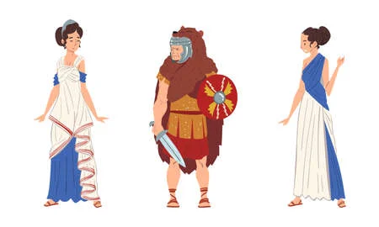
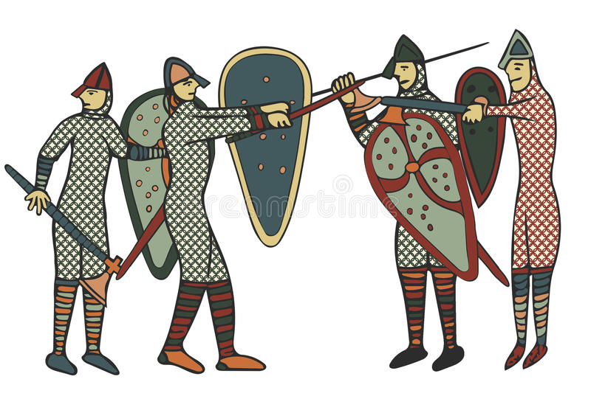
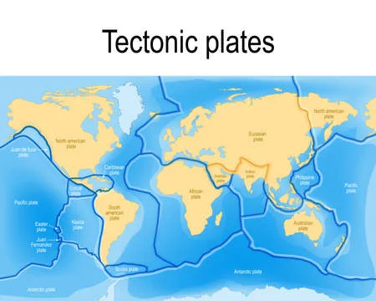
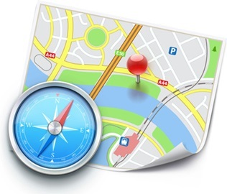
Geography
Tectonics
MFL
A New Start,
Calendar & Celebrations
History
The Tudors
Half Term 1 Half Term 2 Half Term 3 Half Term 4 Half Term 5 Half Term 6
Wider World 7LA
History
The Normans
Geography
Rivers
MFL
Animals, Using Numbers, Fruit and Veg, Going on a Picnic

Slide 2
MFL
A New Start,
Calendar & Celebrations
RF
Geography
Tectonics
LA
History
The Tudors
RF
Half Term 1 Half Term 2 Half Term 3 Half Term 4 Half Term 5 Half Term 6
Wider World 7SA
History
The Normans
RF
MFL
Animals, Using Numbers, Fruit and Veg, Going on a Picnic
RF
Geography
Rivers
LA

Slide 3
Geography
Tectonics
LA
MFL
A New Start,
Calendar & Celebrations
RF
History
The Tudors
LA
Half Term 1 Half Term 2 Half Term 3 Half Term 4 Half Term 5 Half Term 6
Wider World 7CB
History
The Normans
LA
Geography
Rivers
LA
MFL
Animals, Using Numbers, Fruit and Veg, Going on a Picnic
RF

Slide 4
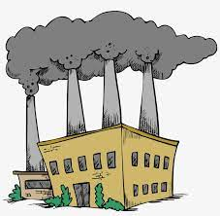
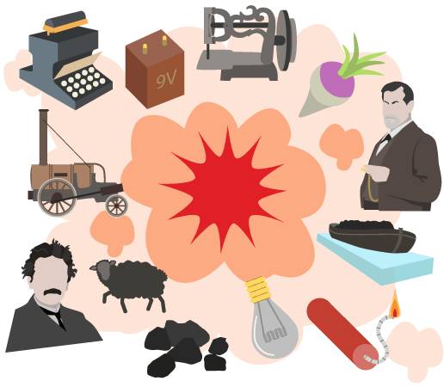
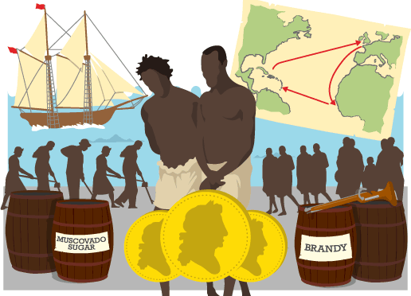
MFL
Welcome to School, My Town, Family Tree
MJ
Geography
World development
AC
History
Transatlantic Slave Trade
MS
Half Term 1 Half Term 2 Half Term 3 Half Term 4 Half Term 5 Half Term 6
Wider World 8AC
History
Health and Medicine
MS
Geography
Kenya
AC
MFL
Body Parts, Feeling Unwell, The Weather
MJ

Slide 5
History
Health and Medicine
MS
MFL
Welcome to School, My Town, Family Tree
MJ
Geography
Kenya
AC
Half Term 1 Half Term 2 Half Term 3 Half Term 4 Half Term 5 Half Term 6
Wider World 8MS
Geography
World development
AC
MFL
Body Parts, Feeling Unwell, The Weather
MJ
History
Transatlantic Slave Trade
MS

Slide 6
Geography
World development
AC
History
Transatlantic Slave Trade
MS
MFL
Body Parts, Feeling Unwell, The Weather
MJ
Half Term 1 Half Term 2 Half Term 3 Half Term 4 Half Term 5 Half Term 6
Wider World 8LQ
MFL
Welcome to School, My Town, Family Tree
MJ
History
Health and Medicine
MS
Geography
Kenya
AC

Slide 7
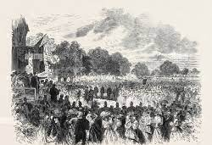
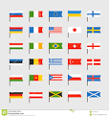
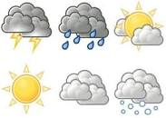
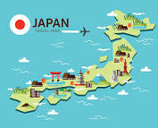
Geography
Deserts/polar regions
RF
History
WW2
SA
MFL
Clothes, Out of This World, Everyday Life
RF
Half Term 1 Half Term 2 Half Term 3 Half Term 4 Half Term 5 Half Term 6
Wider World 9JO
MFL
Talking About Us, School Subjects, In the City, Healthy Eating
RF
Geography
Mega cities
RF
History
Local History Study- Halton through time
SA

Slide 8
Geography
Deserts/polar regions
SA
MFL
Talking About Us, School Subjects, In the City, Healthy Eating
RF
History
Local History Study- Halton through time
SA
Half Term 1 Half Term 2 Half Term 3 Half Term 4 Half Term 5 Half Term 6
Wider World 9L
History
WW2
SA
Geography
Mega cities
SA
MFL
Clothes, Out of This World, Everyday Life
RF

