Slide 1
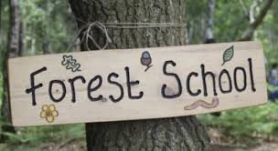
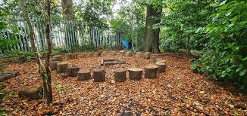
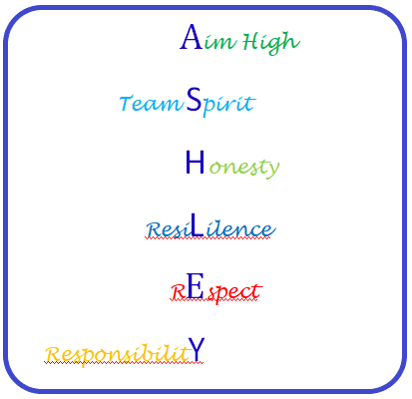
Lift Off Activity programme to support transition from primary to secondary school. Students to develop skills in Awareness Aspiration Attainment
Global Learning Current Affairs Martin Luther King Day Holocaust Memorial Day Children's Mental Health Day Chinese New Year
Forest School - Beginner Introduction to health and safety Woodcraft Shelter building Fire Nature Ropes
Half Term 1 Half Term 2 Half Term 3 Half Term 4 Half Term 5 Half Term 6
Practical Learning Year 7
Life Skills Challenges – Literacy, Numeracy & Digital Skills Practical Literacy Skills – Writing Practical Literacy Skills – Reading Practical Numeracy Skills – Time Practical Numeracy Skills – Measurement Digital Skills
LOTC – Local Area Walk to local shop Walk around local area Visit to Victoria Park Visit to the Hive Leisure Centre to survey facilities The Hive Bowling
Forest School - Beginner Advanced Woodcraft Shelter building Fire Nature Ropes

Slide 2
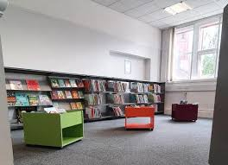
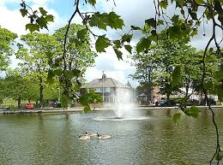
Life Skills Challenge Managing my Money How much do things cost? Luxury or Necessity Shopping Essentials Price Comparisons Visit to Local Shops Visit to Supermarket (Comparing Prices)
Gardening Planting in the Garden Using Produce Wildlife in the Garden Art in the Garden Halton Community Project
Forest School - Intermediate Introduction to health and safety Woodcraft Shelter building Fire Nature Ropes
Half Term 1 Half Term 2 Half Term 3 Half Term 4 Half Term 5 Half Term 6
Practical Learning Year 8
LOTC – Local Area
Library Visit
Kingsway Leisure Centre
Victoria Park /Coffee Shop
Widnes Town Centre
Shopping City Runcorn
Dr’s/Chemist
The Hive
Forest School - Intermediate Introduction to health and safety Woodcraft Shelter building Fire Nature Ropes
Life Skills Challenges – Literacy, Numeracy & Digital Skills Practical Literacy Skills – Writing Practical Literacy Skills – Reading Practical Numeracy Skills – Time Practical Numeracy Skills – Measurement Digital Skills

Slide 3
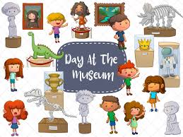
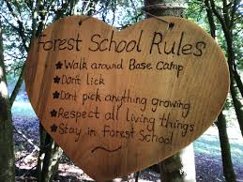
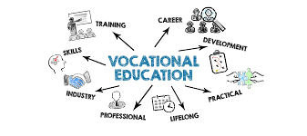
Life Skills Challenges – Literacy, Numeracy & Digital Skills Practical Literacy Skills – Writing Practical Literacy Skills – Reading Practical Numeracy Skills – Time Practical Numeracy Skills – Measurement Digital Skills
LOTC – A Journey Away Train to Liverpool/Museum Visit Local Farm Canalside Walk Formby Beach (Clean Up) Residential (Catalyst Museum)
Forest School - Introduction to health and safety Woodcraft Shelter building Fire Nature Ropes
Half Term 1 Half Term 2 Half Term 3 Half Term 4 Half Term 5 Half Term 6
Practical Learning Year 9
Enterprise Enterprise Project - School Christmas Fayre Grangeway Hub Christmas Fayre
My Future Vocational Tasters in Animal Care Catering Gardening Construction Creative Studies
Forest School - Introduction to health and safety Woodcraft Shelter building Fire Nature Ropes

