Slide 1
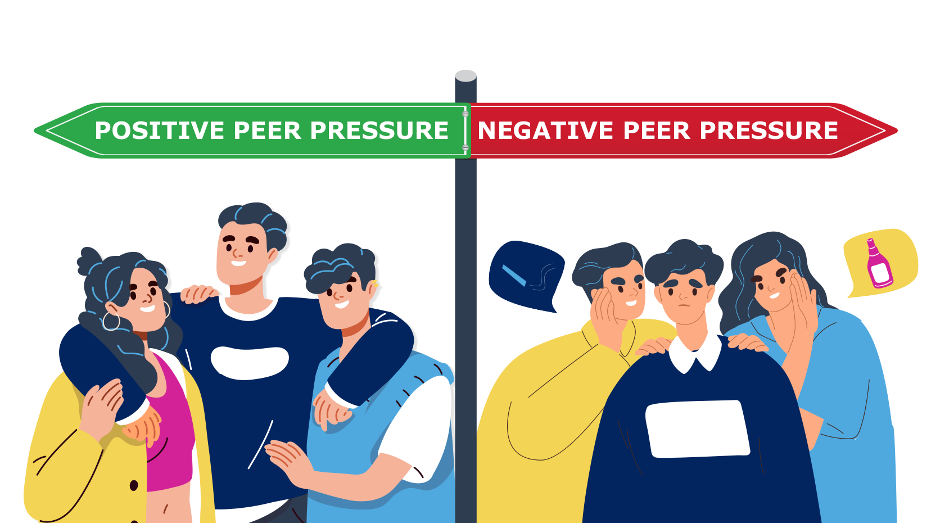
Relationships Managing conflict at home and staying safe Careers Lesson/s Choosing options – Introduction to the careers websites icould linking subjects to careers.
Health & Wellbeing
Managing peer pressure
Careers Lesson/s
Employer Talk
Health & Wellbeing Peer pressure, assertiveness and risk, gang crime
Half Term 1 Half Term 2 Half Term 3 Half Term 4 Half Term 5 Half Term 6
PHSCE Year 9
Relationships Tackling homophobia, transphobia and sexism Careers Lesson/s Using the Start website to view films on a variety of employers and job roles (1 lesson)
Living in the Wider World
Planning and carrying out an Enterprise Project
Living in the Wider World Understanding careers and future aspirations

