Slide 1
Step Up to English
Component 1 – Speaking and Listening
Step Up to English
Component 1 – Writing
Step Up to English
Component 2 - Reading
Half Term 1 Half Term 2 Half Term 3 Half Term 4 Half Term 5 Half Term 6
Subject Year 10
Step Up to English
Component 1 – Reading
Step Up to English
Component 2 – Speaking and Listening
Step Up to English
Component 2 – Writing

Slide 2
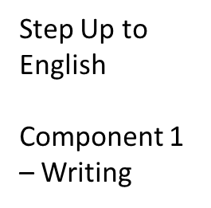
Step Up to English
Component 1 – Speaking and Listening
Functional Skills English – S&L
Discussions
Half Term 1 Half Term 2 Half Term 3 Half Term 4 Half Term 5 Half Term 6
Subject Year 11
Step Up to English
Component 1 – Reading
Functional Skills English – S&L
Presentation skills
Literacy for Life
& the world of work

