Slide 1






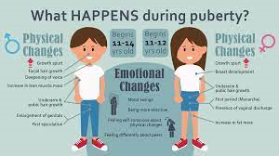













COMMUNITY INCLUSION Relationships - Self-esteem, romance and friendship EMPLOYMENT/CAREERS Introduction to Careers - Raising awareness of the variety of jobs all around us / Employer Talks (The range of jobs available in the NHS / Guess the employer)
GOOD HEALTH SRE - Managing puberty and the issue of unwanted contact / Consent Medication and Drugs - Difference between drugs and medication / taking medication / How alcohol, drugs and tobacco can be dangerous to health
COMMUNITY INCLUSION Relationships - (Exploring family life, understanding different families) Rights and Responsibilities in the community Ashley Values / Respect for Others
Half Term 1 Half Term 2 Half Term 3 Half Term 4 Half Term 5 Half Term 6
Preparing for adulthood Year 7
INDEPENDENT LIVING Housekeeping – Washing Dishes/ Using a toaster and kettle / Setting a table / Making a bed / Waste disposal/ Name and address / Using a post office COMMUNITY INCLUSION Diversity, Prejudice and Bullying and the impact on communities
INDEPENDENT LIVING
Food Management – Types of meals / Ordering Food / Table manners
Transport – Road Safety / Types of transport
COMMUNITY INCLUSION
INDEPENDENT LIVING Personal Appearance and Personal Hygiene / Emergency and Safety Skills GOOD HEALTH Alert Programme - How does my engine run? Managing my emotions

Slide 2















GOOD HEALTH Alcohol and drug misuse and managing peer influence COMMUNITY INCLUSION The law and legal and illegal substances
COMMUNITY INCLUSION Strategies for safely challenging stereotyping, prejudice, bigotry, bullying, and discrimination GOOD HEALTH Mental health and resilience, emotional wellbeing including body image
GOOD HEALTH Managing change and loss
COMMUNITY INCLUSION My own Core values Tackling age and disability discrimination
Half Term 1 Half Term 2 Half Term 3 Half Term 4 Half Term 5 Half Term 6
Preparing for adulthood Year 8
INDEPENDENT LIVING
Common ailments / Medical appointments
INDEPENDENT LIVING
Knowledge of community resources / Emergency and Safety Skills
COMMUNITY INCLUSION Rights and Responsibilities in the Community INDEPENDENT LIVING Household Cleaning Transport – Buses/Directions
EMPLOYMENT /CAREERS
Introduction to the Careers Adviser and the A-Z of Careers
Skills and qualities
EMPLOYMENT /CAREERS
Careers Lessons / STEM Talk
COMMUNITY INCLUSION British law and cultural and religious expectations and practices
COMMUNITY INCLUSION
All individuals have the same rights and opportunities in education and the work place

Slide 3




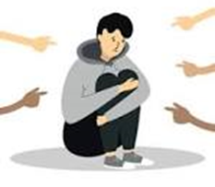


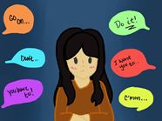






COMMUNITY INCLUSION Peer pressure, assertiveness and risk, gang crime
COMMUNITY INCLUSION Managing conflict at home and staying safe / Diversity, Prejudice and Bullying / Tackling homophobia, transphobia and sexism
EMPLOYMENT / CAREERS Planning and Carrying out an Enterprise Project / Employer Talk
EMPLOYMENT / CAREERS Understanding Careers and Future Aspirations
COMMUNITY INCLUSION Managing peer pressure
INDEPENDENT LIVING
Basic Budgeting Skills
INDEPENDENT LIVING
Basic First Aid / First Aid Kits
Half Term 1 Half Term 2 Half Term 3 Half Term 4 Half Term 5 Half Term 6
Preparing for adulthood Year 9
INDEPENDENT LIVING
Sleep
EMPLOYMENT Introduction to the Careers Service. START Website
INDEPENDENT LIVING
Using the telephone / Talking to unfamiliar people
Emotional Wellbeing
INDEPENDENT LIVING
Washing/Drying Clothes
Housekeeping - Fire Prevention/ Changing Light bulbs
INDEPENDENT LIVING
Planning Meals
Transport – Using Google Maps

