Slide 1
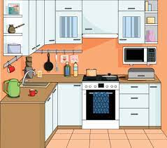
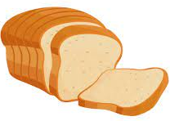
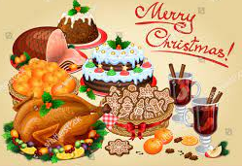
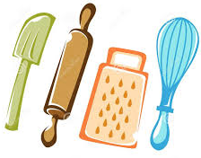
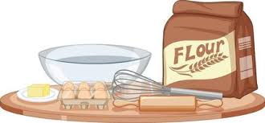
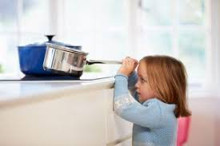
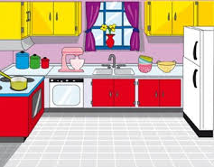
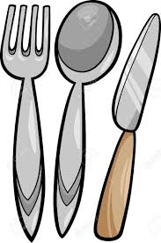
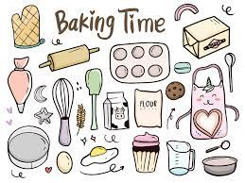
Introduction to the kitchen
&
Baking
(7LA)
Introduction to the kitchen
&
Baking
(7LA)
Introduction to the kitchen
&
Baking
(7SA)
Half Term 1 Half Term 2 Half Term 3 Half Term 4 Half Term 5 Half Term 6
Food Technology Year 7
Health
&
Safety
Religious Festivals
(7LA)
Introduction to the kitchen
&
Baking
(7SA)
Health
&
Safety
Religious Festivals
(7SA)

Slide 2
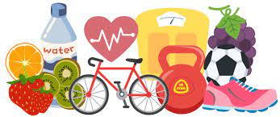
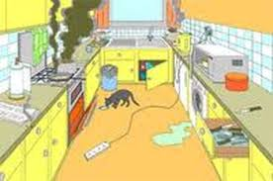
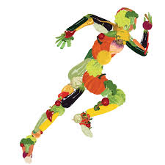
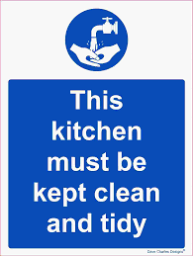
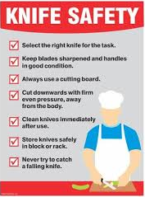
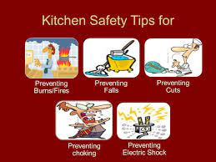
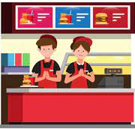
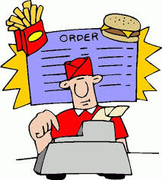
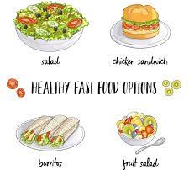
Designing a Food Outlet
&
Mini-Enterprise
(8CB)
Healthy Living
&
Health and Safety
(8CB)
Healthy Living
&
Health and safety
(8 MS)
Half Term 1 Half Term 2 Half Term 3 Half Term 4 Half Term 5 Half Term 6
Food Technology Year 8
Mini-Enterprise
&
Healthy Living
(8CB)
Healthy Living
&
Health and safety
(8MS)
Mini-Enterprise
&
Designing
a Food Outlet
(8MS)

