Slide 1
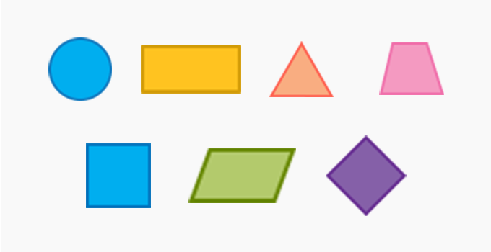
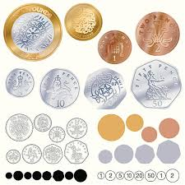
Decimals
Money
Time
Shape
Statistics
Position and direction
Place value
Addition & subtraction
Area
Multiplication and division
Autumn Spring Summer
Maths Year 8 (LQ) WRM 5
Multiplication & division
Length & perimeter
Fractions
Decimals

Slide 2
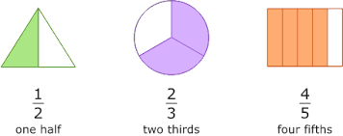
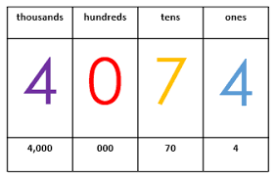
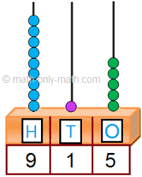
Place Value
Addition & subtraction
Geometry (shape)
Fractions
Geometry (position &direction)
Time
Statistics
Autumn Spring Summer
Maths Year 8 (MS) WRM 2
Length & height
Mass, capacity and temperature
Money
Multiplication & division

Slide 3
Place Value
Addition & subtraction
Geometry (shape)
Fractions
Multiplication & Division - 2 Geometry (position &direction)
Time
Statistics – 1
Money - 2
Autumn Spring Summer
Maths Year 8 (AC) WRM 1/2
Place value 20 – 1
Money - 2
Addition & Subtraction – 1
Multiplication & division – 2
Place value 50 – 1
Length & height
Measures

