Slide 1
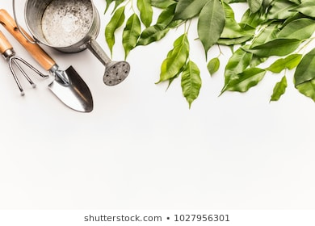
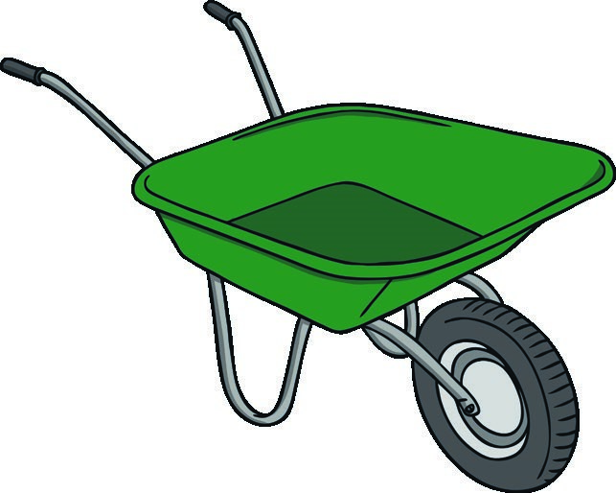
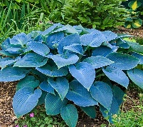
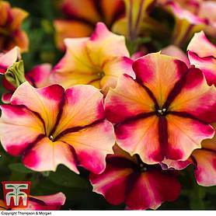
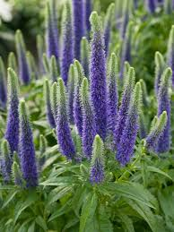
Planting
in the
Gardening
Planting
in the
Gardening
Careers on
Gardening
Half Term 1 & Half Term 2 Half Term 3 & Half Term 4 Half Term 5 & Half Term 6
Gardening Year 11
Planting
in the
Gardening
Careers on
Gardening
Careers on
Gardening

