Slide 1
KS4 Core Curriculum & Options 2025-26
For Further Information Please Contact :-
Sarah Crank
Cawfield Avenue Widnes
Cheshire
WA8 7HG
Phone: 0151 424 4892
E-mail: sec.ashley@haltonlearning.net

Slide 2
At KS4, pupils follow a core curriculum designed to ensure they achieve strong foundations in essential subjects. Pupils will have the opportunity to gain Functional Skills qualifications, which are valuable for future employment. They will be placed in teaching groups that match their abilities, allowing them to learn at a pace that's right for them. Alongside the core subjects, We also offer courses that focus on wellbeing and personal development, helping them to grow as an individual.
Core
English
Entry Level
Level 1 / Level 2
Entry Level
Maths
Level 1 / Level 2
Science
Entry Level
Level 1 / Level 2
Entry Level
Functional Skills Digital
Level 1
Beliefs & Values
Humanities
Preparing for Adulthood
Vocational Studies
PE (Duke of Edinburgh)

Slide 3
In Year 10, pupils have the exciting opportunity to tailor your learning by choosing two option subjects.
Option 1: Select one subject from a choice of three options.
Option 2: Then select another subject from a different set of three options.
Yr10
Home Cooking Skills
Level 1
OR
Creative Media - Art
Entry Level Pathways
OR
Preparing for Work - DT
Entry Level Pathways
AND
Animal Care
Asdan Short Course
OR
Hospitality
Asdan Vocational Taster
OR
Uniformed Services
Asdan Vocational Taster
In Year 11, pupils choose one subject from a choice of three options.
Yr 11
Gardening
Asdan Short Course
OR
Construction
Asdan Vocational Taster
OR
Environmental
Asdan Short Course

Slide 4
ENGLISH
Exam Board | Edexcel Functional Skills English AQA Step up to English
Introduction | English is a compulsory core subject for all pupils. Pupils will study Functional Skills English at either Entry Level, Level 1 or Level 2. Pupils may also study for an Entry Level Step up to English qualification. In Key Stage 4 English is delivered by specialist English teachers. The course aims to provide practical, applicable English skills to help our young people operate effectively in the world around them. Achievement of the qualification demonstrates the ability at an appropriate level to read, write, speak, listen and communicate in English, and to apply these skills effectively to a range of purposes in the workplace and in other real-life situations. Spoken Language skills are assessed as a compulsory aspect of the course.
Summary of the topics you will cover | Component 1: Speaking, listening and communicating Texts should include narratives, explanations, discussions, instructions, information, descriptions and presentations all of varying lengths. Component 2: Reading Texts should include a range of straightforward texts on a range of topics and of varying lengths that instruct, describe, explain and persuade Component 3: Writing Texts should include straightforward texts such as narratives, instructions, explanations and reports of varying lengths. Pupils will cover spelling, punctuation and grammar and writing composition. | Step Up to English (Entry Level): Pupils will produce a coursework portfolio comprising of 3 topic based Non-Exam Assessments. 2 X Literacy Topics 1 X Creative Reading and Writing topics.
Assessment | Functional SkillsLevel 1 & 2 The Functional Skills Qualification in English at Level 1 & 2 consists of one internally-set and internally-marked speaking, listening and communicating assessment, one externally-assessed Reading assessment and one externally assessed writing assessment. These can be completed at set points in the school year. | Functional Skills and Step up to English Entry Level Non-Exam Assessment tasks carried out through- out the year. Portfolio submitted in the Summer term of Year 11.
Further information | If you have any queries concerning this subject or the qualifications, please contact Mrs. Lynsey Leigh or Mrs. Lauren Quinn
Useful websites | http://www.ashleyschool.com/subject/english.php

Slide 5
MATHS
Exam Board | Edexcel Functional Skills Maths WJEC Entry Level Pathways and Numeracy Qualifications
Introduction | Mathematics is a compulsory core subject for all pupils. It is a diverse, engaging and essential subject that equips our pupils with the right skills for their future. At Ashley High School we offer different types of qualifications; Functional Skills, Entry Level Pathways and Entry Level Numeracy. Every student in years 10 and 11 will follow one of these courses, depending on their level of ability.
Summary of the topics you will cover | Functional Skills: Using number and the number system Using common measures, shape and space Handling information and data | Entry Level Pathways Money Measure Shape Data Number Fractions Angles Numeracy will assess the mathematics that pupils will need in their everyday lives, in the world of work, and in other curriculum areas
Assessment | Functional Skills Entry level assessments are completed under classroom conditions, internally assessed and then externally moderated. At Level 1 & 2, pupils complete 2 papers (calculator and non- calculator) which are externally assessed | Entry Pathways Continual assessment to be completed by the summer of Year 11. After internal moderation, student's work is externally moderated.
Further information | If you have any queries concerning this subject or the qualifications, please contact Mrs. O’Connor.
Useful websites | https://www.ashleyhighschool.com/web/mathematics/565512 https://qualifications.pearson.com/en/qualifications/edexcel-functional-skills/maths-2019.html https://www.wjec.co.uk/qualifications/mathematics-entry-pathways/#tab_keydocuments https://www.wjec.co.uk/qualifications/mathematics-numeracy-entry-level#tab_keydocuments

Slide 6
SCIENCE
Exam Board | AQA Entry Level Science/Open Award Level 1 Science
Introduction | At Ashley High School, we offer a supportive and inclusive environment for children with autism and communication difficulties. Our tailored curriculum ensures high-quality education, fostering both academic and personal growth. We provide the AQA Entry Level Certificate (ELC) and Open Award Level 1 Certificate in Science, designed to be accessible for pupils with varying abilities and learning styles
Summary of the topics you will cover | Open Award Science L1 Science Investigation Skills The Human Body Elements and Compounds Wiring Electrical Circuits and Components Plants Acids, Alkalis, and pH Exploring Our Universe | ELC Science Biology: Structure and function of human body systems. Ecosystems and environmental interactions. Evolutionary processes and genetic inheritance. Chemistry: Properties and classification of elements. Differences between mixtures and compounds. Everyday applications of chemistry and sustainable practices. Physics: Basic concepts of energy, forces, and atomic theory. Fundamentals of electricity, magnetism, and waves.
Assessment | Assignments and practical tasks to assess scientific understanding. Hands-on experiments and investigations. Written tests and quizzes. Portfolio of evidence reviewed by teachers. | Teacher-Devised Assignments (TDAs): Practical assessments designed by teachers. Externally-Set Assignments (ESAs): Written tests provided by AQA. Component Requirements: Single Award: Evidence for three components from Biology, Chemistry, and Physics. Double Award: Evidence for all six components.
Further information | If you have any queries concerning this subject or the qualifications, please contact Mr. Rob Jenkins.
Useful websites | http://www.aqa.org.uk/subjects/science http://www.ashleyschool.com/subject/sci

Slide 7
FUNCTIONAL SKILLS DIGITAL
Exam Board | EdExcel Functional Skills Digital Entry Level 3 and Level 1
Introduction | All pupils in Key Stage 4 study ICT to further develop their ICT skills and to equip them in preparation for the world of work. At Ashley High School we offer two levels of qualification, Functional Skills Digital Entry Level 3 and Functional Skills Digital Level 1. Every Year 10 and 11 student will follow one of these courses, depending on their level of ability.
Summary of the topics you will cover | Functional Skills Digital Entry Level 3 Using devices and handling information Creating and editing Communicating Transacting Being safe and responsible online | Functional Skills Digital Level 1 Using devices and handling information Creating and editing Communicating Transacting Being safe and responsible online
Assessment | Functional Skills Digital Entry Level 3 assessment. One externally assessed onscreen assessment test. | Functional Skills Digital Level 1 assessment. One externally assessed onscreen assessment test.
Further information | If you have any queries concerning this subject or the qualifications, please contact Mrs. Angela Ivins.
Useful websites | https://www.ashleyhighschool.com/web/computingict/565585 https://qualifications.pearson.com/en/qualifications/edexcel-functional-skills/digital-2023.html

Slide 8
BELIEFS & VALUES
Exam Board | ASDAN Short Course
Introduction | The Short Course accredits up to 60 hours (6 credits) of Beliefs and Values activities. It will enable pupils to build upon their previous learning from the Beliefs and Values KS3 curriculum helping to support their social and moral development. It provides opportunities for pupils to develop beliefs and values knowledge and skills and to effectively apply these to a wide variety of topics.
Summary of the topics you will cover | This Short Course contains six modules, each covering a different topic Values beliefs and decision making Respect different beliefs and values, and how they contribute to a multicultural society. Environment Gain an awareness of the impact that humans have on the environment and how to protect our planet. Crime and Punishment Become a responsible citizen and understand the laws needed for a fair and just society. Peace and Conflict Appreciate the value of peace in society and understand the impact of conflict. Beliefs and Practice Understand how different religions express their beliefs through worship and actions Inspiration Explore the concept of inspiration from religious and non-religious perspectives.
Assessment | Pupils will be expected to produce a portfolio of evidence to demonstrate their achievements and to gain credits. Each module should take 10 hours to complete. One module is worth one credit
Further information | If you have any queries concerning this subject or the qualifications, please contact Mrs. Caroline Bellard.
Useful websites | ASDAN Website | Beliefs and Values Short Course

Slide 9
HUMANITIES
Exam Board | WJEC– Entry Level Pathways
Introduction | The WJEC Pathways Humanities is a flexible Entry Level qualification designed to recognise a wide range of pupil's achievements in humanities subjects. It offers a broad curriculum encompassing History, Geography, Religious Studies, and general Humanities topics
Summary of the topics you will cover | This short course provides a valuable framework for exploring various aspects of the humanities, developing relevant skills, and achieving a recognised qualification at a level appropriate for the pupil. Topics covered may include: Responding to a tectonic event People & Protest Changing Population Climate Change Prejudice & Discrimination against People
Assessment | The course is internally assessed based on the fulfillment of assessment criteria for each unit. Evidence of learning is then externally moderated by WJEC.
Further information | If you have any queries concerning this subject or the qualification, please contact Mrs. Reetta Foulkes.
Useful websites | http://www.wjec.co.uk/qualifications/humanities/ humanities-entry-pathways/

Slide 10
PREPARING for ADULTHOOD (P4A)
Exam Board | Open Awards (Independent Living and Travelling Independently)
Introduction | The Key Stage 4 Preparing for Adulthood curriculum aims to equip our young people with the tools and skills that they will need to lead a fulfilling adult life. The programme focusses on 4 pathways: health, community inclusion, independent living and employment. We work with other local agencies and professionals to ensure that our pupils receive the best information and guidance to help them make well informed and realistic decisions.
Summary of the topics you will cover | The Preparing for Adulthood programme provides full coverage of the RSE & Health NC Programme of Study and pupils also have the opportunity to study for accredited qualifications in Independent Living and Travelling Independent Travel. Pupils will study a range of units that could include: Health Physical Health, Mental Health and Wellbeing RSE (Relationship and Sex Education) Health and Safety Independent Living Looking after Yourself and Your Home Food and Drink Preparation Household Cleaning Travelling Independently Managing Money Community Inclusion Building and Maintaining Relationships Local Community Provision Citizenship Participation in Society Employment Career Planning Preparing for the World of Work Experiencing the World of Work
Assessment | The Independent Living and Travelling Independently elements of the course are accredited. Pupils will be required to complete a portfolio of evidence set and marked by the education provider and externally quality assured by Open Awards. Candidates must provide sufficient evidence that they have the required knowledge, skills and understanding of the assessment criteria and that it is their own work.
Further information | If you have any queries concerning this subject, please contact Nicola Lightfoot / Maxine Symes
Useful websites | https://www.gov.uk/government/publications/relationships-education https://www.brook.org.uk/online-rse-courses/ https://www.ndti.org.uk/projects/preparing-for-adulthood

Slide 11
VOCATIONAL STUDIES
Exam Board | EDEXCEL BTEC Entry Level 3 Entry to Vocational Studies
Introduction | The Pearson BTEC Level Entry 3 in Entry to Vocational Study qualifications are designed around practical skills and tasks that place an emphasis on pupils demonstrating what they can do rather than what they know in theory. The qualifications give pupils the opportunity to acquire and develop generic and transferable skills in order to complete tasks and demonstrate a level of achievement that enables them to progress to further learning.
Summary of the topics you will cover | Pupils will study two mandatory units that include: Skills for Learning Team Challenge In addition, pupils will study a range of optional units that could include Financial Awareness Living with Online Technology Communication with People Contributing to the Community Providing Customer Service Responding to a Situation Finding Out about a Topic Presenting to Others Time Management Using Guidance
Assessment | All units in this course are internally assessed and externally verified. Pupils will be required to produce a portfolio of evidence in response to a pre-set assignment brief. Pupils must provide sufficient evidence that they have the required knowledge, skills and understanding of the assessment criteria and that it is their own work.
Further information | If you have any queries concerning this subject, please contact Nicola Lightfoot / Maxine Symes
Useful websites | https://qualifications.pearson.com/en/qualifications/btec-entry-level-level-1-and-level-1-introductory/vocational-study-entry3.html

Slide 12
THE DUKE OF EDINBURGH BRONZE AWARD
Exam Board | Duke of Edinburgh
Introduction | Year 10 pupils will have the opportunity to complete the Duke of Edinburgh’s Bronze award. In order to achieve the award pupils must complete their own personal programme of physical, skill and volunteering sections and complete an expedition. Pupils will have the freedom to choose which activities they wish to undertake for their physical, skills and volunteering. The Duke of Edinburgh’s programme will be a real adven- ture and a challenge; it’s different for everybody and every- body will grow from the experience. Pupils will try new things and have fun at the same time! The DofE award is a valuable addition to your CV when applying to college, uni- versity or employers but most of all it will give pupils treasured memories of good times that will last a life time and will help continue their own personal development to preparing for adulthood. The expedition section is the part pupils look forward to the most. This consists of a five-mile hike, demonstrating navigational skills, cooking and some great action-packed activities.
Summary of the topics you will cover | Volunteering section: 3 months Physical section: 3 months Skills section: 3 months Expedition: 2 days/1 night One of the sections must be completed for 6 months
Assessment | All pupils will complete the online E-DofE sections and will be assessed during their expedition.
Further information | If you have any queries concerning this subject or the qualification, please contact Mr Ashley Kay
Useful websites | https://www.dofe.org/what-is-dofe/

Slide 13
THE DUKE OF EDINBURGH SILVER AWARD
Exam Board | Duke of Edinburgh
Introduction | Following on from achieving the Bronze award, Year 11 pupils will have the opportunity to gain a Duke of Edinburgh’s Silver award. Similar to the Bronze award, pupils are required to complete their own personal programme of physical, skill and volunteering sections and complete an expedition. In the Silver award there is more emphasis on volunteering. Pupils are encouraged to explore new opportunities and try new things outside of school for the different sections (Skill and Physical). However, there will be options to complete these in school. Pupils will put their skills into practice during their two nights and three days expedition. This is an excellent and fun challenge for pupils, consisting of a long hike, camping in tents, cooking for themselves as well as taking part in fun activities. Upon completion of the Silver award, It is hoped that pupils that meet the criteria for Gold award will be able to access this at Ashley Sixth Form.
Summary of the topics you will cover | Volunteering section: 6 months (compulsory) Physical section: 3 or 6 months Skills section: 3 or 6 months Expedition: 3 days/2 nights One further section (Skills or Physical) must be completed for 6 months.
Assessment | All pupils will complete the online E-DofE sections and will be assessed during their expedition.
Further information | If you have any queries concerning this subject or the qualification, please contact Mr Ashley Kay
Useful websites | https://www.dofe.org/what-is-dofe/

Slide 14
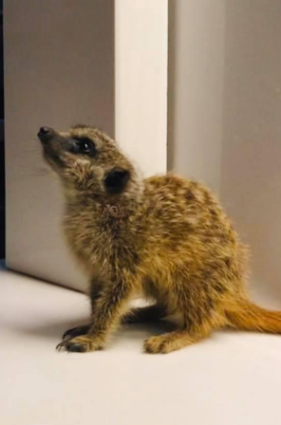
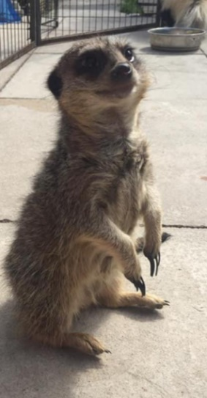
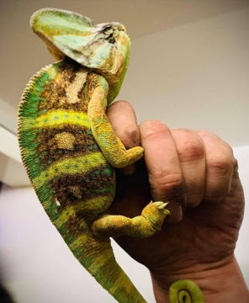
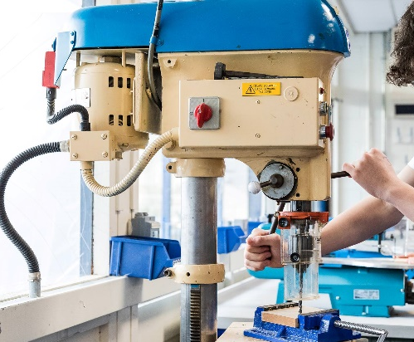

Slide 15
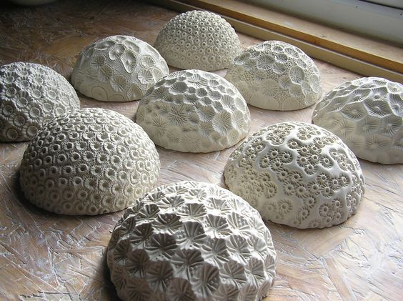
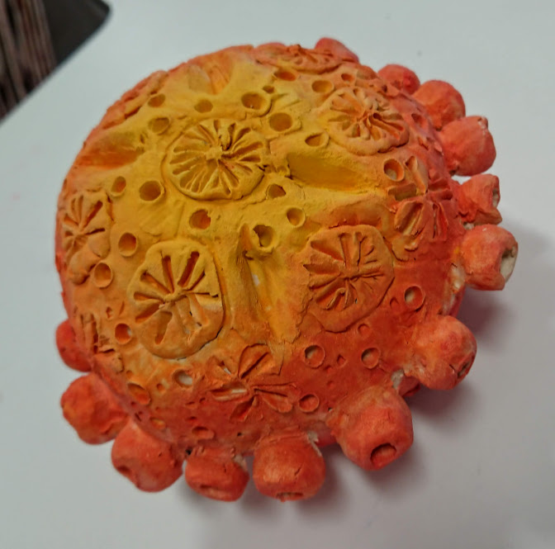
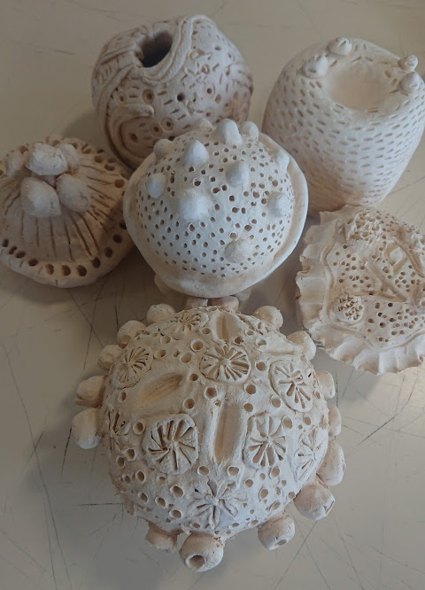
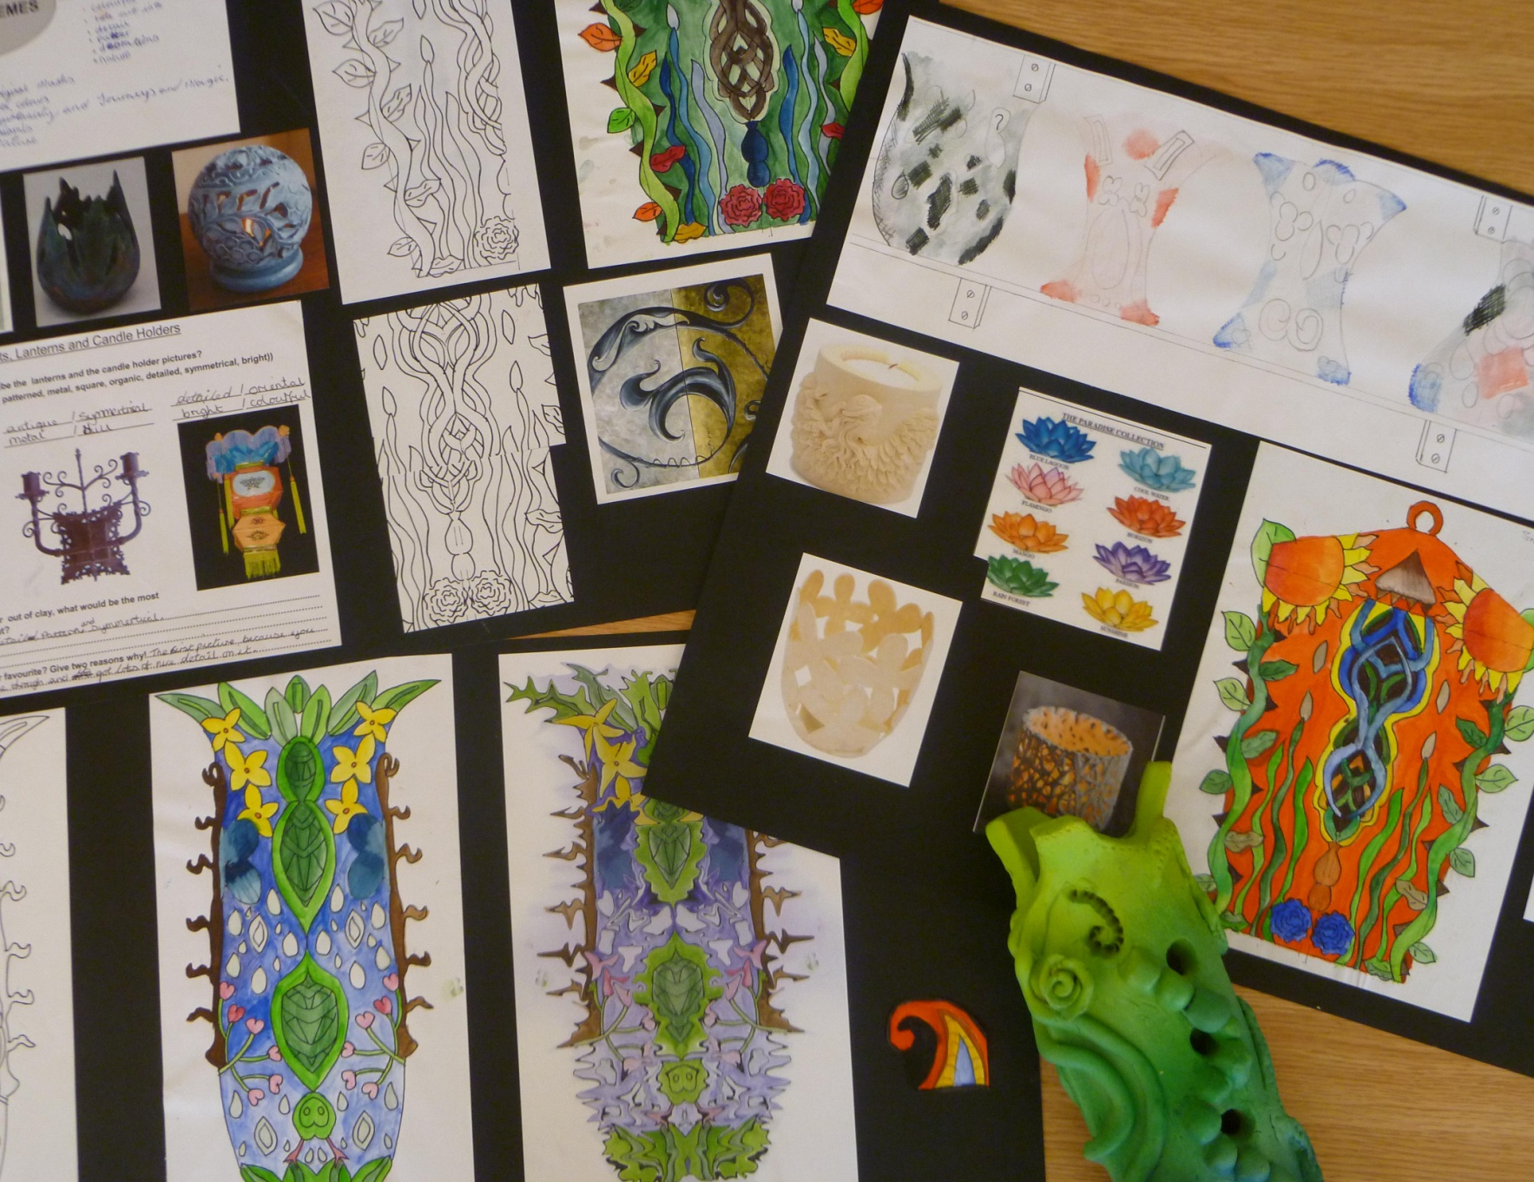

Slide 16
HOME COOKING SKILLS
Exam Board | Edexcel
Introduction | The aim of the qualification is to give every young person the basic skills and knowledge to be able to cook for themselves in a healthy and cost-effective way for the rest of their lives and the confidence to share these skills with family and friends.
Summary of the topics you will cover | Pupils will learn: Hygiene and safety for cooking Cooking skills How to choose fresh ingredients How home cooking is value for money How to read food labels Nutritional value of foods How to present food attractively
Assessment | BTEC Home Cooking Skills is internally assessed. To achieve a ‘pass’ pupils must have successfully achieved all the assess- ment criteria. Pupils will be required to keep a cooking skills record. Pupis must demonstrate that they can prepare and cook food safely and hygienically.
Further information | Pupils can progress onto employment or food related voca- tional qualifications. If you have any queries concerning this option or the qualifica- tions please contact Mr Gordon Gorst.
Useful websites | www.edexcel.com/homecookingskills

Slide 17
CREATIVE MEDIA
Exam Board | WJEC Entry Level Pathways
Introduction | The WJEC Pathways Creative Media offers units that allow pupils to explore the world of creative media through a hands-on approach.
Summary of the topics you will cover | Pupils choosing this option will undertake two units of study: a Ceramics unit, where they will explore the exciting possibilities of working with clay, and a Film Genre unit, where they will delve into the conventions and characteristics of different types of films. The Ceramics unit within WJEC Pathways Creative Media (under the umbrella of Art and Design) is designed to enable pupils to acquire practical skills and knowledge in this three-dimensional art form. This unit encourages exploration of materials, techniques, and processes specific to working with clay. Pupils will typically: Develop practical skills: Engaging with various ceramic techniques such as hand-building (pinching, coiling, slab building). Explore materials and tools: Understanding the properties of different clays, glazes, and the safe use of relevant tools and equipment. Develop ideas and designs: Learning to research, plan, and create their own ceramic outcomes, often drawing inspiration from different sources and artists. Experiment with form, texture, and surface decoration: Exploring a range of ways to shape, add texture to, and decorate ceramic pieces. Understand the work of ceramic artists and designers: Gaining awareness of historical and contemporary ceramic practices and their influences. The Film Genre unit, part of the WJEC Pathways Creative Media qualification, aims to give pupils an understanding of how films are categorised into genres and the key features that define them.
Assessment | Pupils will be required to complete a portfolio of evidence internally assessed and externally moderated by WJEC. This qualification is available at Entry 1, 2 or Entry 3, pupils will need to achieve 8-12 credits for an Award.
Further information | If you have any queries concerning this subject or the qualification, please contact Mrs. Sarah Crank
Useful websites | https://www.wjec.co.uk/qualifications/creative-media-and-performance-arts-entry-pathways/#tab_keydocuments

Slide 18
PREPARING FOR WORK
Exam Board | WJEC Entry Level Pathways
Introduction | The WJEC Pathways Preparing for Work offers a range of Design and Technology units within its flexible framework. These units are designed to help pupils develop practical skills, knowledge, and understanding relevant to the world of work in design and technology-related fields.
Summary of the topics you will cover | The specific units available can vary, pupils will study a range of units that could include: Design & Technology Making a Product Designing and modelling Health & Safety
Assessment | Pupils build a portfolio of evidence through practical tasks, projects, and potentially work-related experiences. Assessment is internal, with pupils demonstrating their competence against specific criteria. Successful completion of these units can contribute to a Preparing for Work Award. This qualification is available at Entry Level 2 or Entry Level 3, pupils will need to achieve 8-12 credits for an Award.
Further information | If you require any further information concerning this subject or the qualification, please contact Mr. Rob Stringfellow
Useful websites | http://www.wjec.co.uk/qualifications/preparing-for-work/

Slide 19
ANIMAL CARE
Exam Board | ASDAN Short Course
Introduction | This Short Course accredits up to 60 hours of Animal Care activities. It provides opportunities for pupils to develop Animal Care knowledge and skills, and how to use them effectively.
Summary of the topics you will cover | The specific units available can vary, pupils will study a range of units that could include: Animal Investigation Safety Around Animals Looking After Animals Animals in Trouble Animals In the Media Animals and the Law Careers in Working with Animals
Assessment | Pupils build a portfolio by engaging in practical tasks, investigations, and recording their progress within these modules. The course is internally assessed, leading to an ASDAN certificate upon successful completion.
Further information | If you have any queries concerning this subject or the quali- fications, please contact Mr. Ryan Hanlon
Useful websites | https://www.asdan.org.uk/courses/programmes/animal- care-short-course

Slide 20
HOSPITALITY
Exam Board | ASDAN Hospitality Vocational Taster
Introduction | The ASDAN Hospitality Vocational Taster offers pupils a concrete introduction to a career in the Hospitality Industry. The course aims to equip pupils with the practical skills and knowledge to work in Hospitality.
Summary of the topics you will cover | This vocational option contains six modules linked to six different areas of hospitality. Pupils will study a range of units that could include Hospitality services Food and beverage service Housekeeping and front office services Events Food safety and health and safety in hospitality Careers in hospitality
Assessment | Pupils must present evidence of their activities in an organised portfolio or e-portfolio. This will contain: a record of challenges completed, with supporting evidence for each challenge recording documents, showing how pupils have planned and reviewed their activities summary of achievement, highlighting skills development personal statement
Further information | If you have any queries concerning this subject, please contact Nicola Lightfoot
Useful websites | https://www.asdan.org.uk/courses/hospitality-vocational-taster/

Slide 21
Uniformed Services
Exam Board | ASDAN Uniformed Services Vocational Taster
Introduction | The Uniformed Services option contains modules in: military – army, navy, air force; policing and public order; fire and rescue service; prison service and security work; health and safety in uniformed service; careers in uniformed services.
Summary of the topics you will cover | Course Content This vocational taster contains six modules, corresponding to different aspects of uniformed services: Military – army, navy, air force Policing and public order Fire and rescue service Prison service and security work Health and safety in uniformed services Careers in uniformed services
Assessment | Requirements Pupils must present evidence of their activities in an organised portfolio. This will contain: A record of challenges completed, with supporting evidence for each challenge Recording documents, showing how pupils have planned and reviewed their activities Summary of achievement, highlighting skills development Personal statement
Further information | If you have any questions or would like to know a little about the course, please contact Mr Gorst
Useful websites | https://www.asdan.org.uk/courses/uniformed-services-vocational-taster

Slide 22
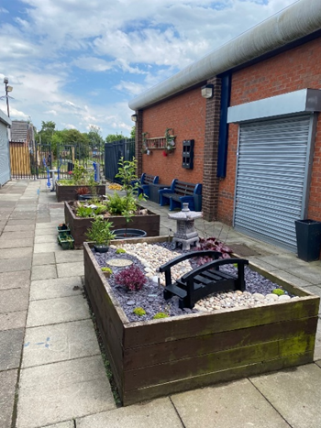
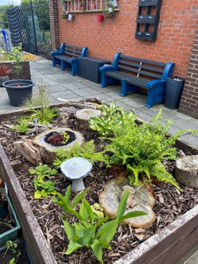
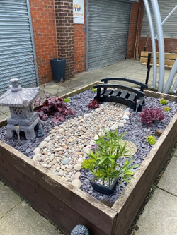
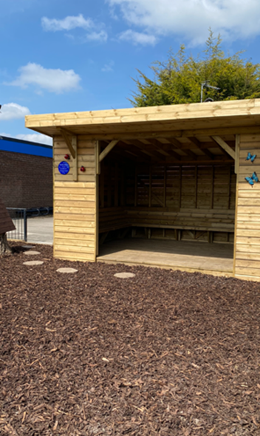
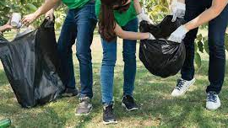
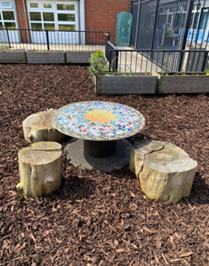

Slide 23
GARDENING
Exam Board | ASDAN Gardening Short Course
Introduction | This is a short course that gives pupils the opportunity to develop their gardening knowledge and skills and use them effectively, it combines practical learning with personal development.
Summary of the topics you will cover | The ASDAN Gardening Short Course provides a fantastic opportunity to develop practical gardening skills alongside personal, social, and work-related abilities. Gardening activities promote a healthy lifestyle and can have a positive impact on mental health and well being. Gardening is a fantastic way to relax, de-stress, and appreciate the outdoors. The ASDAN Gardening Short Course is divided into eight modules, covering a wide range of topics. Some of the areas that may be covered are: Planting in the garden Growing food on the allotment Construction in the garden Art in the garden Wildlife in the garden Careers in gardening This course isn't just about growing flowers or vegetables. Pupils will gain valuable life skills like: Planning and organisation Responsibility and perseverance Appreciation for the environment
Assessment | Pupils build a portfolio by engaging in practical tasks, investigations, and recording their progress within these modules. The course is internally assessed, leading to an ASDAN certificate upon successful completion. This short course is an engaging way to cultivate a love for gardening, acquire valuable life skills, and understand the benefits of connecting with nature
Further information | If you have any queries concerning this subject or the qualifi- cations, please contact Mrs Sarah Crank
Useful websites | www.asdan.org.uk/courses/programmes/gardening-short- course

Slide 24
CONSTRUCTION
Exam Board | ASDAN Construction Vocational Taster
Introduction | This is a short course that gives pupils the opportunity to develop valuable practical skills and develop their knowledge of the construction employment sec tor and will hopefully help them to make informed and long lasting decisions about their post-16 destinations and develop valuable practical skills
Summary of the topics you will cover | The ASDAN Short Course Construction covers a range of essential topics through engaging modules, potentially including: General construction operations Bricklaying Carpentry Painting and decorative finishing Health and safety in the construction sector Careers in the construction sector Pupils will also develop valuable transferable skills like: Problem-solving Teamwork Time management
Assessment | Pupils will be expected to produce a portfolio of evidence to demonstrate their achievements and to gain credits. Each section should take 10 hours to complete. One section is worth one credit
Further information | If you have any queries concerning this subject or the qualifications, please contact Mr Rob Stringfellow
Useful websites | https://www.asdan.org.uk/courses/programmes/construction -vocational-taster

Slide 25
ENVIRIONMENTAL
Exam Board | ASDAN Environmental Short Course
Introduction | The ASDAN Environmental Short Course is a flexible program designed to accredit up to 60 hours of environmental activities and projects. Developed in partnership with The Wildlife Trusts, it aims to foster a knowledge and love of the natural world in pupils.
Summary of the topics you will cover | Course Content The Short Course is split into six modules: My environment – review and awareness raising The atmospheric environment The built environment The natural environment The wider environment My environment – managing and monitoring
Assessment | Pupils build a portfolio of evidence by completing challenges within these modules, which can include practical activities, investigations, and recording their progress. The course is internally moderated, and upon successful completion, pupils receive an ASDAN certificate. This short course is a great way to develop environmental awareness, practical skills, and a sense of responsibility towards the planet.
Further information | If you have any queries concerning this subject or the qualifications, please contact Nicola Lightfoot
Useful websites

Slide 26
A Parent’s Guide to Access Arrangements
As a new school year begins, year-10 pupils commence their GCSE, or equivalent courses. This means a whole new set of challenges ahead for pupils, and their parents. For our pupils there is the added stress of facing that part of education many dread; formal exams, extended writing tasks and copious amounts of unfamiliar text. As parents we know that some children can get ‘help’ (formally known as Access Arrangements) in exams, but what does this
mean and who receives this?
Every year the Joint Council for Qualifications (JCQ) produce the following document:
Adjustments for Candidates with Disabilities and Learning Difficulties, Access Arrangements and Reasonable Ad- justments, General and Vocational Qualifications.
The rationale behind Access Arrangements is to allow pupils with special educational needs, disabilities or tempo- rary injuries to:
Access the assessment/exam
Show what they know and can do without changing the demands of the assessment/exam
These are part of the ‘Reasonable Adjustments’ of the Equality Act 2010 which requires an awarding body (any or-
ganisation that produces formal examinations) to make reasonable adjustments where a student who is disabled
What Access Arrangements may be available?
The following list is by no means exhaustive. They are in general the most used arrangements for Ashley pupils.
Access Arrangements that require pupils to be formally assessed by a ‘specialist assessor’ before a school can ap- ply for them:
Extra Time (this is generally up to 25% extra time for each paper and course work or controlled assessments)
A reader
Use of a word processor
A Scribe
Access Arrangements that can be given by a school or college without formal assessments and do not need to be applied for:
A prompter
Supervised rest breaks
Coloured overlays
Coloured/enlarged papers
Read Aloud (some pupils find that reading aloud helps them understand what they have read. Obviously, this would be a distraction for others so they can sit their exams in a separate room with an invigilator pre- sent)
How is a student identified as needing Access Arrangements?
Pupils are generally identified by teachers, parents or student concerns on potential difficulties in exams. Then it is determined what would be the most appropriate arrangement. As already shown, some of these arrangements
require a specialist formal assessment before they can be granted. A specialist assessor is: A specialist Teacher that holds a level 7 qualification or a recognised qualification in assessing pupils for Access Arrangements. JCQ recommend this as best practice for all schools and colleges.
At Ashley High School the assessments used measure the following:
Word recognition
Reading comprehension
Spelling accuracy
www.jcq.org.uk/exams-office/access-arrangements-and-special-consideration

Slide 27
Access Arrangements Assessments
The assessment must be carried out no earlier than the beginning of year 9 for Access Arrangements in years 10 and 11. It is advisable that these assessments are done at the end of year 9 as they are valid for two years and will
therefore, cover a student until the end of year 11. For pupils in 6th Form the assessments are carried out in year
11. To qualify for any Access Arrangement that requires formal assessment, a student’s scores must fall well below the average expected for a student of the same chronological age.
Additional evidence required
For all Access Arrangements the Examinations Officer must also produce a document that, according to JCQ, ‘paints a holistic picture of need’. This confirms a student’s normal way of working in school and could contain the follow-
ing:
Arrangements used in practice papers and mock exams
Comments and observations of teaching staff
Interventions used during years 7,8 and 9 (individual learning plans, support given, small group work)
Screening test results
Reasonable Adjustments used when working in the classroom, mock exams or internal school tests.
This emphasises how important it is that schools ensure Reasonable Adjustments are in place as soon as possible for children with identified learning difficulties.
Will my child lose marks if they have an Access Arrangement? Scribe
In subjects where separate marks for spelling, punctuation and grammar (SPaG) are being awarded the student will not be credited the marks for spelling and punctuation. They will be awarded marks for grammar. These are general- ly 3% of the total marks. Subjects that award separate marks for SPaG are:
GCSE English/English Language
GCSE English Literature
GCSE History
It should be noted that in the new GCSE English Language a student using a scribe may lose 20% of the total marks. A scribe cannot be used for Functional skills English Writing
Reader
Pupils do not lose any marks for having a reader
What can I do as a parent?
Talk to your child, ask them what they feel would be the best form of support for Access Arrangements. They are the
ones that have to sit the exams. Consider the implications of Access Arrangements and the long-term aim of pro- moting independence. Using a reader and a scribe is not a viable long-term prospect for a young adult although it can prepare them for using computer readers and voice activated software. You can arrange a meeting with the Examinations Officer to discuss the options.
Conclusion
Access Arrangements are reasonable adjustments that should level the playing field. They are not in
place to create an unfair advantage, nor should they disadvantage a young person. As such Reasonable Adjustments should be put in place as soon as possible. This enables the student to develop their exam techniques over time so an Access Arrangement is their normal way of working. It is not an arrange- ment suddenly presented to them just before sitting their first examination. There are implications for schools in terms of the costs of formally assessing pupils and facilitating Access Arrangements that
require extra rooms, staff and computers during the exams. However, these are not insurmountable especially given the potential of enabling a young person to experience the exam success they are ca- pable of.

