Slide 1
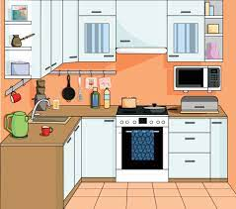
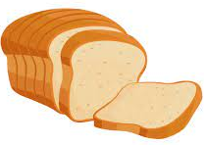
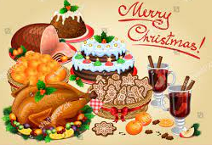
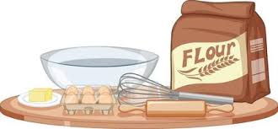
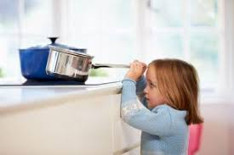
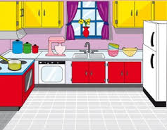
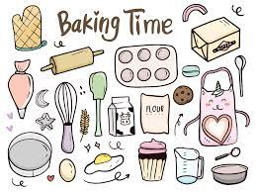
Introduction to the kitchen
&
Baking
Food nutrition
&
Independent cooking
Food nutrition
&
Independent cooking
Half Term 1 Half Term 2 Half Term 3 Half Term 4 Half Term 5 Half Term 6
Food Technology Year 7
Health
&
Safety
Religious Festivals
Introduction to the kitchen
&
Baking
Health
&
Safety
Religious Festivals

Slide 2
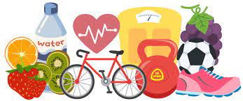
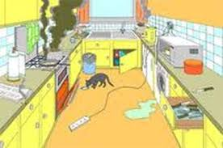
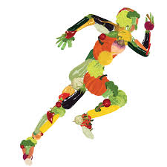
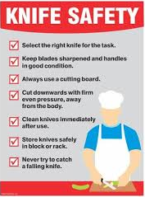
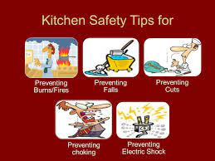
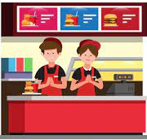
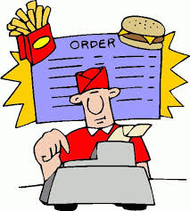
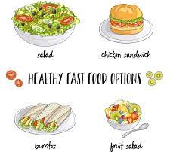
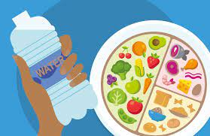
Designing a Food Outlet
&
Mini-Enterprise
Mini-Enterprise
&
Food Nutrition
Mini-Enterprise
&
Health and Safety
Half Term 1 Half Term 2 Half Term 3 Half Term 4 Half Term 5 Half Term 6
Food Technology Year 8
Mini-Enterprise
&
Healthy Living
Mini-Enterprise
&
Health and safety
Mini-Enterprise
&
Designing
a Food Outlet

Slide 3
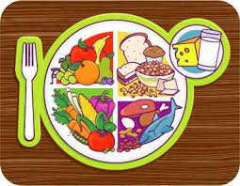
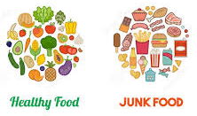
Individual Cooking Skills
Nutrition
&
Health
Home Cooking
Fast Food Project
Individual Cooking Skills
Nutrition
&
Health
Half Term 1 Half Term 2 Half Term 3 Half Term 4 Half Term 5 Half Term 6
Food Technology Year 9
Individual Cooking Skills
Nutrition
&
Health
Individual Cooking Skills
Nutrition
&
Health
Home Cooking
Fast Food Project

