Slide 1




Promoting
Core Skills across the Curriculum
Ashley High School
2018
Notes:
Diane to do seating plan to ensure all staff/subjects mixed up and support staff not with own teachers. This to ensure broad range of views across range of subjects.

Slide 2

In 2016, we worked with the British Council to pilot the introduction and embedding of the 6 CORE SKILLS across our Curriculum:
Collaboration & Communication
Critical Thinking & Problem Solving
Creativity & Imagination
Citizenship
Digital Literacy
Student Leadership & Personal Development

Slide 3
What are we doing at
Ashley High School
to promote the 6 Core Skills?

Slide 4
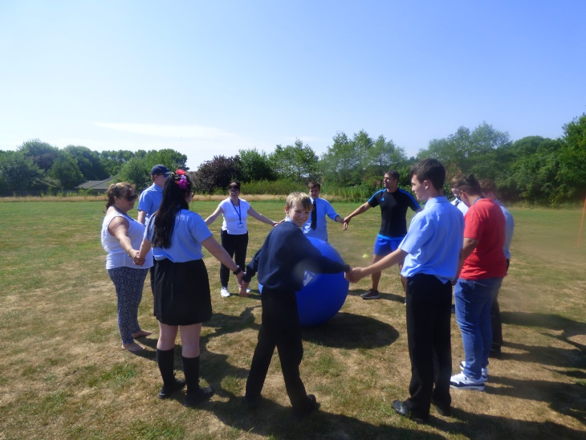
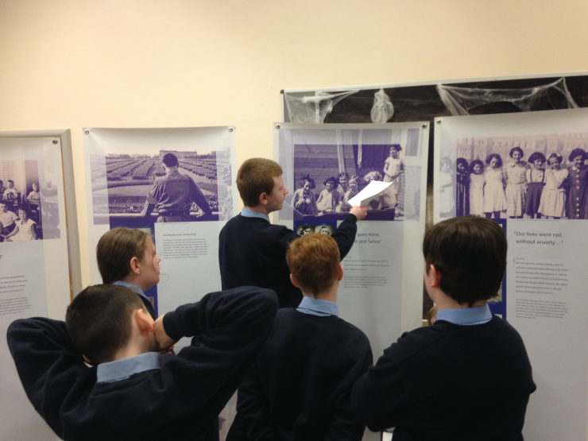
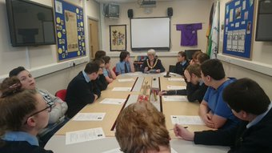
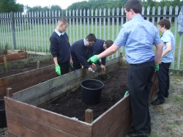
Collaboration & Communication

Slide 5

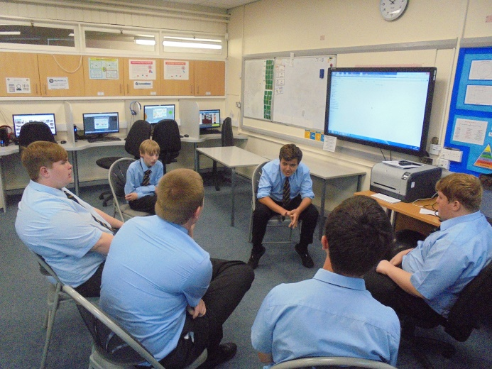
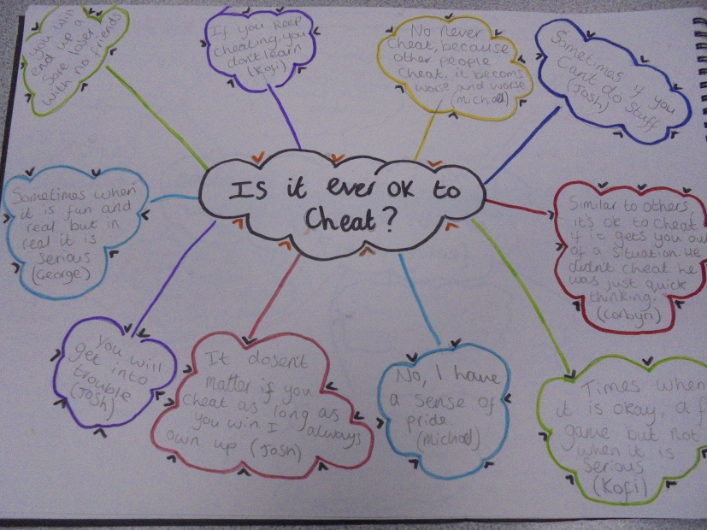
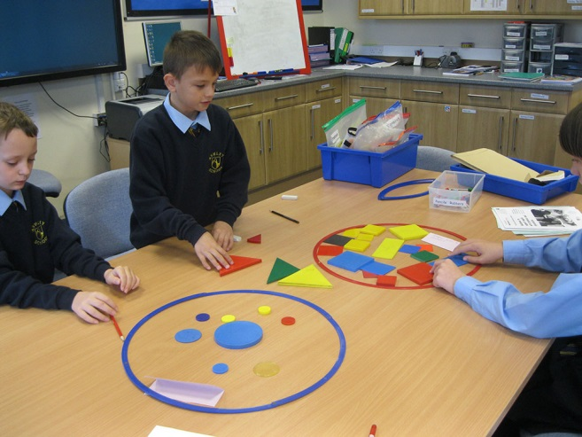
Critical Thinking & Problem Solving
Philosophy 4 Children (P4C) sessions

Slide 6
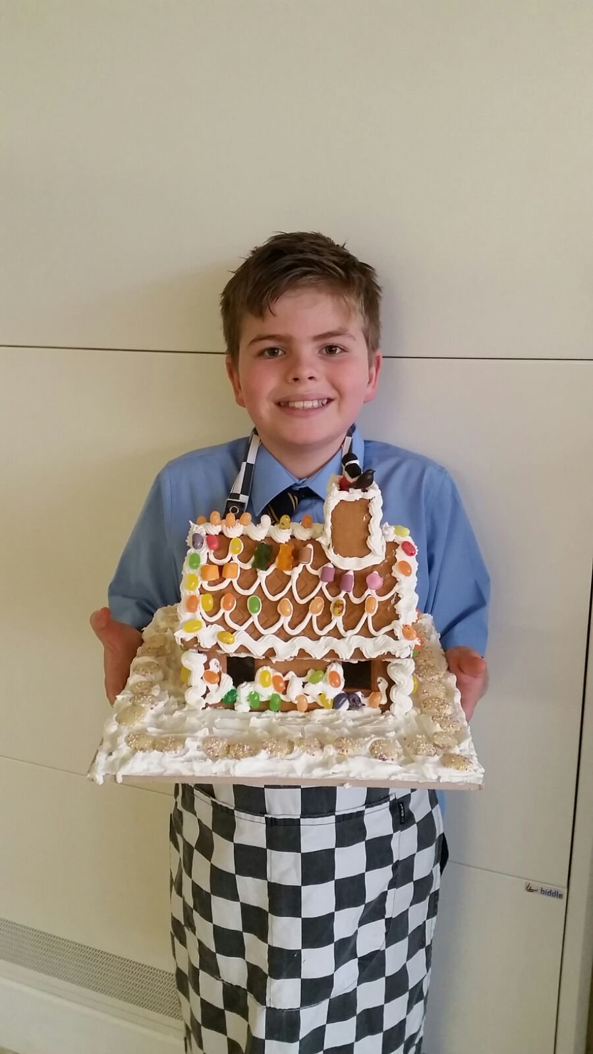
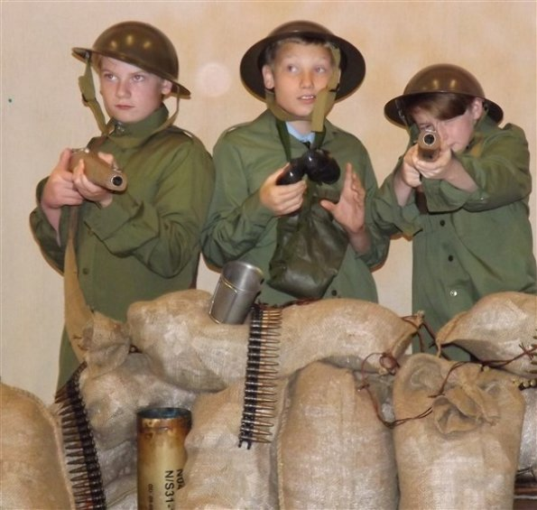
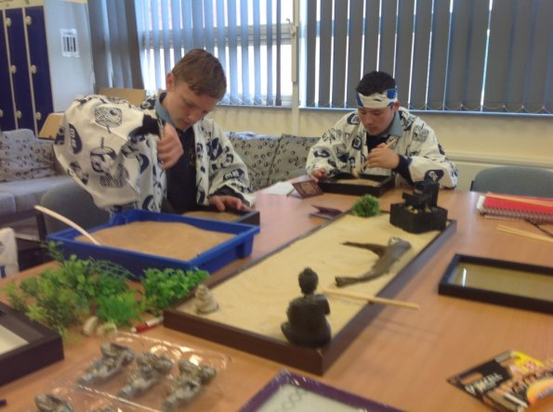
Creativity & Imagination

Slide 7
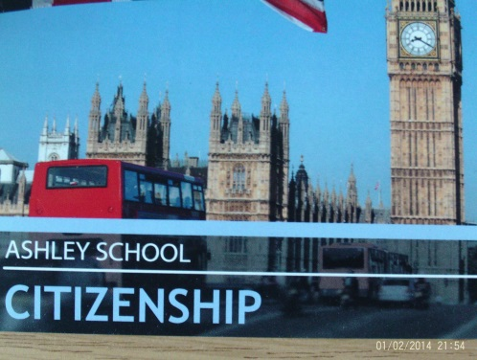
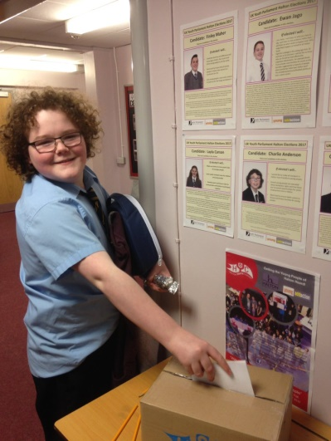
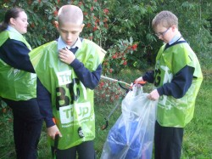
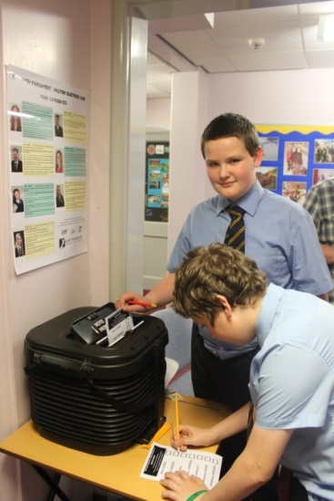
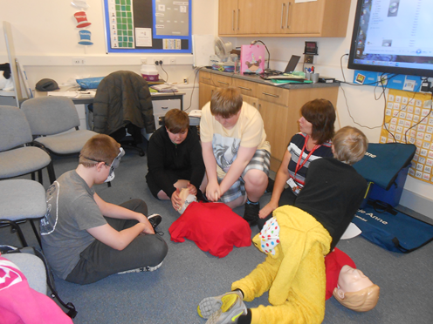
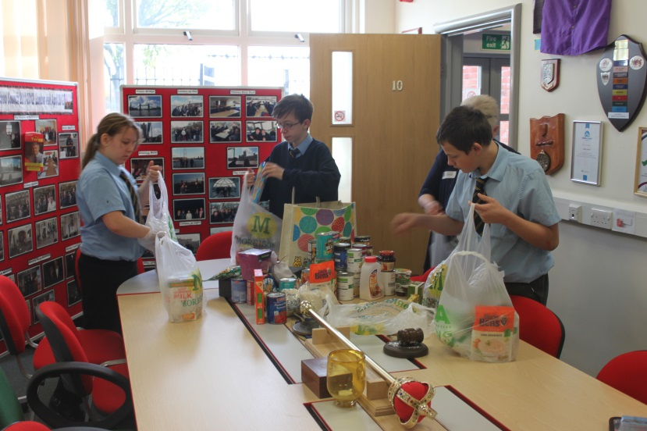
Citizenship

Slide 8
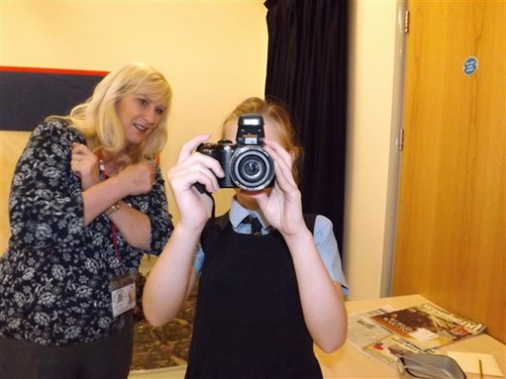

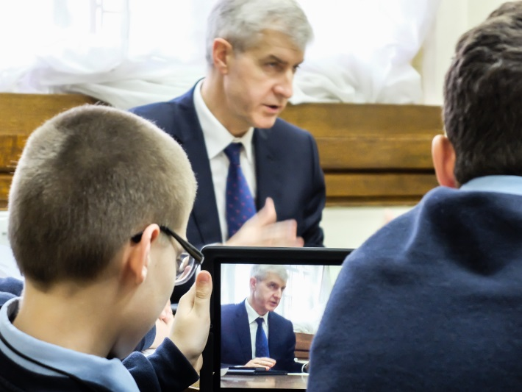
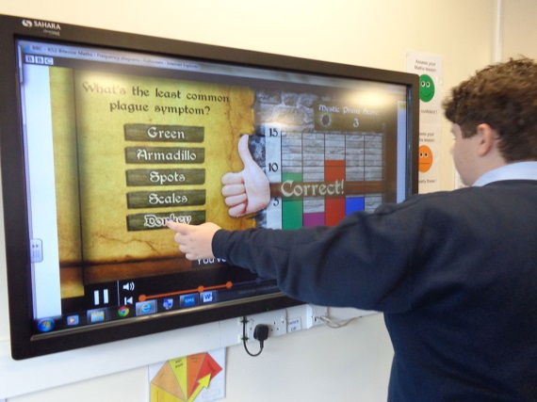
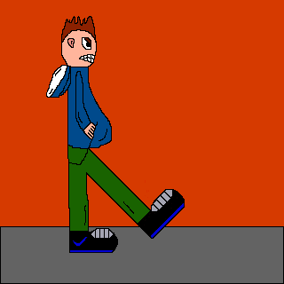
Digital Literacy
I-Media (creating moving animations)
Photography
Using Photoshop
Video recording
Interactive TV activities
Filming

Slide 9
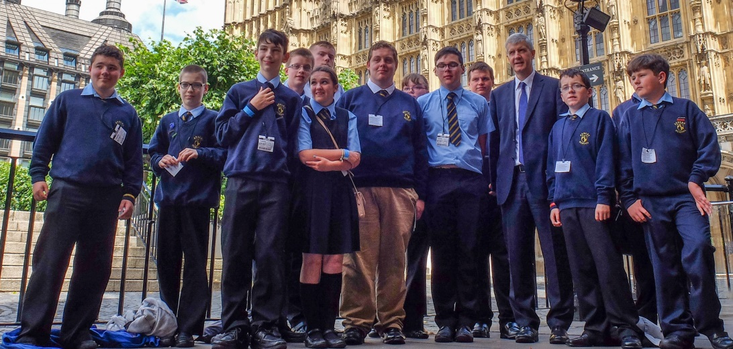
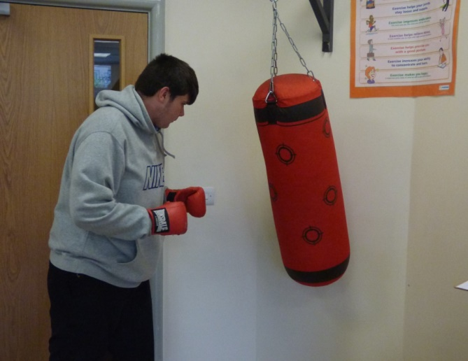
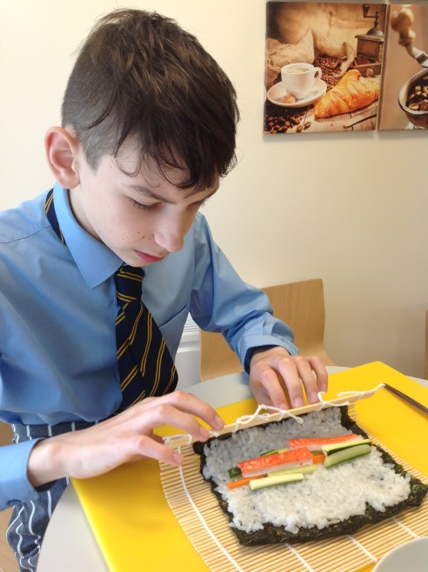
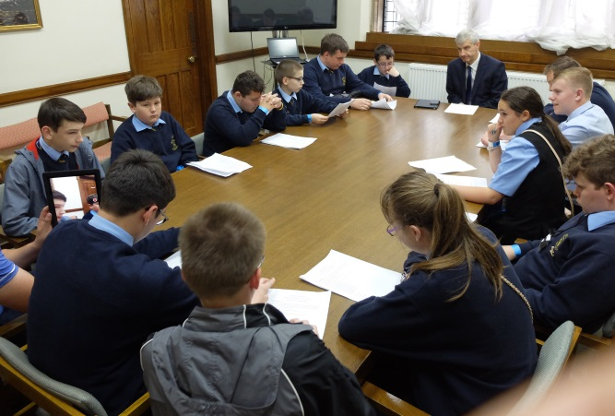
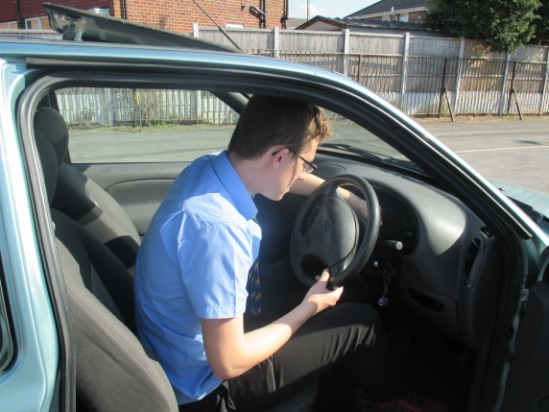
Student Leadership & Personal Development

Slide 10











School Awards

Slide 11
Self-evaluation 2017
The 6 Core Skills are now embedded across our curriculum and are included in all medium term plans
Many overlap with the requirements we have to meet from the National Autistic Society (eg. communication & collaboration).
The top ten non-negotiables within our Teaching and Learning policy include some of the 6 Core Skills (eg. planned opportunities for problem solving, ICT/Digital Literacy)
These 6 CORE SKILLS reinforce, further develop and enhance our curriculum to the benefit of all our students

Slide 12
Planning
Core Skills are now
fully embedded into all subject planning

Slide 13
Personal Development
Weekly Personal Development lessons at Key Stage 3 are now linked to each of the Core Skills

Slide 14
Personal Development Units
How are they organised?
Each class group at Key Stage 3 is timetabled for 1 lesson per week. Each unit runs for a half term (6 sessions). At the end of a half term, classes rotate.
Speech and Language games/activities e.g. using our social filter, how to maintain conversations (Communication & Collaboration)
Philosophy for Children- P4C (Critical Thinking)
Photography/Expressive Arts project (Creativity & Imagination)
First Aid, Recycling, Drug Awareness, Forest School, Coastal School (Citizenship)
I-media/Use of Photoshop software (Digital Literacy)
Duke of Edinburgh, Mayor’s Award (Student Leadership)

Slide 15
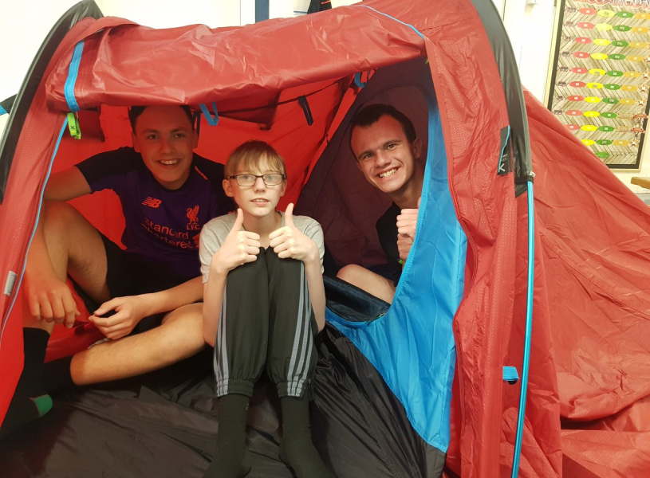
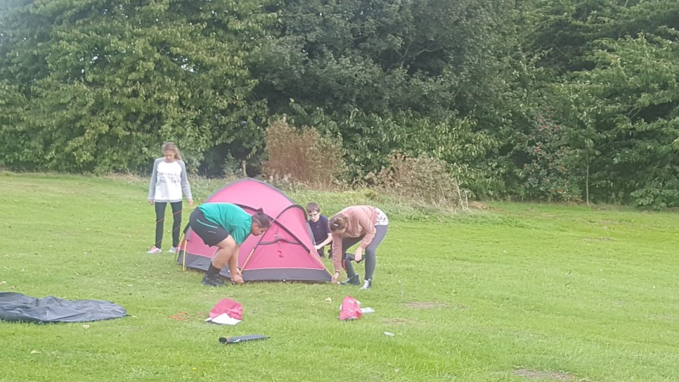

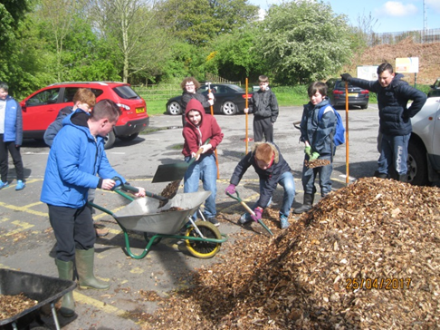

Slide 16
Digital Literacy
How has it been developed?
Digital Literacy has been expanded across the curriculum
New software (Photoshop) and hardware (Digital Bridge cameras) have been purchased to support expanded delivery
DL projects introduced from Y7- 6th form (eg. I-media animation with Year 7 group)
I-Media teacher given responsibility for DL across school

Slide 17
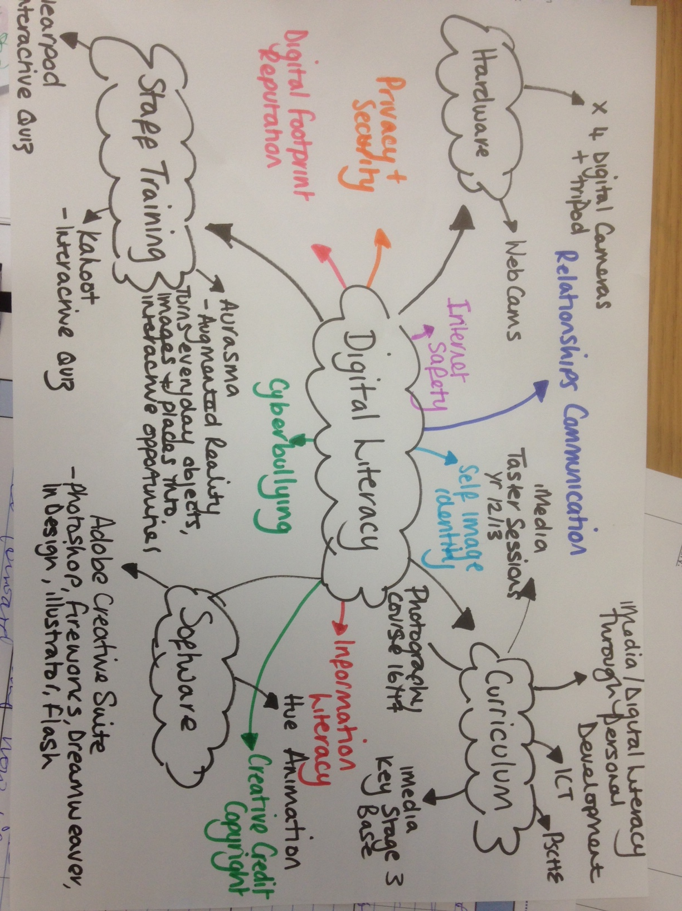

Slide 18
Core Skills
How are we further embedding these skills at Ashley High?
All Pupil Premium funded interventions are now linked to the Core Skills
Evidence of impact case studies identify links to Core Skills
Students becoming more aware of the skills they are developing as they take part in the wide range of curricular and extra curricular activities on offer

Slide 19
End

