Slide 1
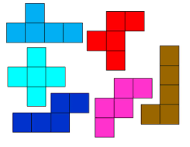
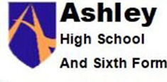
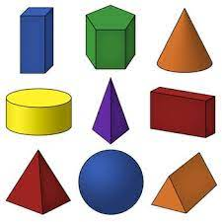
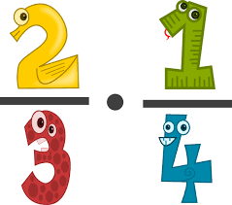
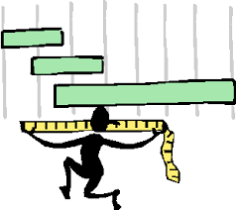
Place value
Addition & subtraction
Multiplication & division
Fractions
Money
Time
Shape
Statistics
Autumn Spring Summer
Students will also complete WJEC assessments – Number, Data, Shape, Measures, Fractions, Angles and Money
Maths Year 10
Multiplication & division
Length & perimeter
Fractions, decimals and percentages
Mass & capacity

Slide 2
Working with measures
Money
Coursework completion
Preparing for post 16 Maths
Autumn Spring Summer
Students will complete the WJEC Entry Pathways Maths qualification
Maths Year 11 WJEC Entry 2 / 3
Money (cont.)
Working with whole numbers

