Slide 1
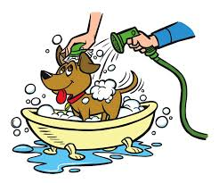
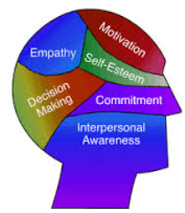
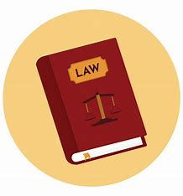
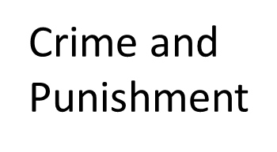
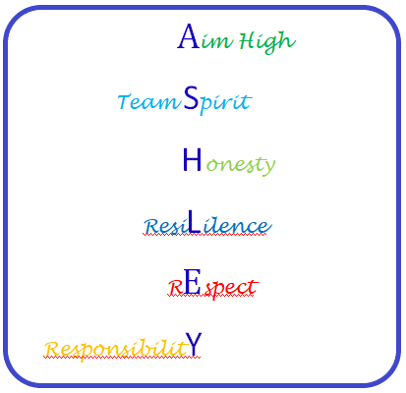
Values Beliefs and Decision Making
Crime and Punishment
Environment
Half Term 1 Half Term 2 Half Term 3 Half Term 4 Half Term 5 Half Term 6
Beliefs and Values Year 10
Values Beliefs and Decision Making

Slide 2
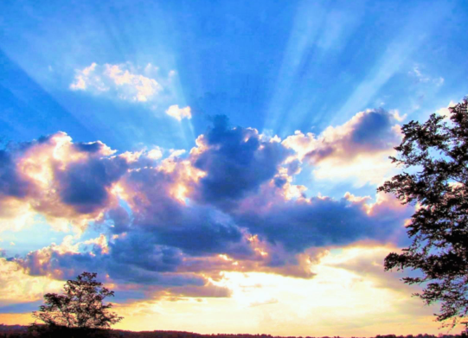
Beliefs and Practice
Peace and Conflict
Inspiration
Half Term 1 Half Term 2 Half Term 3 Half Term 4 Half Term 5 Half Term 6
Beliefs and Values Year 11
Peace and Conflict
Beliefs and Practice
Inspiration

