Slide 1
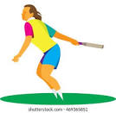
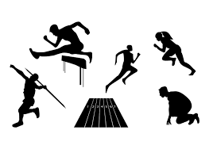
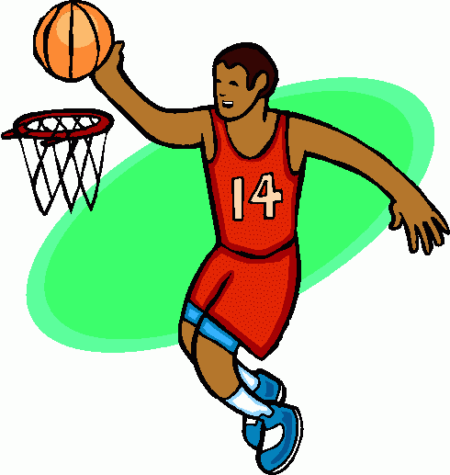
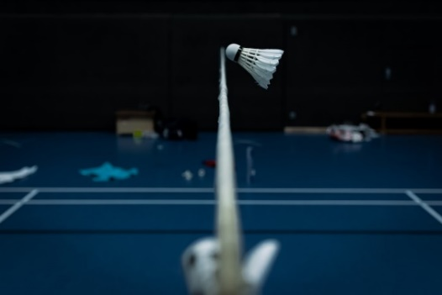
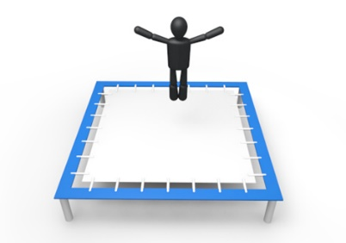
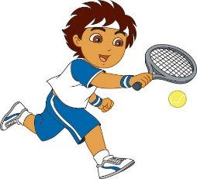
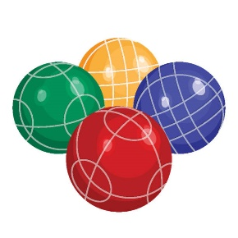
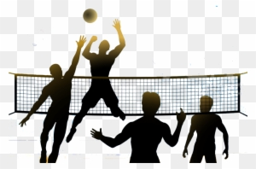
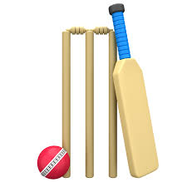
Basketball Gymnastics
Health Related Fitness
Hockey
Rounders
Athletics
Half Term 1 Half Term 2 Half Term 3 Half Term 4 Half Term 5 Half Term 6
P.E. Year 7
Badminton
Boccia
Trampolining
Volleyball
Tennis
Cricket

Slide 2
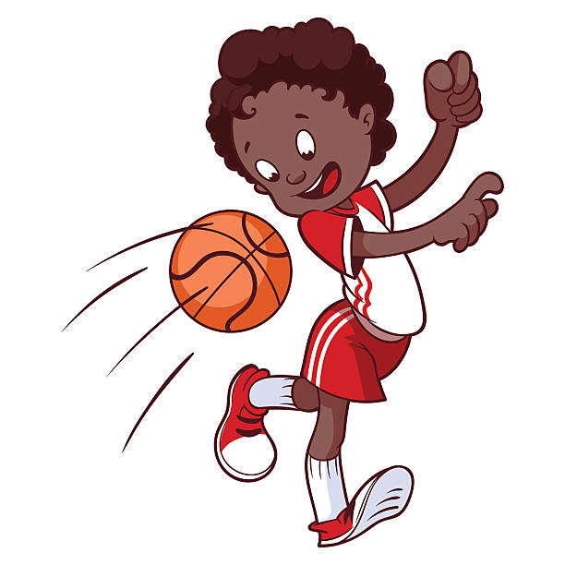
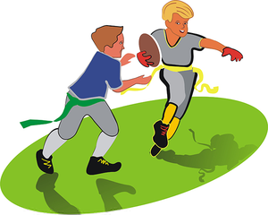
Basketball Orienteering
Health Related Fitness
Hockey
Rounders
Athletics
Half Term 1 Half Term 2 Half Term 3 Half Term 4 Half Term 5 Half Term 6
P.E. Year 8
Dodgeball Badminton
Trampolining
Tag Rugby
Tennis
Cricket

Slide 3
Half Term 1 Half Term 2 Half Term 3 Half Term 4 Half Term 5 Half Term 6
Basketball
Team building
Health Related Fitness
Hockey
Rounders
Athletics
P.E. Year 9
Dodgeball Badminton
Trampolining
Tag Rugby
Tennis
Cricket

