Slide 1
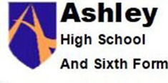
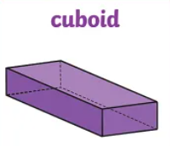
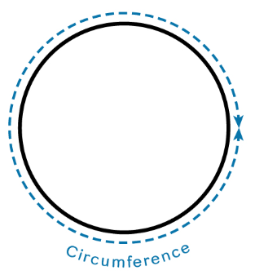
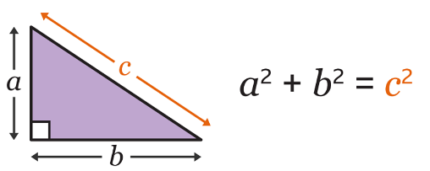
Angles
Scale diagrams and bearings
Basic number
Factors and multiples
Basic algebra
Basic fractions
Coordinates and linear graphs
Basic percentages
Perimeter and area
Circumference and area
Real life graphs
Basic probability
Transformations
Congruence and similarity
2D representations of 3D shapes
∏r² sounds like area to me…..
Half Term 1 Half Term 2 Half Term 3 Half Term 4 Half Term 5 Half Term 6
Maths Year 10 AQA GCSE (F yr1 of 2)
Basic decimals
Rounding
Collecting and representing data
Sequences
Ratio and proportions
Properties of polygons
Equations
Indices
Standard Form
Calculating with rectangles
Measures
Statistical measures
Constructions and loci

Slide 2
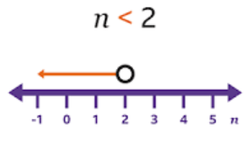
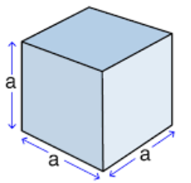
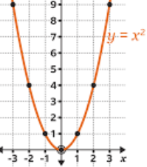
Properties of polygons
Real life graphs
Probability
Volume
Algebra and graphs
Sketching graphs
Mock examinations (2)
Direct and inverse proportion
Quadratic graphs
Growth and decay
Vectors
Half Term 1 Half Term 2 Half Term 3 Half Term 4 Half Term 5 Half Term 6
Maths Year 11 AQA GCSE(F yr 3 of 3)
Algebra quadratics
Mock examinations (1)
Inequalities
Recap of trigonometry
Solving quadratic equations
Revision
(x+1)(x-3) = 12

