Slide 1
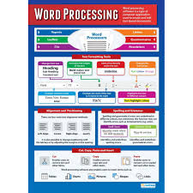
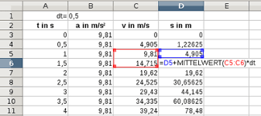
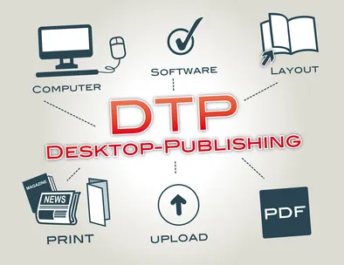
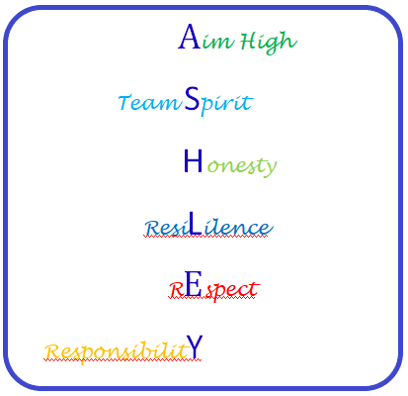
10RH/10RF – Digital Functional Skills @ E3 – Using devices and handling information / Creating and editing
10SC – Digital Functional Skills @ Level 1 – Using devices and handling information / Creating and editing
10RH/10RF – Digital Functional Skills @ E3 – Communicating
10SC – Digital Functional Skills @ Level 1 – Communicating
10RH/10RF – Digital Functional Skills @ E3 – Using devices and handling information / Creating and Editing
10SC – Digital Functional Skills @ Level 1 – Using devices and handling information / Creating and Editing
Half Term 1 Half Term 2 Half Term 3 Half Term 4 Half Term 5 Half Term 6
ICT Year 10
10RH/10RF – Digital Functional Skills @ E3 – Using devices and handling information / Creating and Editing
10SC – Digital Functional Skills @ Level 1 – Using devices and handling information / Creating and Editing
10RH/10RF – Digital Functional Skills @ E3 – Using devices and handling information / Creating and editing
10SC – Digital Functional Skills @ Level 1 – Using devices and handling information / Creating and editing
10RH/10RF – Digital Functional Skills @ E3 – Communicating
10SC Digital Functional Skills @ Level 1 – Communicating

Slide 2
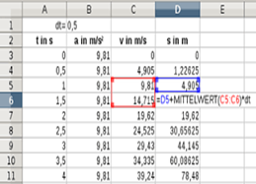
11GG – WJEC E3 Certificate – Word Processing Software / Presentation Software / Spreadsheet Software / Database Software / Internet Fundamentals
11RS – WJEC Level 1 Certificate – Database Software / Spreadsheet Software / Desktop Publishing Software
11GG – WJEC E3 Certificate – Spreadsheet Software / Database Software
11RS – WJEC Level 1 Certificate – Database Software
11GG – WJEC E3 Certificate – Using Email / Internet Fundamentals
11RS – WJEC Level 1 Certificate – Database Software / Desktop Publishing Software
Half Term 1 Half Term 2 Half Term 3 Half Term 4 Half Term 5 Half Term 6
ICT Year 11
11GG – WJEC E3 Certificate – Presentation Software / Spreadsheet Software
11RS – WJEC Level 1 Certificate – Spreadsheet Software / Database Software
11GG – WJEC E3 Certificate – Database Software / Desktop Publishing Software
11RS – WJEC Level 1 Certificate – Database Software / Desktop Publishing Software
11GG – WJEC E3 Certificate – Using Email / Internet Fundamentals
11RS – WJEC Level 1 Certificate – Desktop Publishing Software

