Slide 1
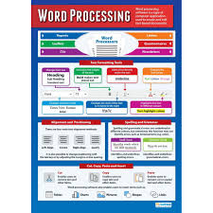
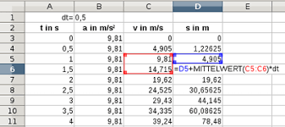
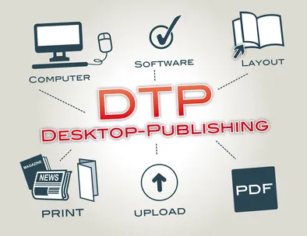
10AK – E3 Certificate – Spreadsheet Software
10GG – Presentation Software
10AK – E3 Certificate – Database Software
10GG – Level 1 Certificate – Spreadsheet Software
10AK – E3 Certificate – Word Processing Software
10GG – Level 1 Certificate – Word Processing Software
Half Term 1 Half Term 2 Half Term 3 Half Term 4 Half Term 5 Half Term 6
ICT Year 10
10AK – E3 Certificate – Presentation Software
10GG – Level 1 Certificate – Word Processing Software / Presentation Software
10AK – E3 Certificate – Spreadsheet Software / Database Software
10GG – Level 1 Certificate – Presentation Software / Spreadsheet Software
10AK – E3 Certificate – Desktop Publishing Software
10GG Level 1 Certificate – Spreadsheet Software

Slide 2
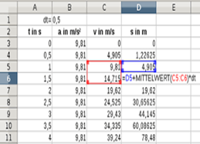
11L - E3 Certificate – Spreadsheet Software
11RS – Functional Skills L2 exam preparation
11L – E3 Certificate – Desktop Publishing Software
11RS – FS L2 exam preparation
11L – E3 Certificate – Using Email / Internet Fundamentals
11RS – FS L2 exam preparation
Half Term 1 Half Term 2 Half Term 3 Half Term 4 Half Term 5 Half Term 6
ICT Year 11
11L – E3 Certificate – Database Software
11RS – FS L2 exam preparation
11L – E3 Certificate – Using Email
11RS – FS L2 exam preparation
11L – E3 Certificate – Internet Fundamentals
11RS – FS L2 exam preparation

