Slide 1
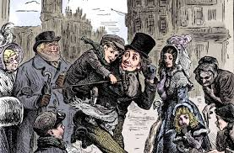
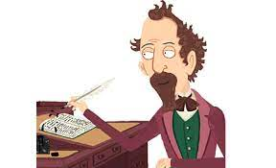
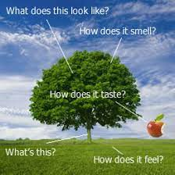
Classics – A Christmas Carol
Shakespeare –
Romeo and Juliet
Contemporary Fiction –
Refugee Boy/Terror Kid/Ghost boys etc.
Half Term 1 Half Term 2 Half Term 3 Half Term 4 Half Term 5 Half Term 6
English Year 9
Descriptive/
Narrative Writing
Speaking & Listening

