Slide 1
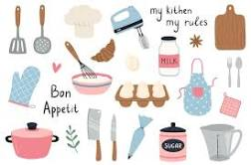
Looking After Yourself and Your Home / (Group 1)
Household Cleaning (Group 1)
Food and Drink Preparation (Group 1)
Half Term 1 Half Term 2 Half Term 3 Half Term 4 Half Term 5 Half Term 6
Independent Living Year 11
Household Cleaning (Group 2)
Looking After Yourself and Your Home / (Group 2)
Food and Drink Preparation (Group 2)

