Slide 1
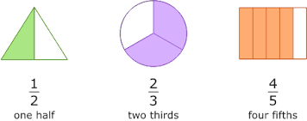
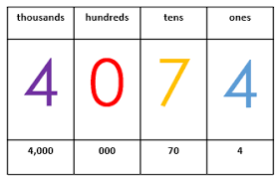
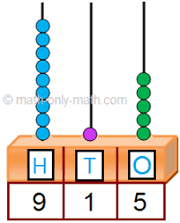
Place Value
Addition & subtraction
Geometry (shape)
Fractions
Geometry (position &direction)
Time
Statistics
Autumn Spring Summer
Maths Year 7 (CB) WRM 2
Length & height
Mass, capacity and temperature
Money
Multiplication & division

Slide 2
Place Value
Addition & subtraction
Multiplication & Division
Fractions
Money
Time
Shape
Statistics
Autumn Spring Summer
Maths Year 7 (SA) WRM 3
Multiplication & Division
Length & Perimeter
Fractions
Mass & capacity

Slide 3
Place Value
Addition & subtraction
Geometry (shape)
Multiplication & division
Fractions
Geometry (position &direction)
Place Value
Money
Time
Autumn Spring Summer
Maths Year 7 (LA) WRM 1
Place value
Addition & Subtraction
Length & height
Mass& volume

